Slide 1
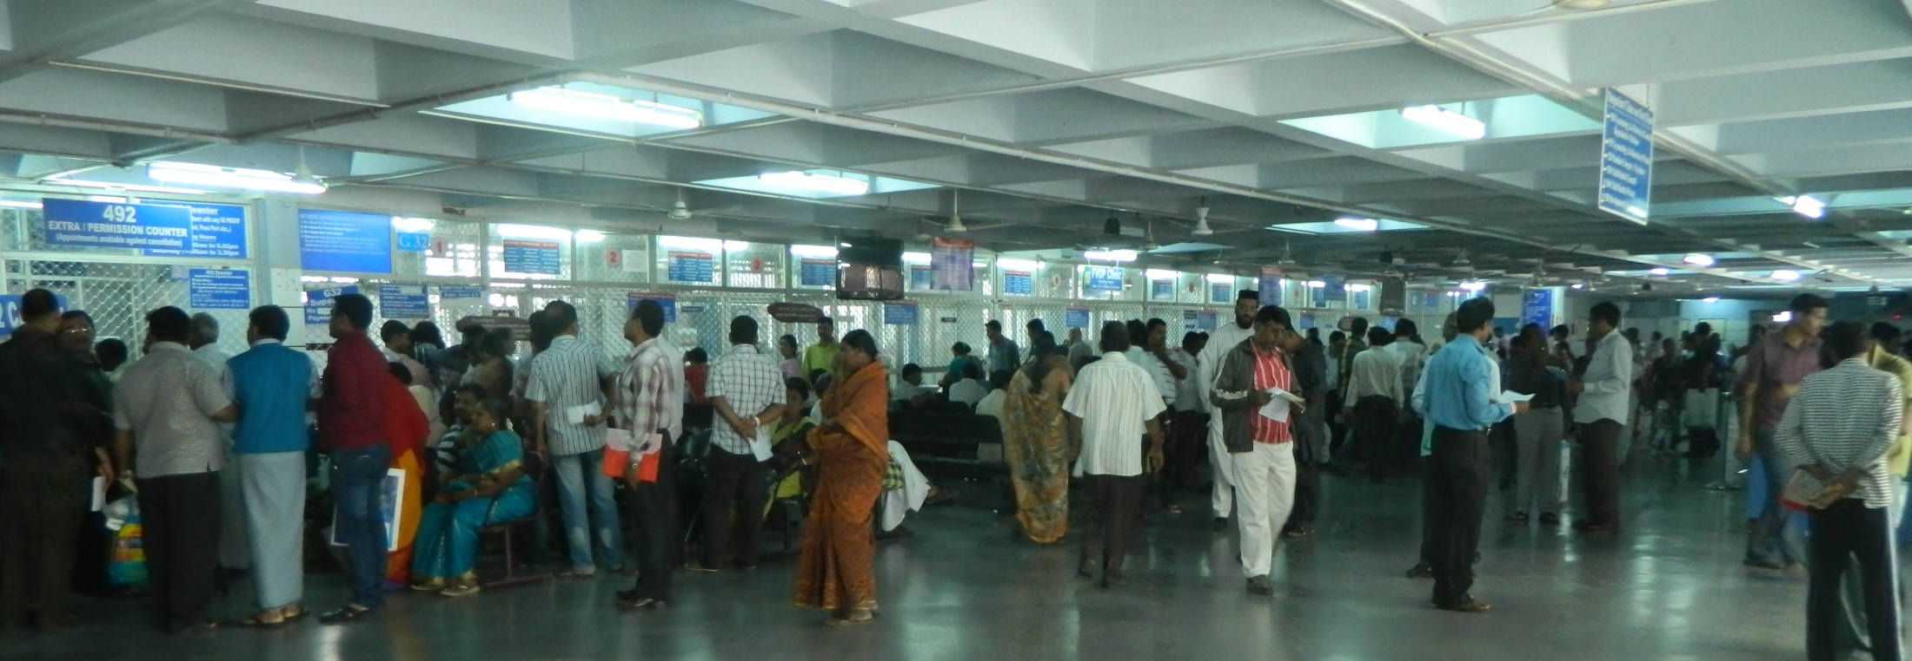
Quality Improvement Initiative:
Reducing patient waiting times in the Pharmacy
Christian Medical College, Vellore
Objectives
Reduce patient waiting time
Identify best methods to decrease waiting time without compromise on quality

Slide 2
Audit 2013
Remedial measures over 18 months
Re-audit

Slide 3
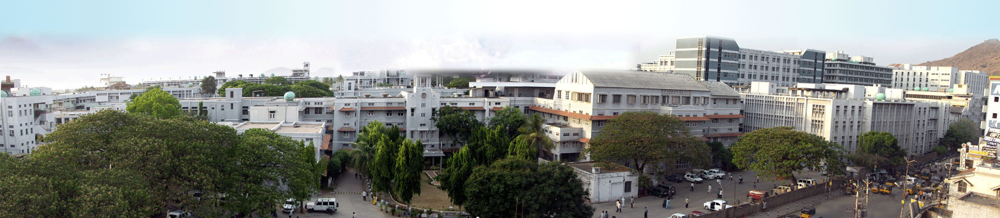
Daily at CMC, Vellore
7500 outpatients
2500 inpatients
230 pharmacists
9000 prescriptions
28000 individual drugs

Slide 4
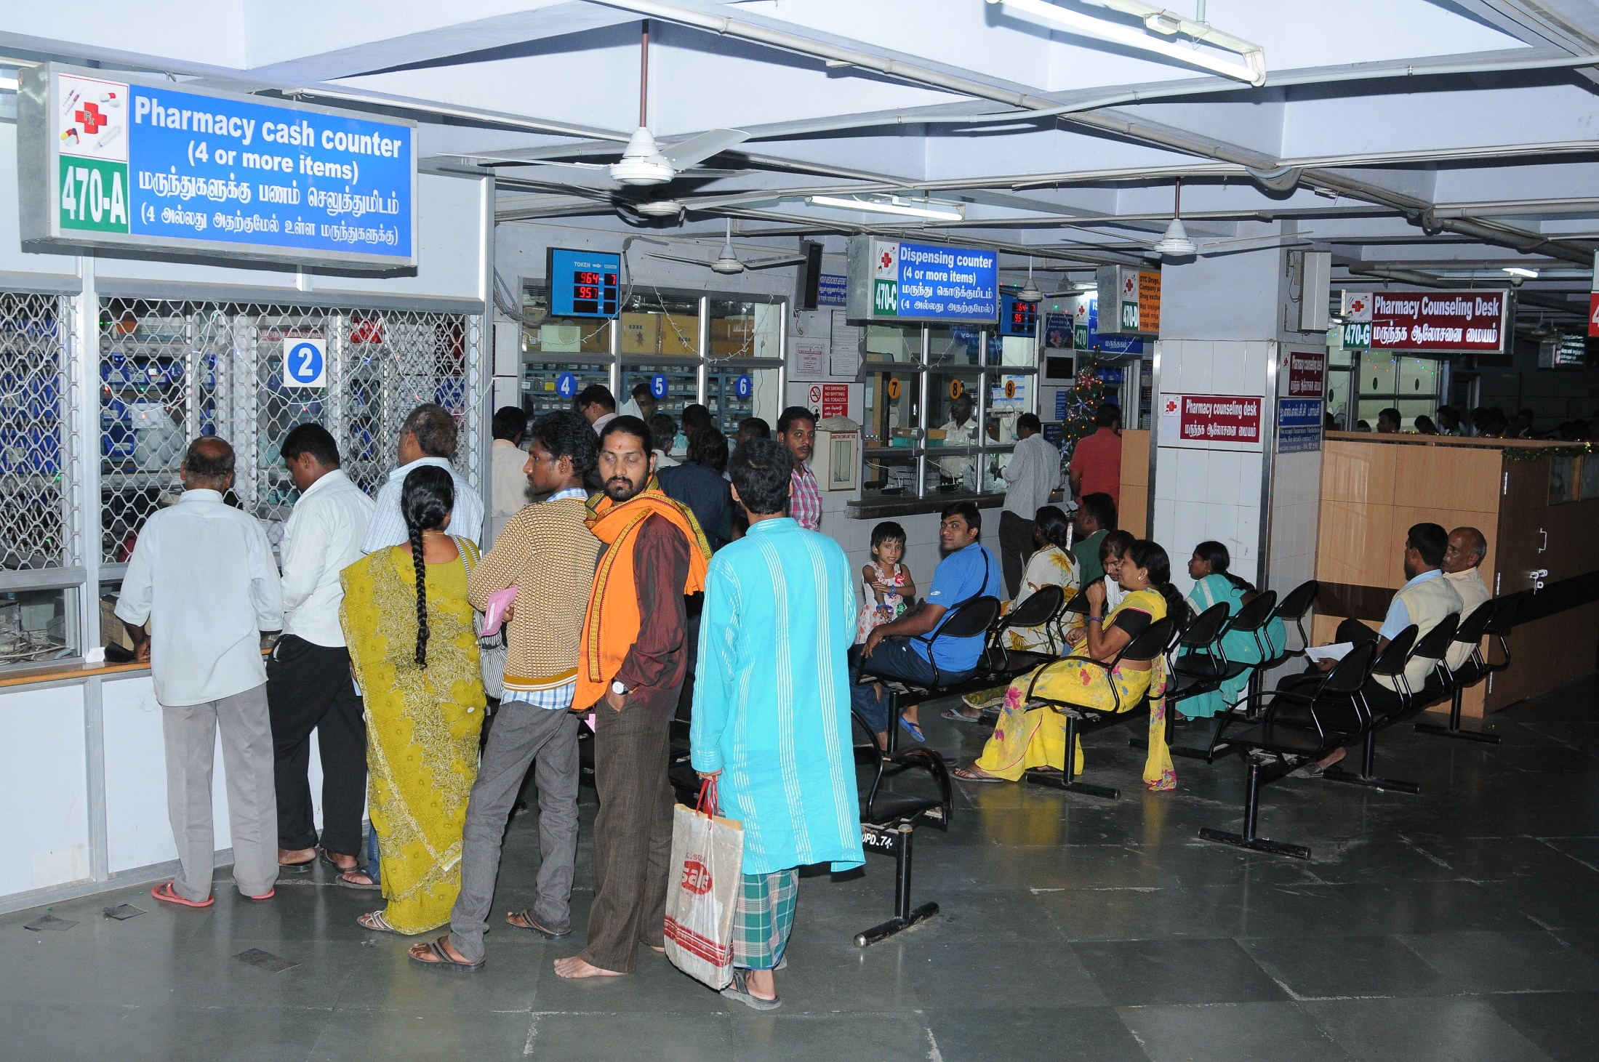
Audit 2013- Waiting times
ISSCC pharmacy -29 minutes

Slide 5
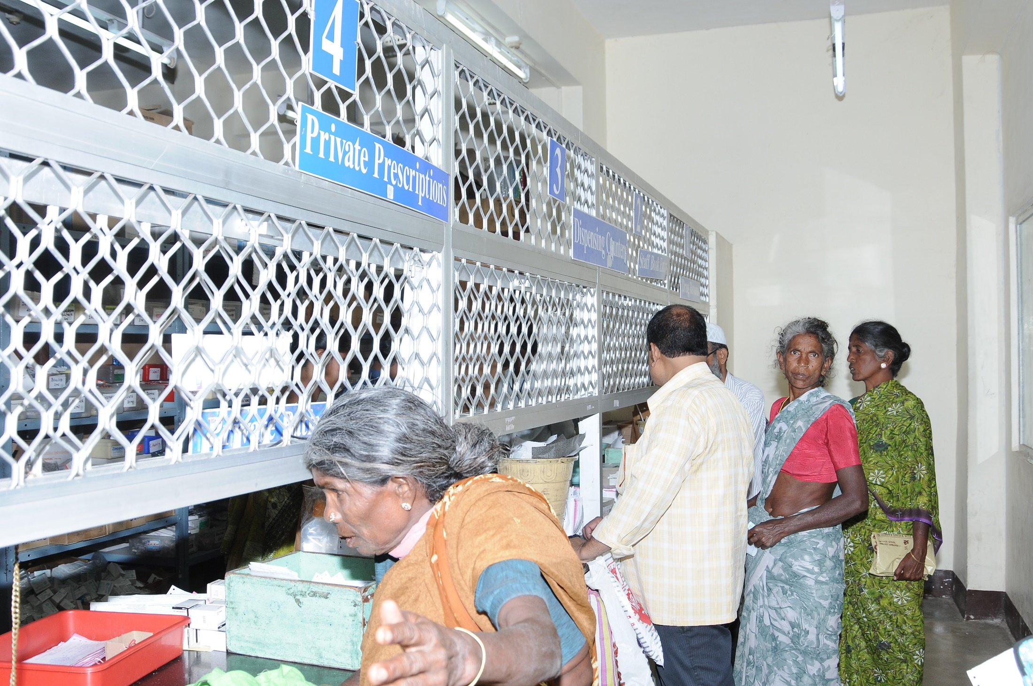
Audit 2013- Waiting times
Main pharmacy -44 minutes

Slide 6
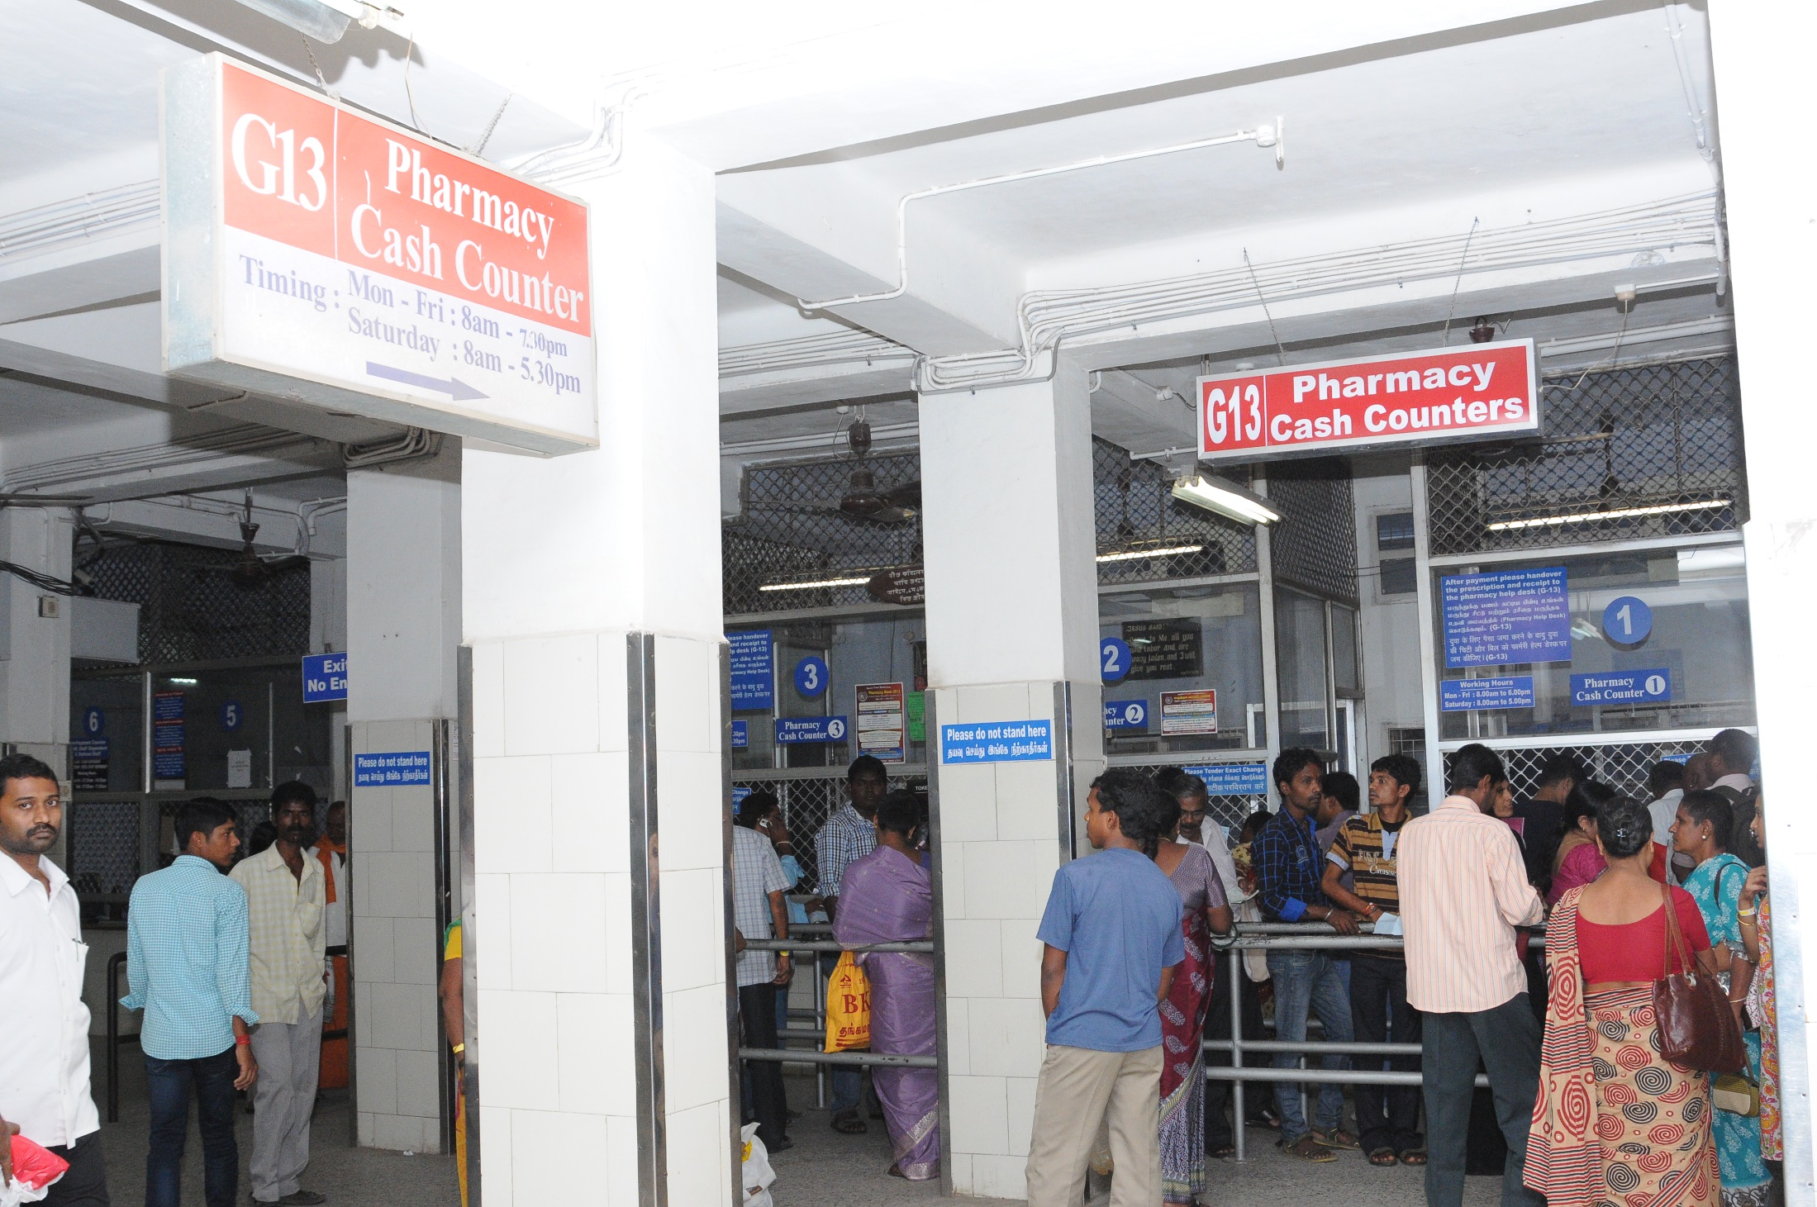
Audit 2013- Waiting times
OPD pharmacy -1 hour 19 minutes

Slide 7
Problems identified by the audit
Poor signs
Lack of segregation
Delays due to patient education

Slide 8
Remedial Measures
Big and bright signs
Creation of zones – 1-2 items; 3-4 items; 5 and more
Separate queues for each zone
Splitting of front end and back end pharmacists
Dual printing of bills and labels
Token display system
Counter communcation system
Separate counter for drug returns
Multiple satellite pharmacies
Separate counselling desks(free of charge)

Slide 9
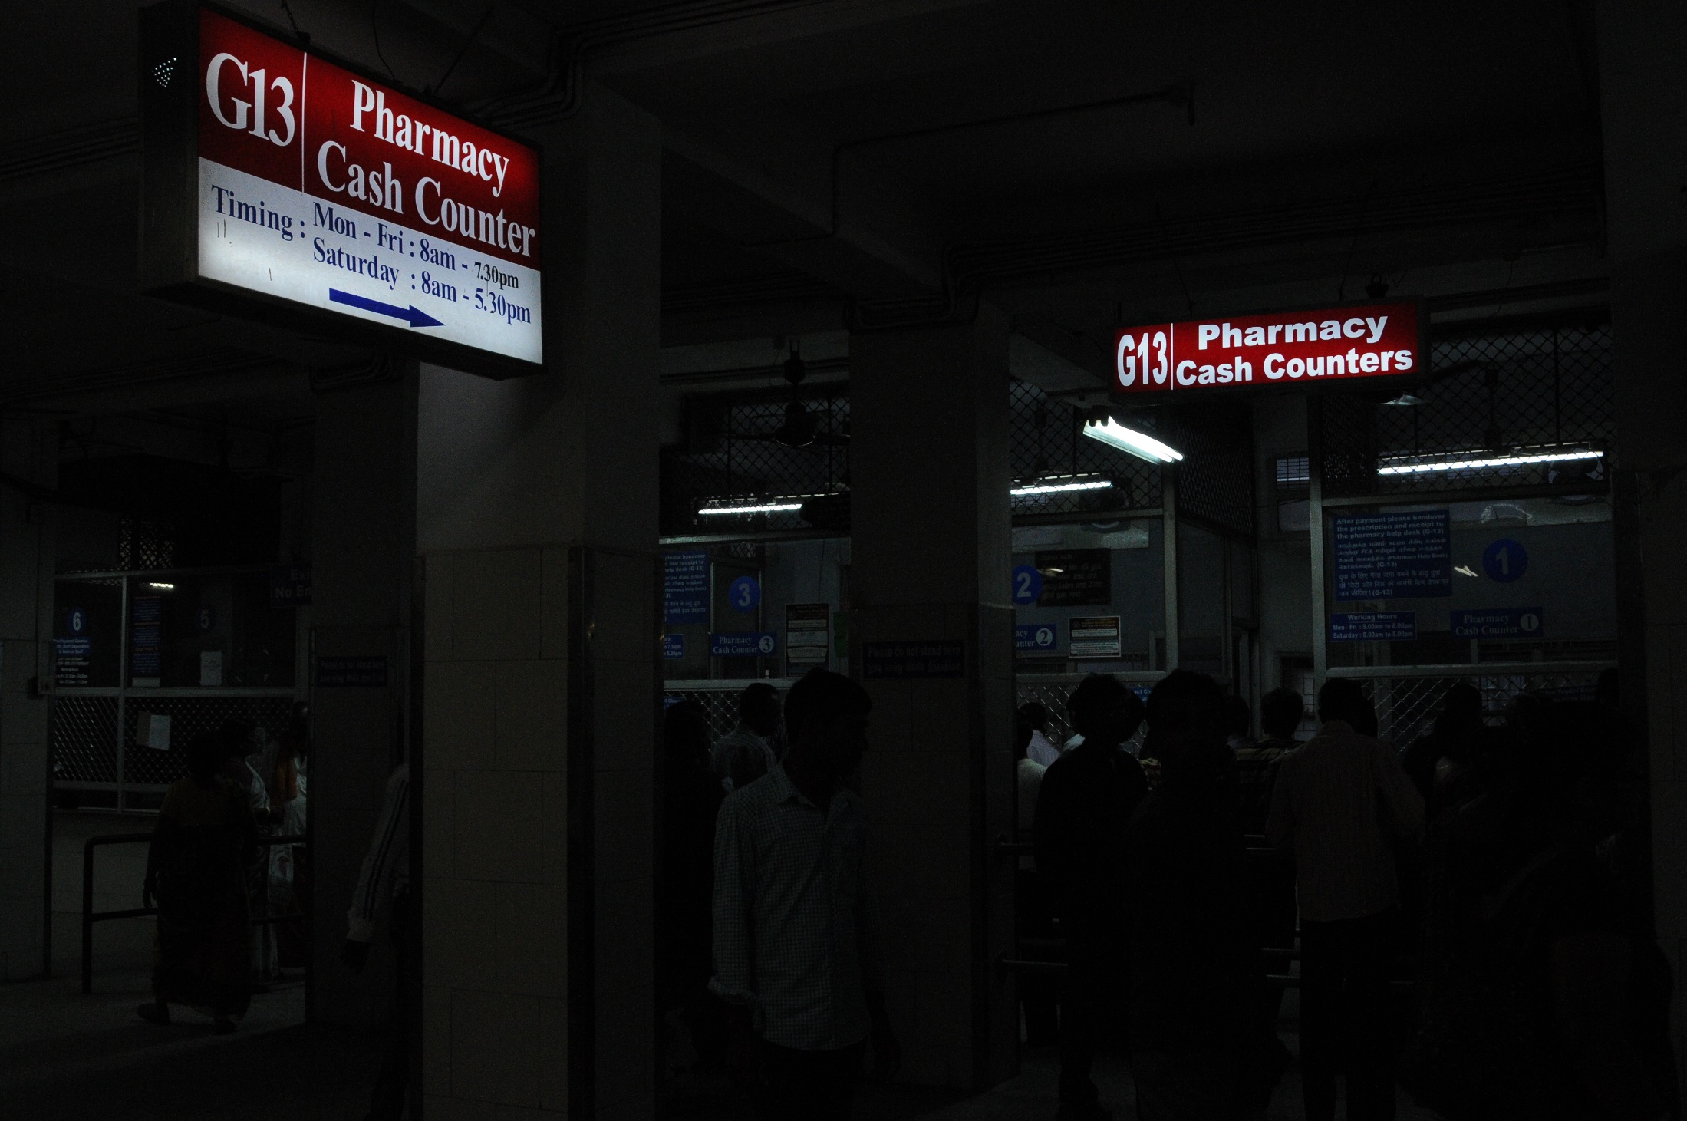
Big and Bright Signs

Slide 10
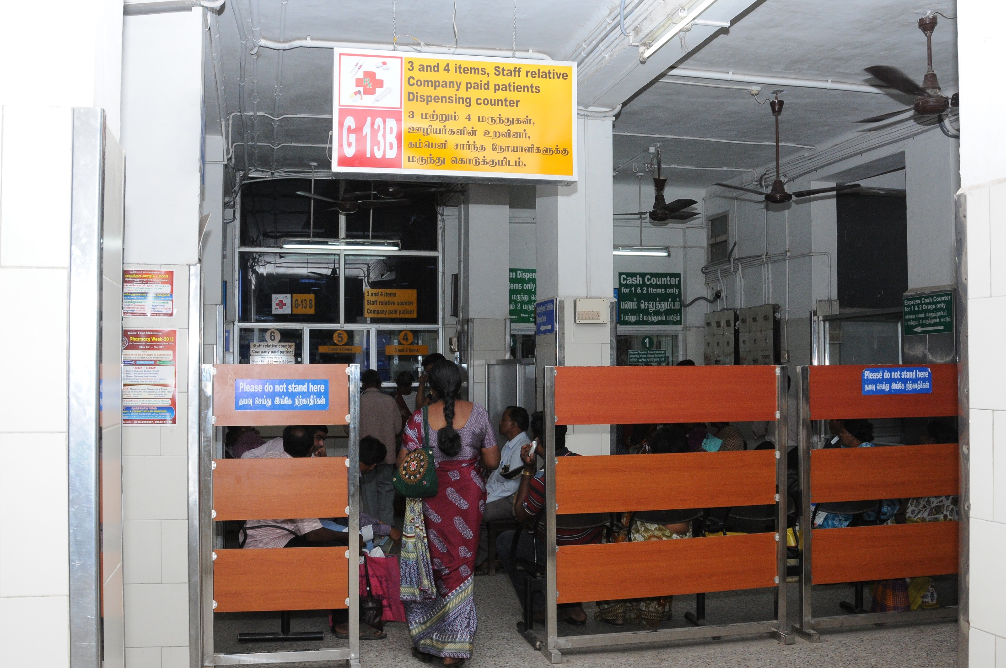
Creation of zones
1-2 items
3-4 items
5 and more

Slide 11
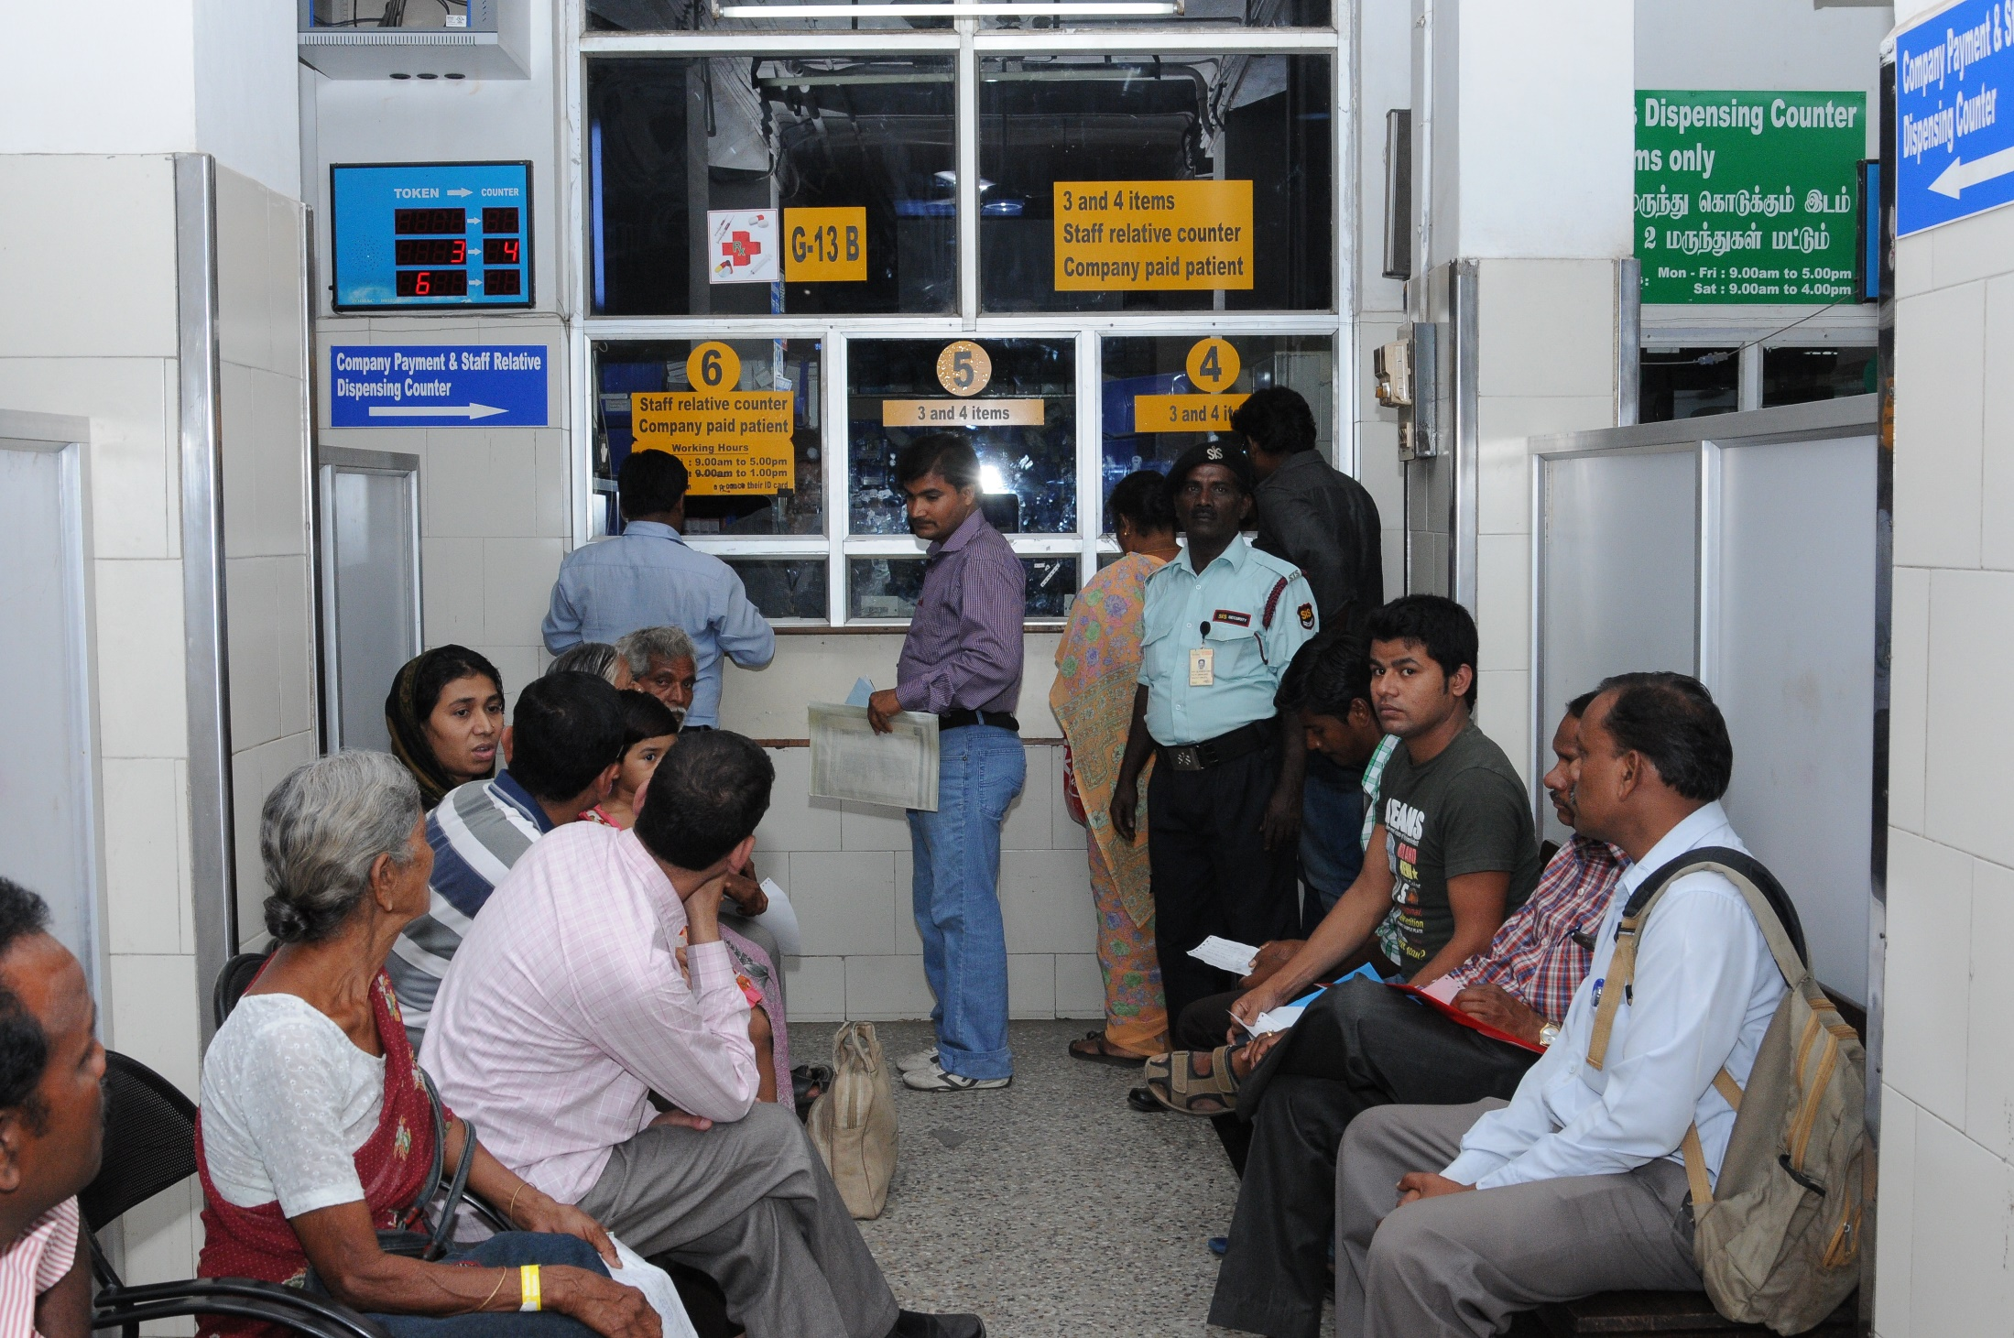
Separate queues for each zone

Slide 12
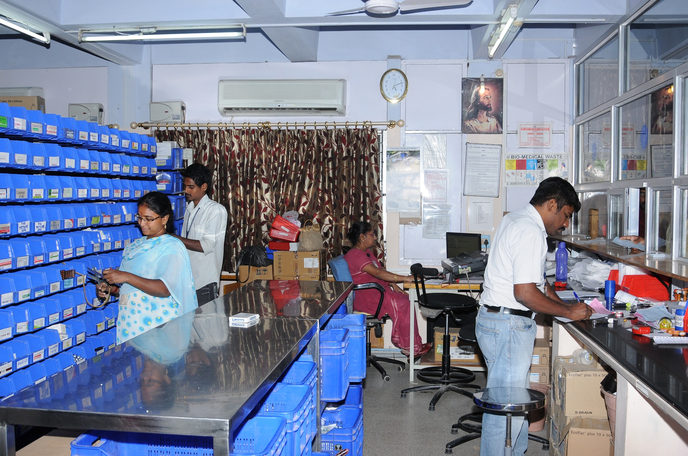
Splitting of front end and back end pharmacists

Slide 13
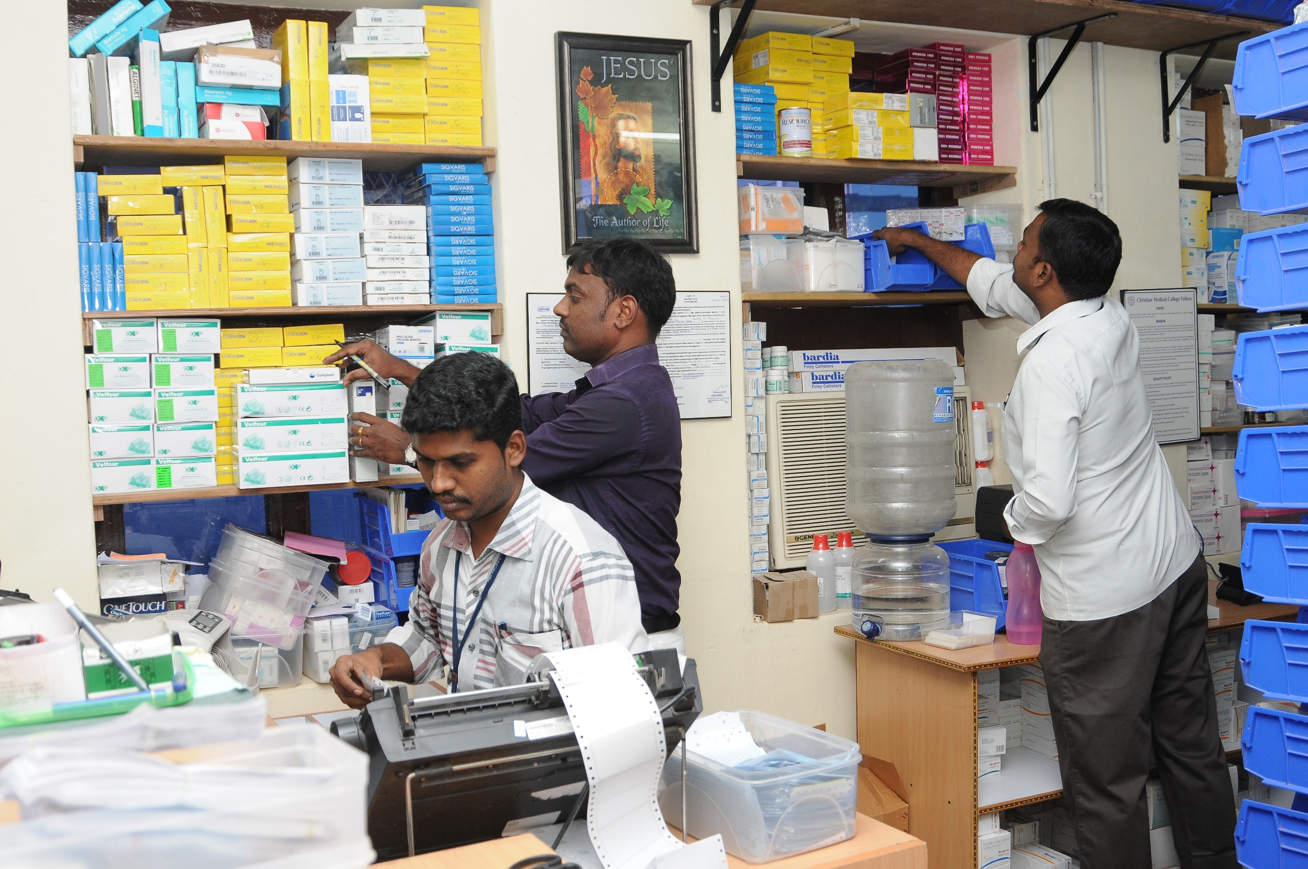
Dual printing of bills and labels

Slide 14
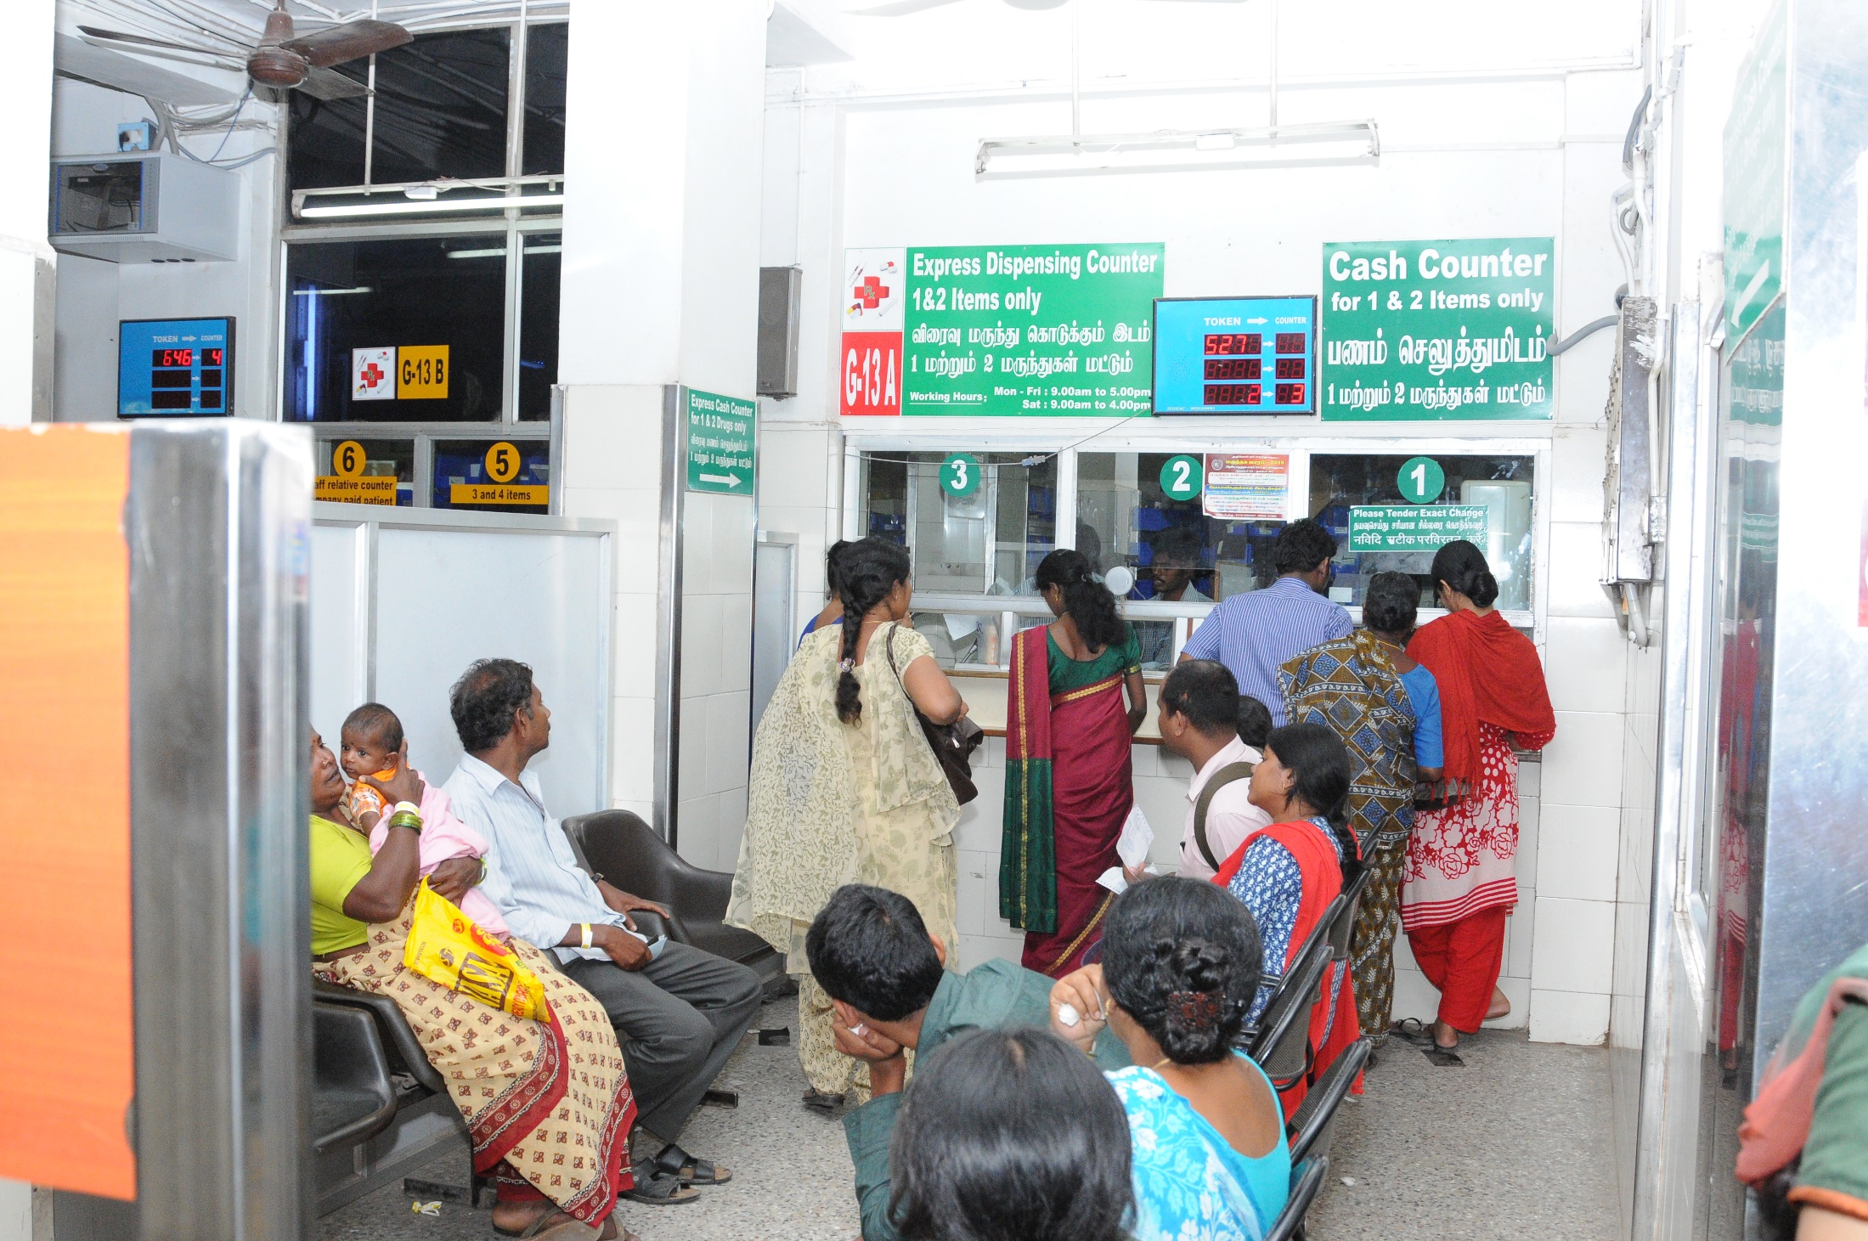
Token display system

Slide 15
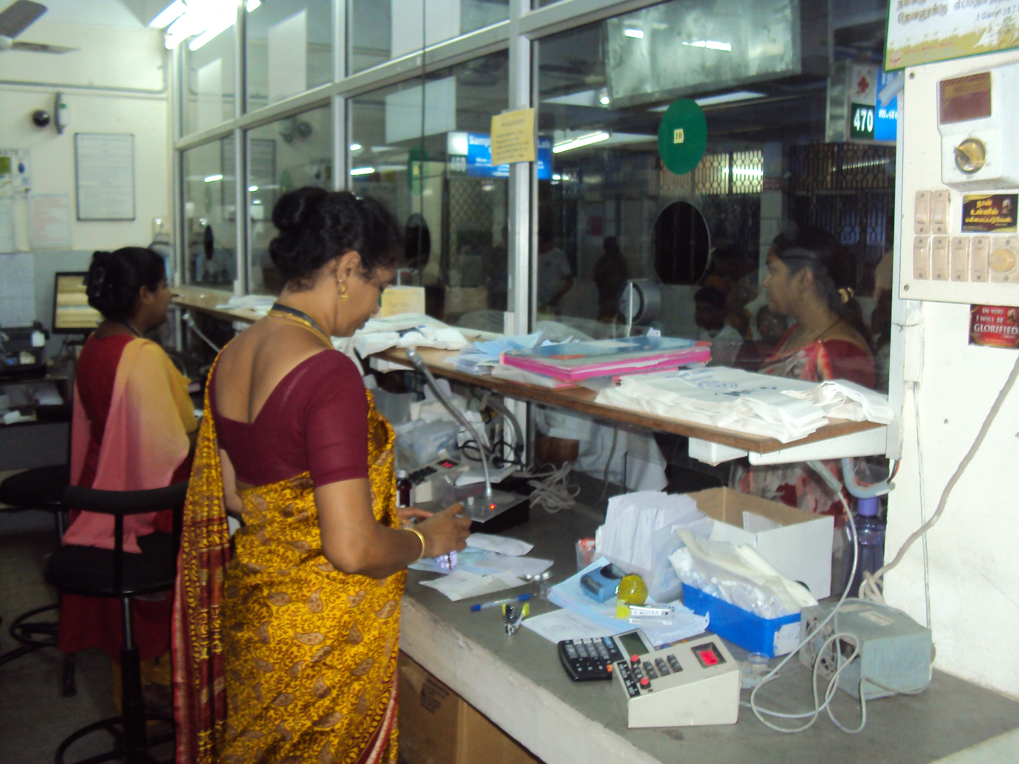
Counter communcation system

Slide 16
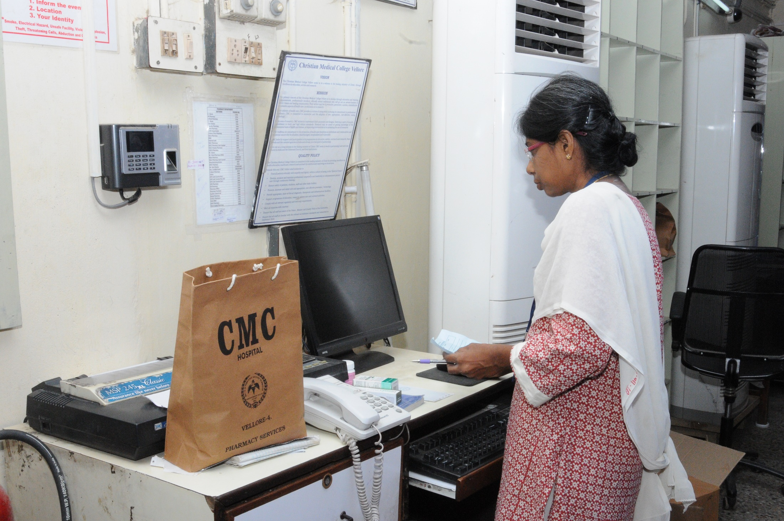
Separate counter for drug returns

Slide 17
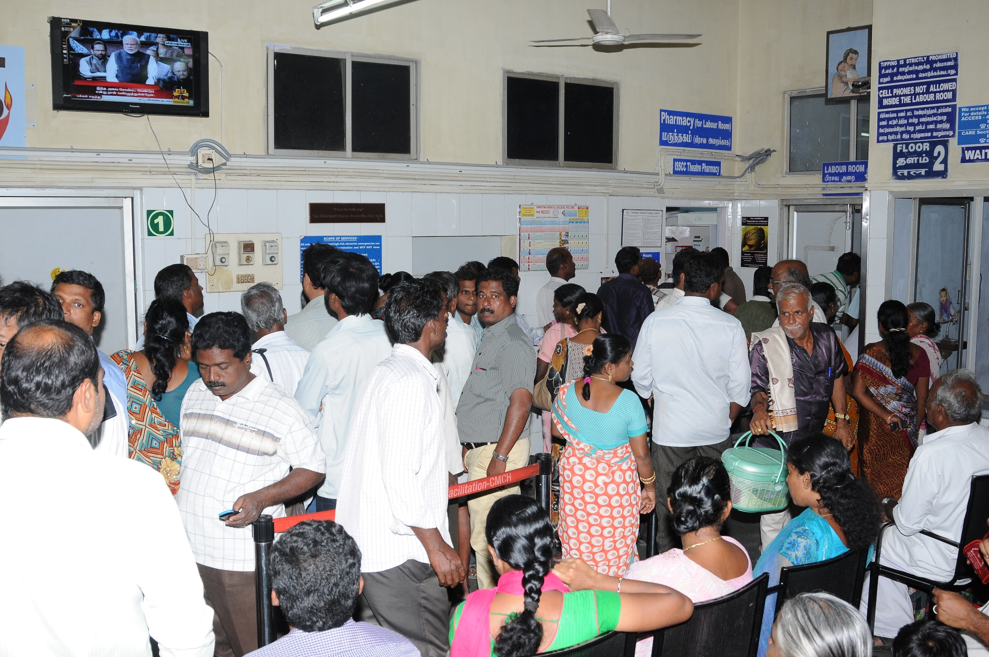
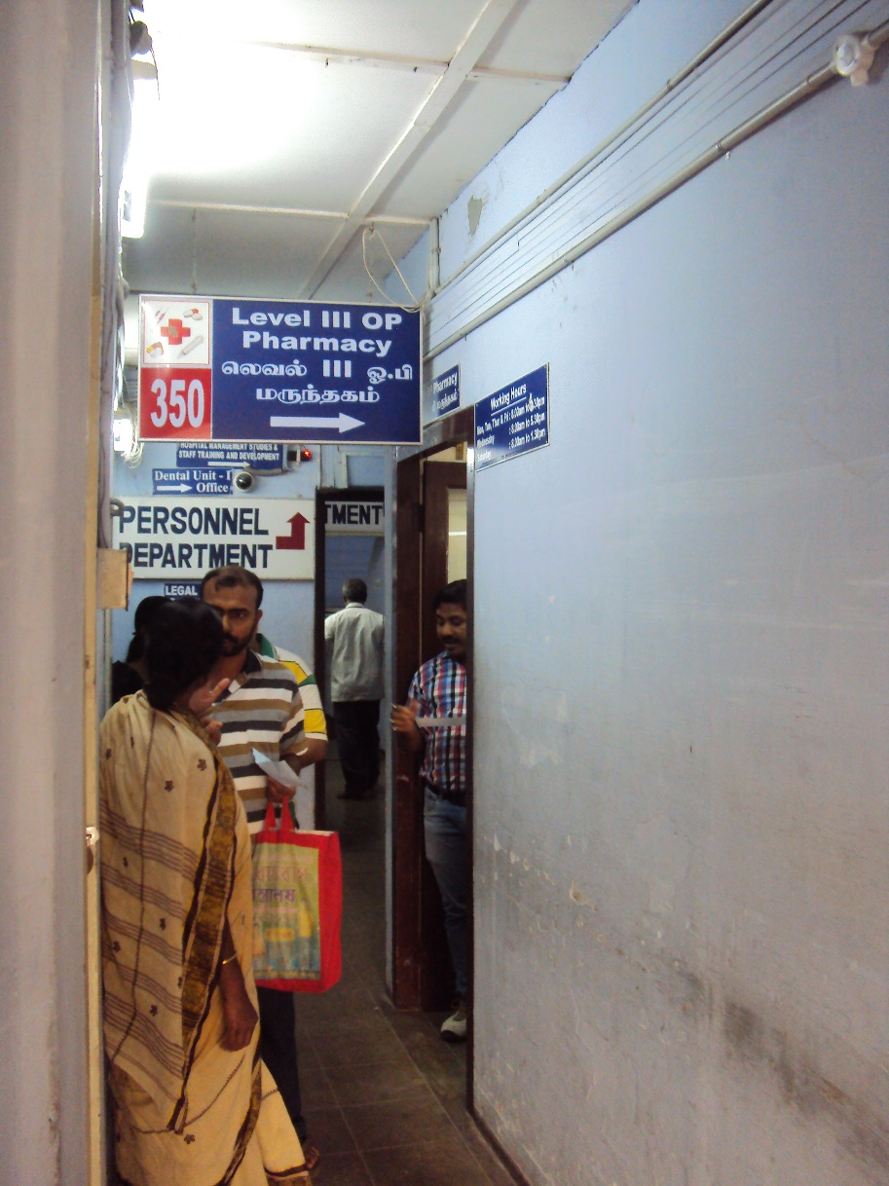
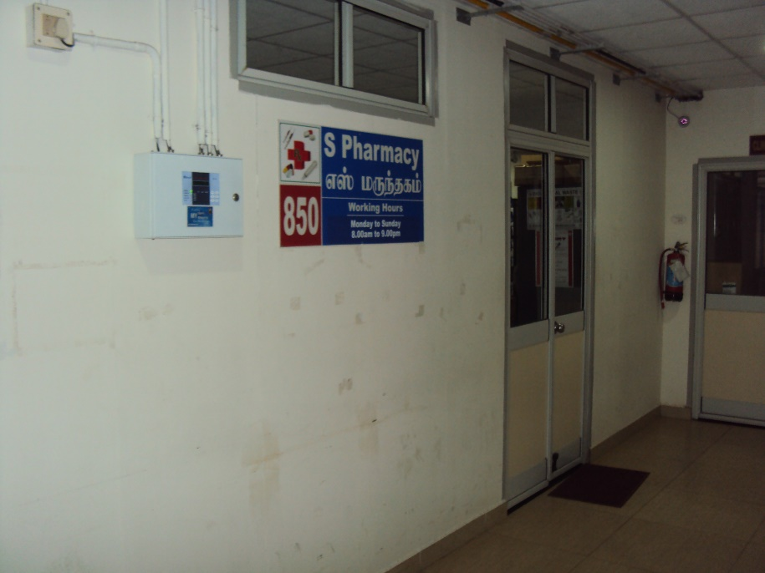
Multiple satellite pharmacies

Slide 18
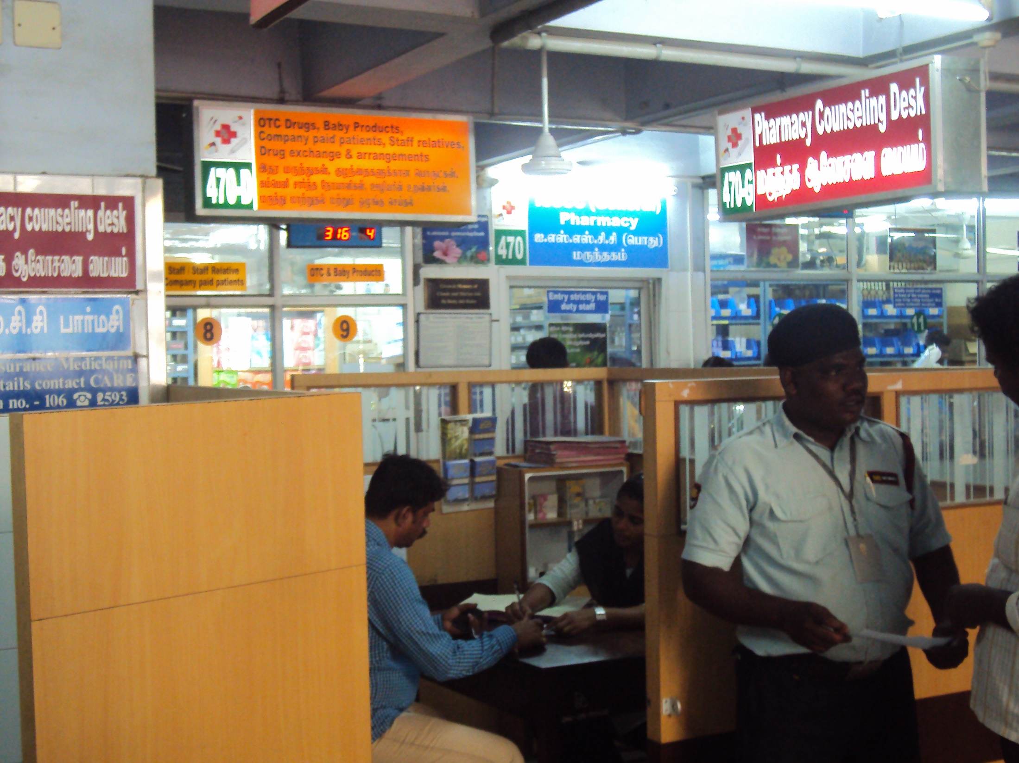
Separate counselling desks(free of charge)

Slide 19
Impact

Slide 20
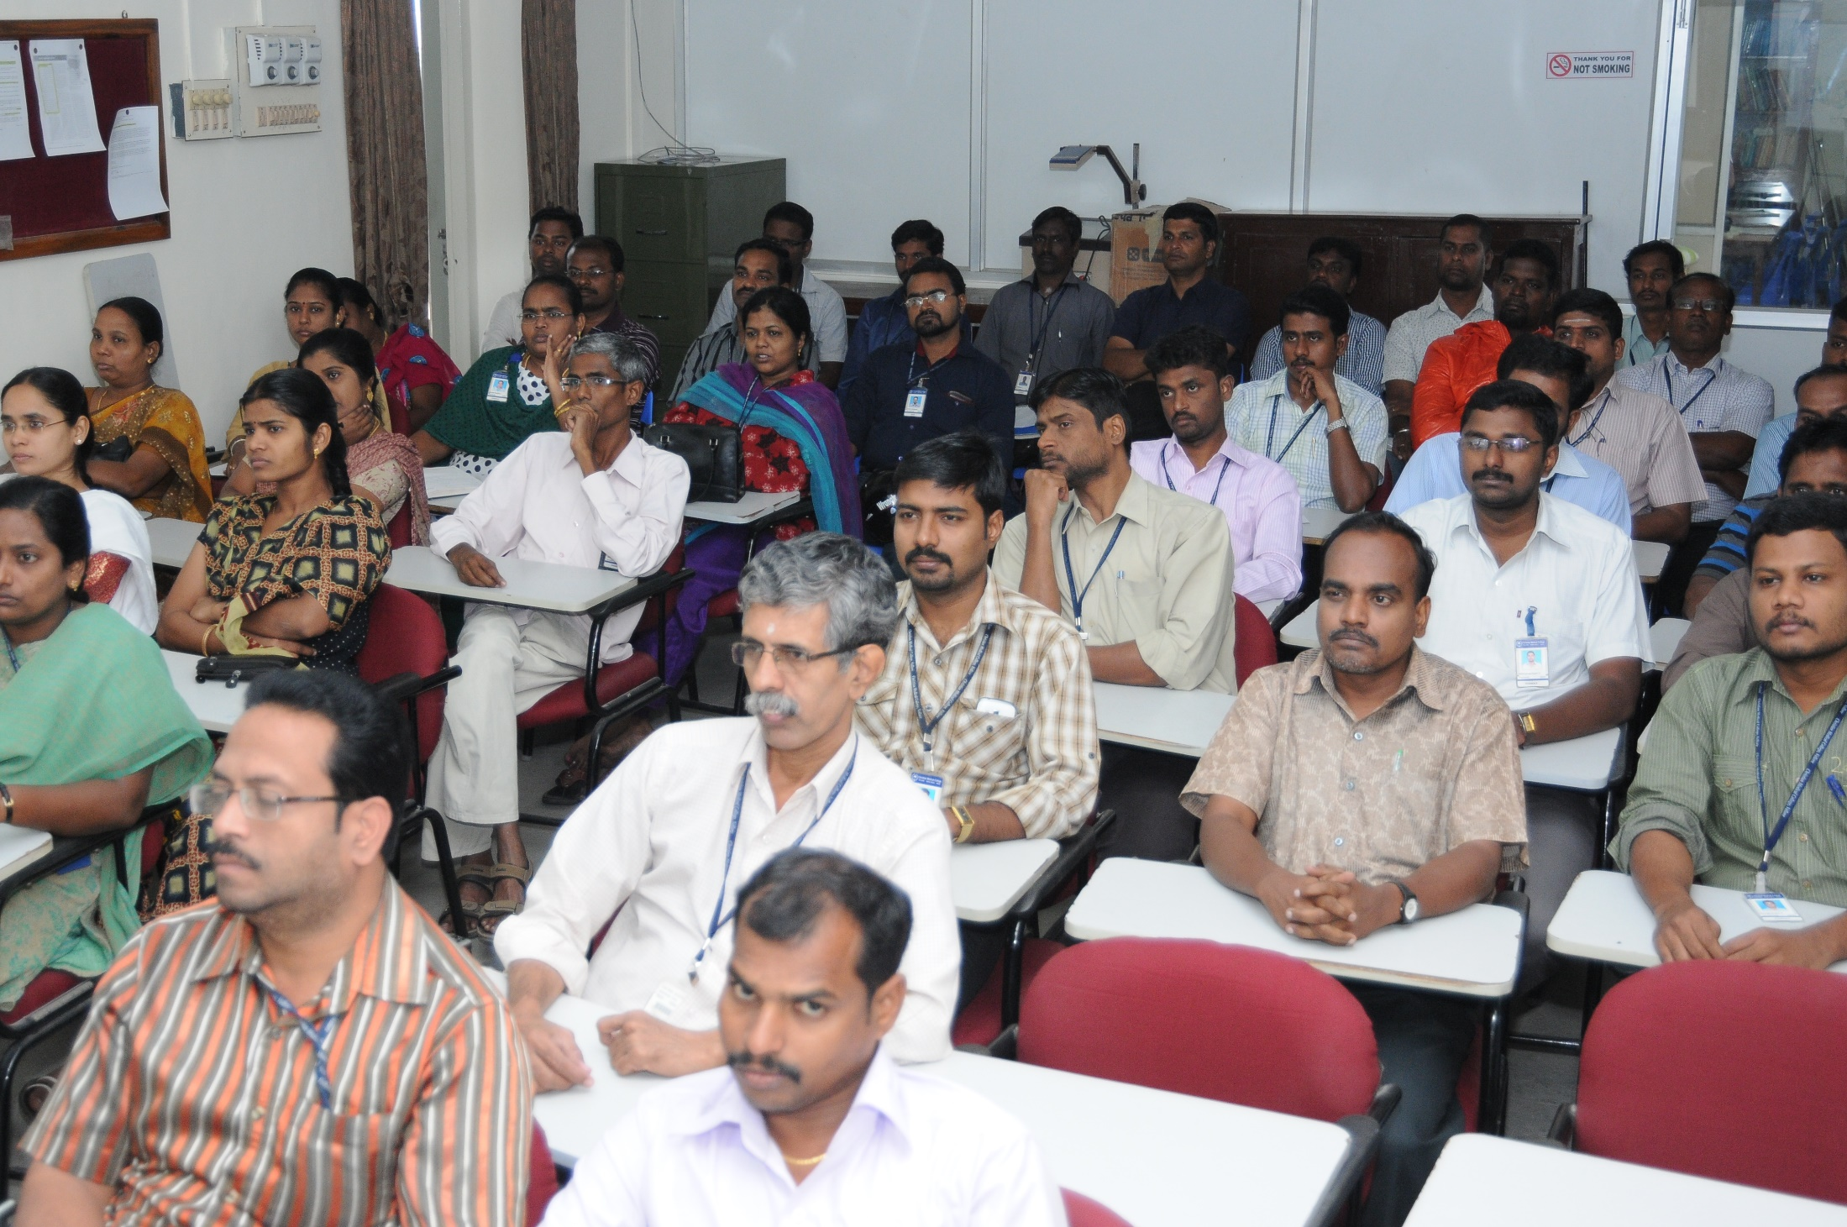

Slide 21
