Slide 1
IT as enabler of patient care
Dr Naveen Chitkara
MBBS ,MS (Medical College Rohtak)
M Ch Neurosurgery (SMS, Jaipur)
Ex Associate Professor Neurosurgery (2000-03)
Ex HOD Neurosurgery Oxford Hospital, Jalandhar(2003-12)
HOD Neurosciences, NASA Brain and Spine Centre, Jalandhar (2013 -
Associated with Quality related researches and NABH for last 3years

Slide 2


Slide 3
The journey
began in 2013…….(The lean start up by Eric Reis)

Slide 4
The journey
began in 2013……..
Understanding the ‘needs’
of quality and
use of technology

Slide 5


Slide 6




Slide 7
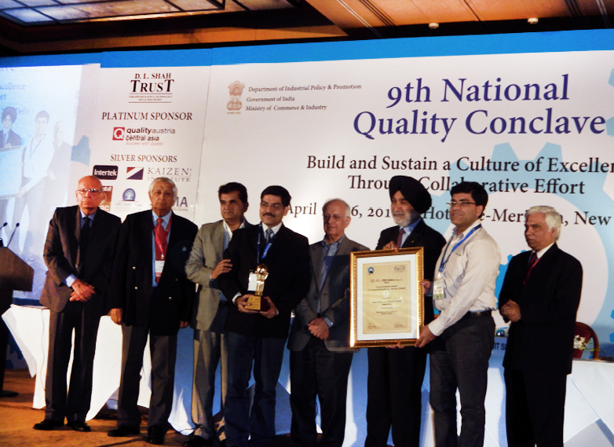

Slide 8
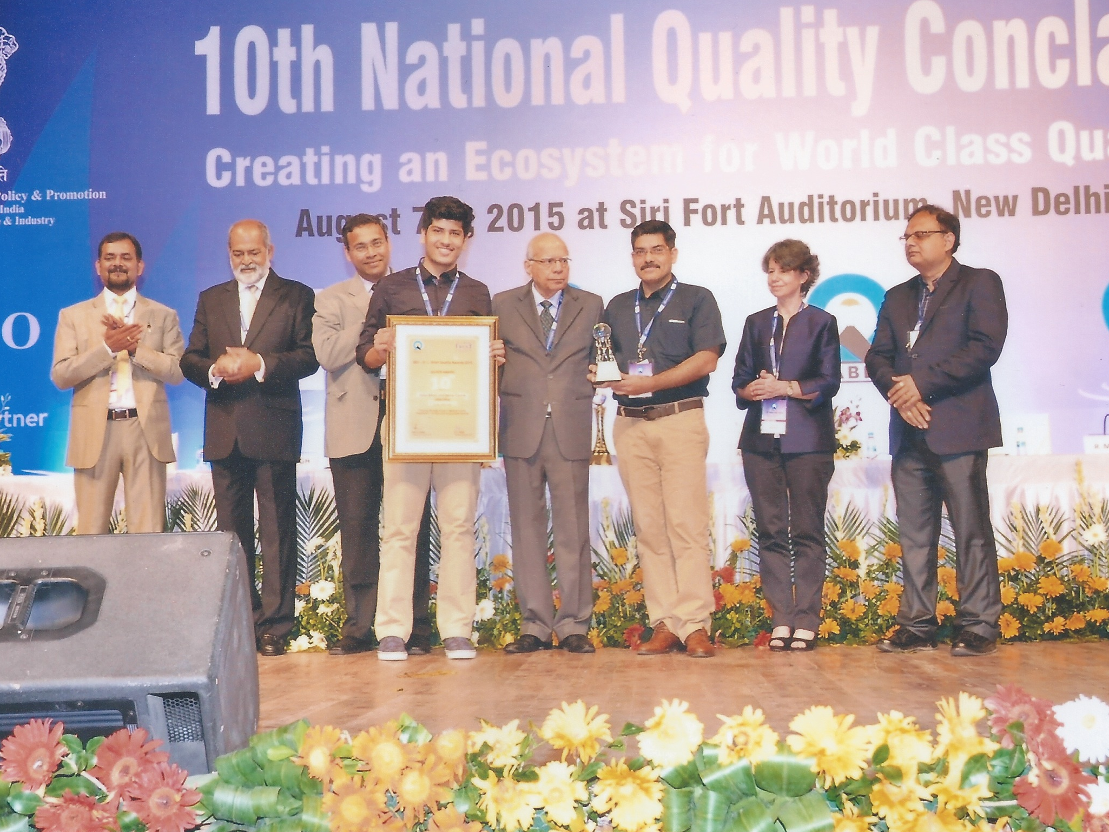

Slide 9
One time cost for up gradation
Increase in recurrent expenditure
1-1.5 lac per bed
25-35%
10,000 per bed
2-3%

Slide 10
Patient Management
Eliminating discharge time
Bed management
Wait times
Paper less
In and out patient management
Prescriptions
Accountable method of files storage in MRD

Slide 11
Investigations
Investigation history/timeline
Critical Alerts
Turn around times and RCA
Traceability of compliance at all levels
Blood Bank management

Slide 12
Miscellaneous
Accounting
Empanelment bills tracking
Statistical reports
Appointment management
Follow ups of feed backs

Slide 13
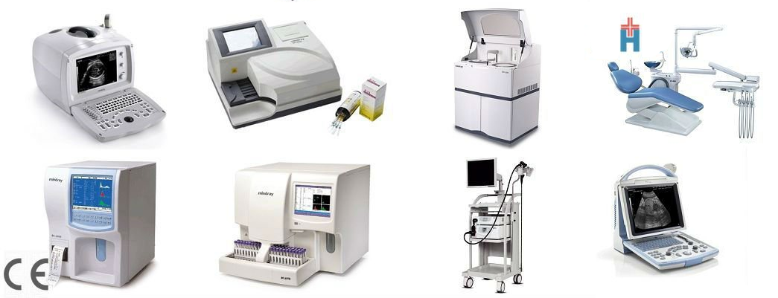
Inventory
Inventory management
AMC/CMS/Calibration alerts
Critical equipment downtime
Non critical equipment downtime

Slide 14
HR Dept
Health log of all employees
Training module
Follow up of NSI and BBF
Appraisal
Evaluation of all quality parameters

Slide 15
Quality tracking
Comparison of different variables
RCA and CAPA
Traceability
Policy management
Consents
Trends
Monthly alerts
Action taken

Slide 16
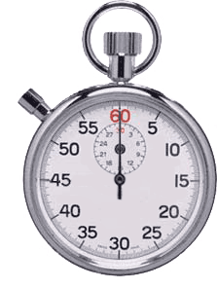

Real time tracking
On Line
Dynamic to the level of infinity

Slide 17
What we could not do,

Slide 18

Hand holding.

Slide 19

Fellow: Neuro Intervention, Medical School, Georgia, USA
Neuro Intervention, FHU, Japan
Neuro Sonology, NUH, Singapore
Minimally invasive Spine surgery, NUH, Singapore
Published 46 articles in International and National journals
8 innovative surgical techniques
Past Associate Editor: Neurology India
Current Asian Editor: Neurosurgical Science
.

Slide 20


Slide 21


