Slide 1






NABH Accreditation from a Tier 3 town in South India:
Experiences and expectations
Dr.Anuradha Pichumani DGO FICOG MBA
Consultant Obs & Gynaecologist
Executive Director
NABH Accreditation Coordinator
Sree Renga Hospital, Chengalpattu, Tamil Nadu

Slide 2

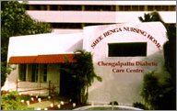

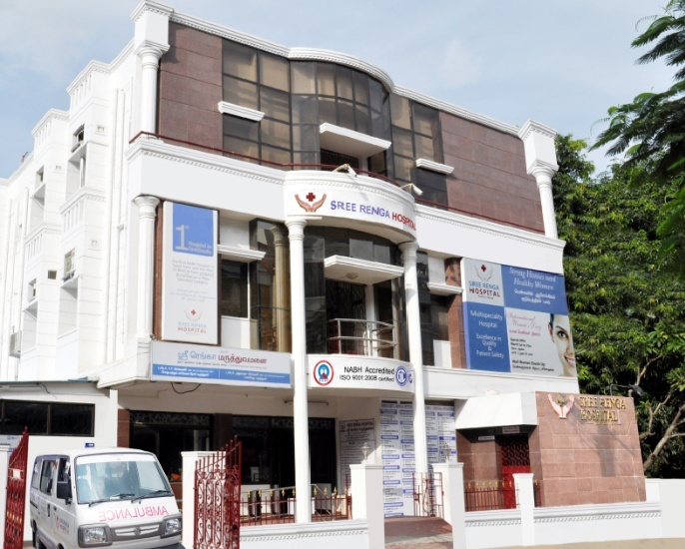



25 years journey towards
service excellence
1992 2016

Slide 3

Quality of Service
and
Patient Safety
NABH provided an opportunity to benchmark, validate and continuously improve ourselves .

Slide 4

Experiences
Nursing
Introduction of Code Blue and CPR training
Continuous training – helped reduce errors and
Improve Patient Safety
Diagnostics
Recognition and timely reporting of Critical Values and Alerts

Slide 5

Experiences
Safety
Fire alarms, Emergency Route Plans
Quality
Data collection for CQI

Slide 6


Awareness of NABH
The Skills Gap
Costs

Slide 7

Challenge
Awareness of NABH
Awareness about NABH and the concept of Quality in healthcare delivery - Low
Educating people about accreditation –
Expensive and time consuming

Slide 8

How we overcame
Awareness of NABH
Educating Doctors – Newsletters
Educating public - Native language publications, social media

Slide 9

How CAHO can help
Awareness of NABH
Help generate demand for Quality in healthcare via
Editorial content in the media
Print and TV advertising
Publishing an App to locate accredited healthcare
services easily
Educate end users on the new levels of accreditation
(Entry-level, pre-accreditation) in the NABH pyramid

Slide 10

Challenge
The Skills Gap
Recruiting Specialist Consultants and personnel for the Quality department
Migration of skilled nurses to metro cities and even moving abroad
About 10 medical colleges located within 40 km of Chengalpattu – competing for patients, Consultants and employees

Slide 11
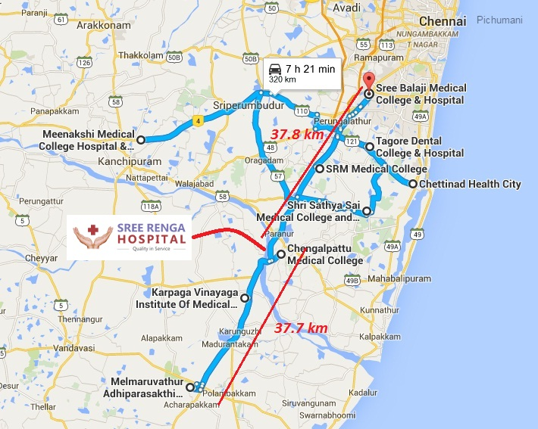
Challenge
The Skills Gap
10 Medical Colleges and Govt. Hospitals in a 40 km radius

Slide 12
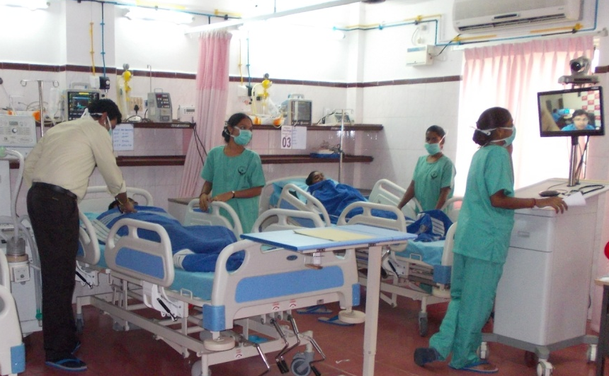
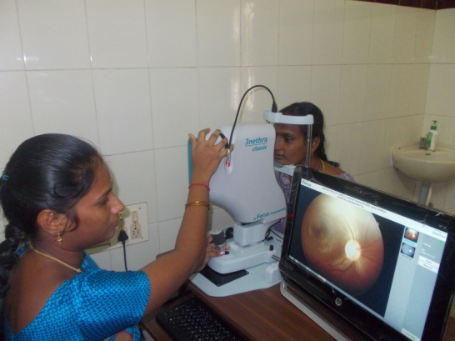
How we overcame
The Skills Gap
Doctors: Recruitment of Tele-Intensivist (for the ICU) and Tele-Ophthalmologist, to complement the in-house capabilities
Nurses: Teaching NABH Standards to students of our paramedical institute. Graduating students are employed to assist Nurses in maintaining NABH records.

Slide 13

How CAHO can help
The Skills Gap
To maintain the NABH-mandated Nurse-Patient ratio
Conduct Bridge Courses and award Certifications to paramedical students with work experience

Slide 14

Challenge
Costs
Servicing and maintenance of equipments in a Tier 3 town costs more – help has to come from the city
Insurance reimbursements low for NABH-accredited hospitals in Tier 3 towns, citing the location

Slide 15

How CAHO can help
Costs
Facilitate a discussion with IRDAI
Ensure appropriate reimbursements are awarded to Cashless treatments provided at NABH-accredited hospitals in Tier 3 towns
No discrimination based on geography

Slide 16

NABH Accreditation from a Tier 3 town in South India:
Experiences and expectations
In a nutshell
Benefits include improved patient outcomes, via upgrades to Quality and Safety
Challenges will remain but can be sorted out, via creative approaches
Understanding and support from NABH and CAHO will encourage more hospitals in Tier 2/3 towns to undertake NABH accreditation

Slide 17
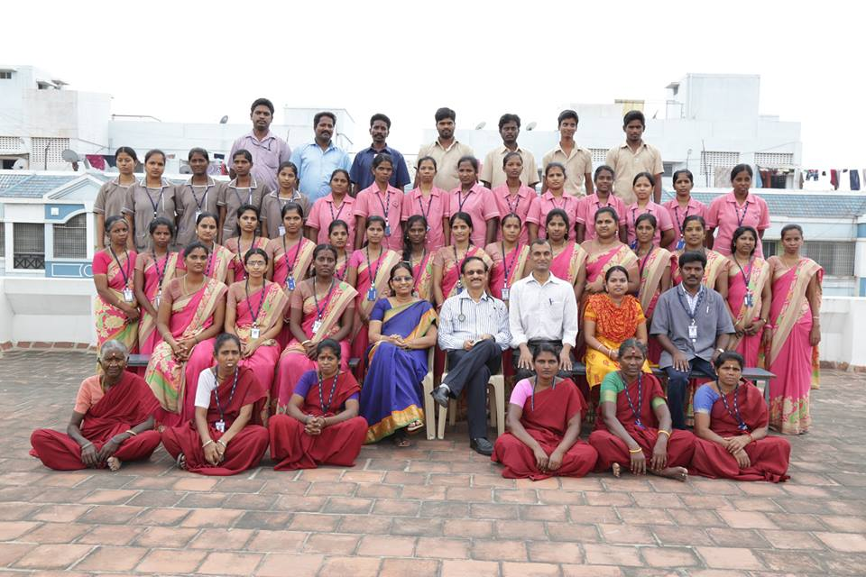

Thank you

