Slide 1
Delight: Beyond patient satisfaction
Dr. Badari Datta
Bangalore Baptist Hospital

Slide 2


What is Quality?
Quality= Perception-Expectation
Notes:
How do we define quality, there are many definitions. One way of defining it is quality= patient perception – expectation. IF the expectations are more than the perception, quality is percieved as poor. If the perception is better then the

Slide 3
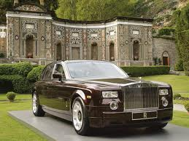
“Imagine that the hospital is …”
“A Rolls Royce, because of the expense.”
http://www.the-hospitalist.org/details/article/256805/Patient_Satisfaction_the_Hospitalists_Role.html
Notes:
From the patient’s perspective, hospitals can be scary and unfriendly places. The American Hospital Association’s Reality Check (4) evaluated the public’s perceptions of hospitals and hospital care using a time-honored technique of asking focus group participants to imagine that the hospital was an animal and a car.

Slide 4

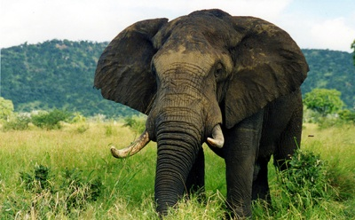
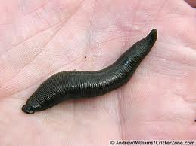
“Imagine that the hospital is …”
“A bear…a grizzly…horrible.”
“Elephant…large…cumbersome.”
“A leech.…I’m sure all hospitals aren’t that lowly.”
http://www.the-hospitalist.org/details/article/256805/Patient_Satisfaction_the_Hospitalists_Role.html

Slide 5
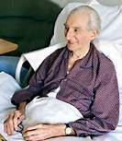
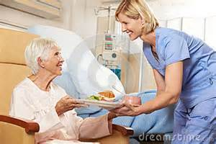
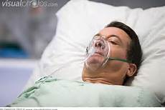
Patient Expectations
Low
Medium
High

Slide 6
What do patients expect
Structures
Processes
Communication
Empowerment
Empathy
Ethics

Slide 7

Project “Hello”

Slide 8
Project Hello
Purpose: To talk to patients post discharge
  To find out how they are doing
  To clarify if there is any confusion
  Follow up date
  Confirm when and How to call ICE
  To get feedback
Who has to do it
  Doctors?
  Nurse?
  Guest relation staff?

Slide 9
Hello… I am calling from BBH….

Slide 10
Thank God… You called me!!
Doctor’s call
  Pain management
  Medication reconciliation
  Modified advise
Nurse’s call
  Reiteration of discharge advise
  I will get back after checking with doctors
GR call
  How was your experience
  Anything I can help
  Follow Up advise
  If you need call me

Slide 11
Expression of Delight (%)

Slide 12
Learning
Patients are delighted when doctors call them as a strong “I CARE” message is given.
Difference in delight between Nurses and others may be related to Nurses empowerment as they tell “Let me Check with the doctor”
GR staff’s involvement is necessary and adds value as the general and Nonclinical aspects are covered
GR+Doctors>GR+Empowered Nurses> GR alone
Strategy for who should call which patient group

Slide 13

My mini research on What’s app
Non clinical friends were asked a question
“what is the thing you care the most or worried most when you visit a hospital apart from clinical care”
90% answered…
“The hospital may cheat us “

Slide 14
Story… but real one…
Mr. Dayal , a successful NRI Businessman gets admitted to hospital
Gets better after 5 days.. Very happy with the nursing care
Offers 5000 Rs. Tips to a nurse. She tells “Thanks sir, I can’t accept this. If you want you can donate to Poor patient’s fund”
He offers same for another nurse.. Same answer

Slide 15
He wants to meet the CEO
“This ethics I am trying to build in my organisation, How did you achieve it”
Very pleased and delighted about the hospital
Decides to give some donation to hospital…

Slide 16
Some donation.. given
Two and half lakh rupees
Per month for poor patient care
For ever
4.75 Crores to develop hospital infrastructure

Slide 17
Learning
Unfortunately, Ethics has become a delight factor
Need of the hour is “ETHICS”
Empathy will follow
How to communicate ethics and empathy… To be learnt
Only things patients care for is
“I CARE” attitude

Slide 18
Thank you

