Slide 1

Quality of Anaesthesia Induction and anxiety levels among the children – An Audit
Dr. Ekta Rai. MRCA,MD
Department of Anesthesia
Christian Medical College
Vellore
Notes:
Good morning to all.. Am going to present the audit we conducted over a period of 2 months at christian medical college, vellore.The field of paediatric ananesthesia has evolved in past few years. In recent times the psychological impact created by surgery and ananesthesia on the child and the family has caught attention. There are previous studies which have highlighted the three important areas of psychological stress during the course of anaesthesia namely anxiety at induction ,agitation in early post operative period.and development of negative behavioural.

Slide 2
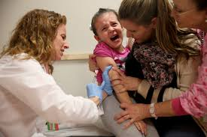

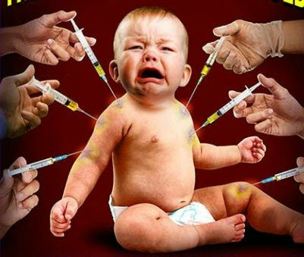

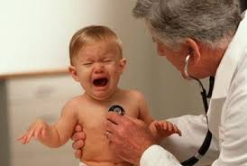
Background for the audit
Observation in the hospital
Global Awareness
Notes:
The background to the audit was that we were following practice of premedicating all the children coming for operation with a long acting sedative as the time of surgery can be anticipated but very difficult to predict accurately. It was noticed that the premedicated children will be sometimes very restless at the time of induction and after the procedure took long time to wake up in recovery. There has been case reports of arrest post operatively in children who have got premedication. To avoid the problem related to anxiety , and also problem related also to too much of the sedatives.

Slide 3
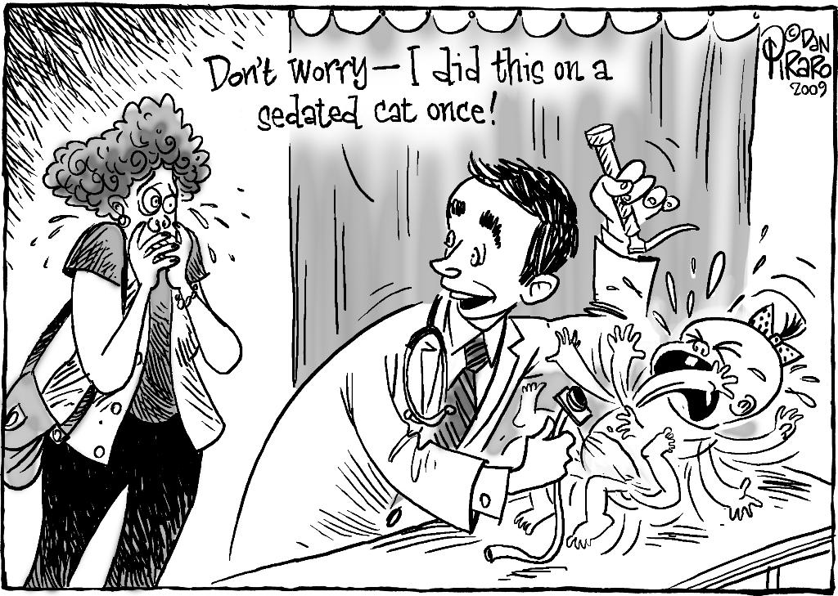
Impact of poor Quality of Induction

Slide 4

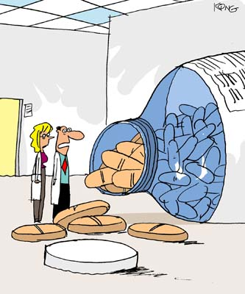
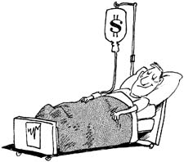
Impact of poor quality of induction
Physiological
Psychological

Slide 5
Aim
Incidence of poor quality of induction
Factors associated with poor induction
Based on the finding take measures

Slide 6
WORK FLOW
IRB Approved
Prospective Observational Cohort Study
Period= 2 months
Informed Consent from Parents
Verbal Assent taken as appropriate from the child.
Recruited
103
Analysed
78
Notes:
Pilot study was done on 20 chldren to fine tune the study
Out of 25 children- 9 children procedure was cancelled due to lack of time; 8 were under some insurance schemes and they could not get that; 7 data filled was not complete
PI along with 4 technicians were involved in the study

Slide 7
Work Flow
Inclusion Criteria
Elective surgery
In patient
2-15 years
Exclusion Criteria
Not willing to take part in the study
Major surgeries requiring morbidity, blood transfusion and ICU admission
Mental retardation, Autistic children

Slide 8
Work Flow
Ward
Holding Bay ; Induction Room
Interviewed- Primary Care giver
Socio-economic status
Child illness
Temperament of child
Anxiety among children and parent
Anxiety Scores

Slide 9
Outcome
ICC (Induction compliance checklist)
Score > 4 – Poor Induction
Incidence of poor induction 30.77 % (24/78)
Reference: Kain Z,Mayes L, O’Connor TZ et al. Preoperative anxietyin children, predictor and outcomes.Arch Pediatr Adolesc Med 1996;150:1238-1245

Slide 10
Results
Factors associated with poor induction
Age (2 to 4 yrs)
White Coat Fear | 5.6 times high ICC scores
Pre-medication (94.9 %) | Not associated with low ICC scores
Sedation | 90% protection against high ICC scores
Parental presence | Complex phenomenon
Childs acceptance for surgery | 12 times protective against high ICC scores
Inhalational induction` | High ICC scores
Distraction techniques (less than 50% used) | Protective

Slide 11
Anxiety Levels
Pre-operative anxiety
Ward – 10.3%
Holding bay- 6.5% (unmonitored sleeping children)
Separation anxiety -20.5%
Induction room – 25.6%

Slide 12
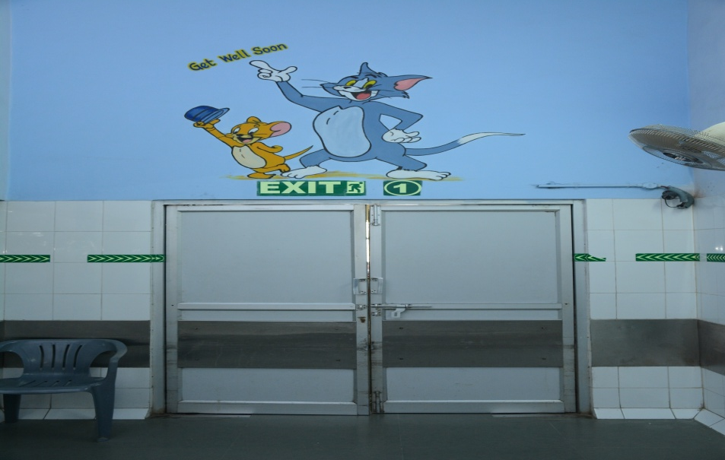
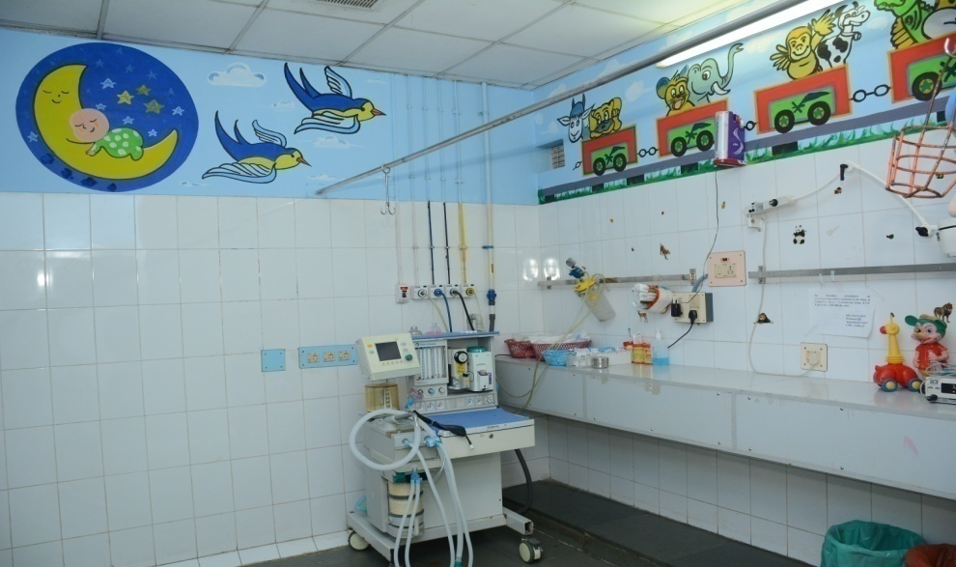
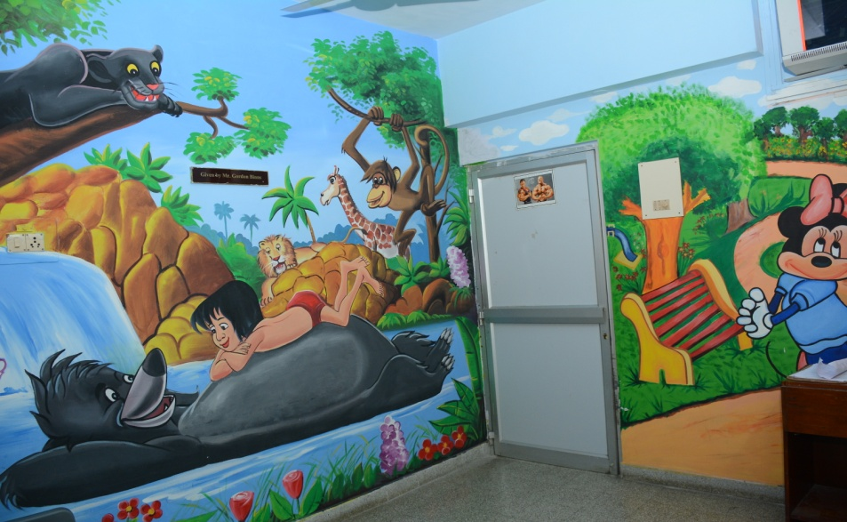
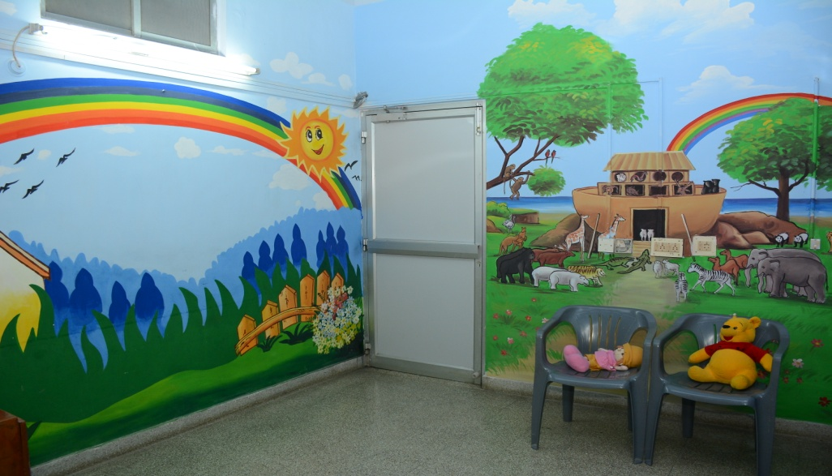
Steps Taken- 1.Kids Friendly atmosphere

Slide 13
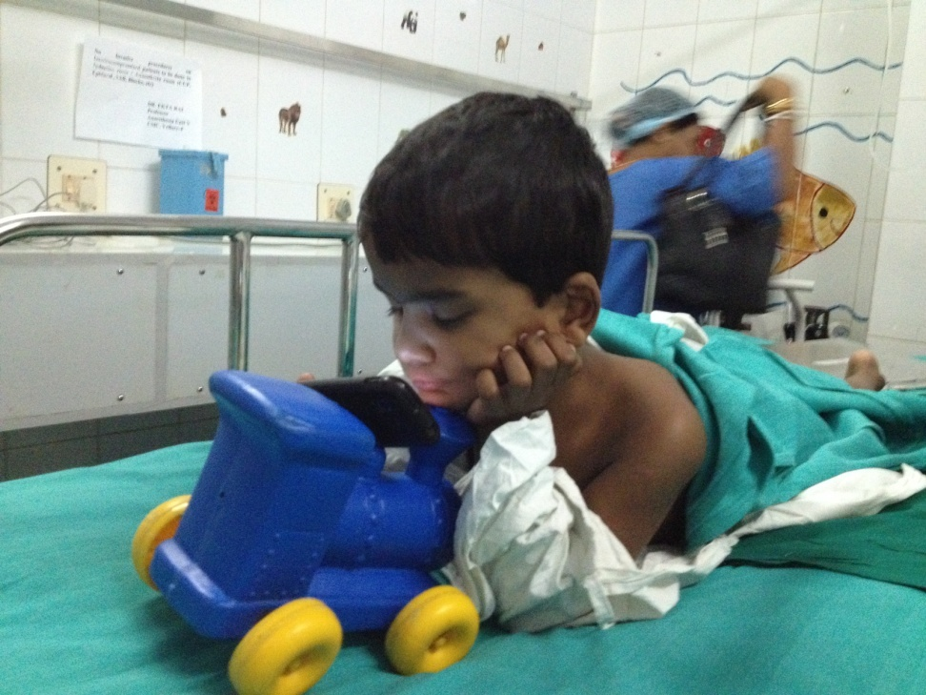
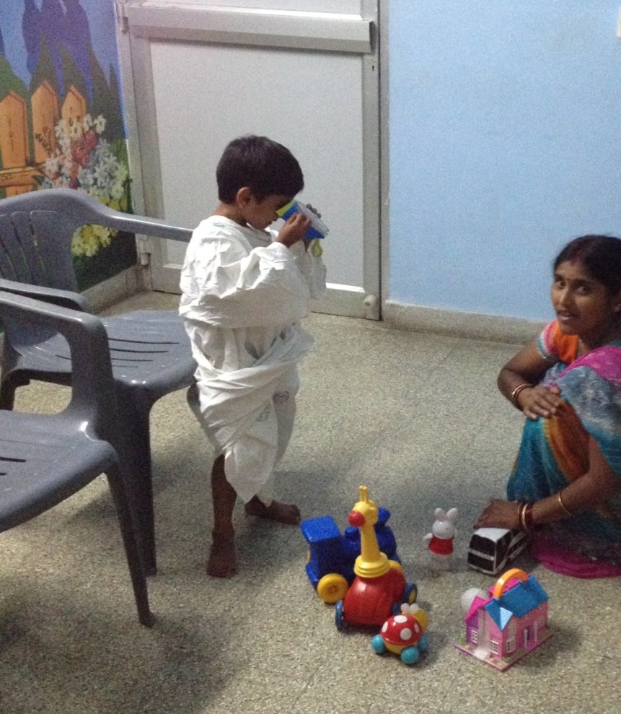
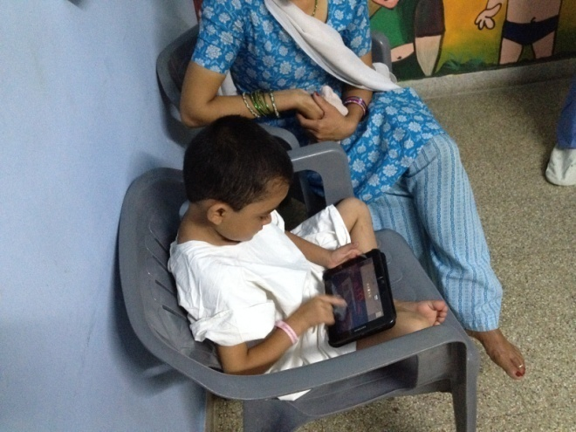
Holding Bay

Slide 14
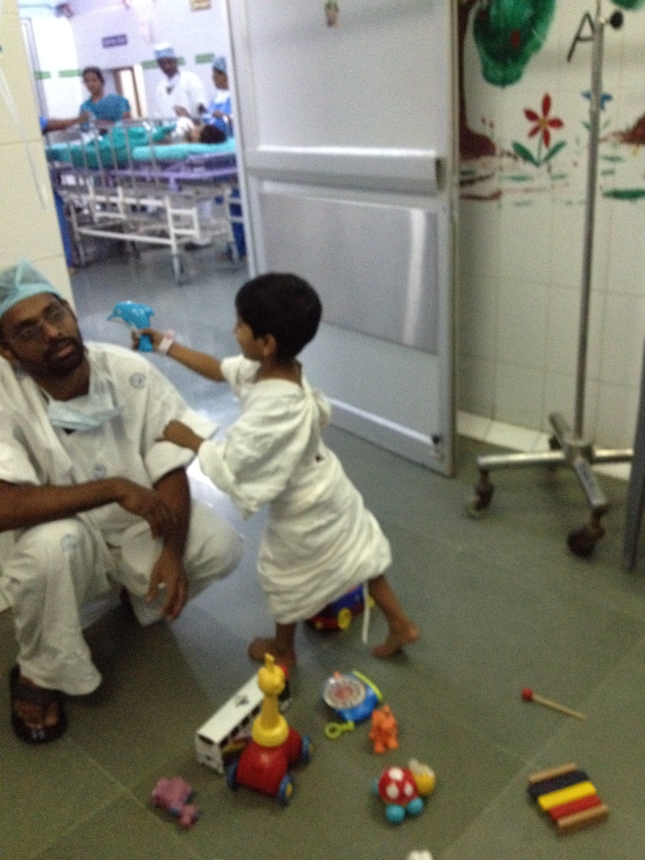
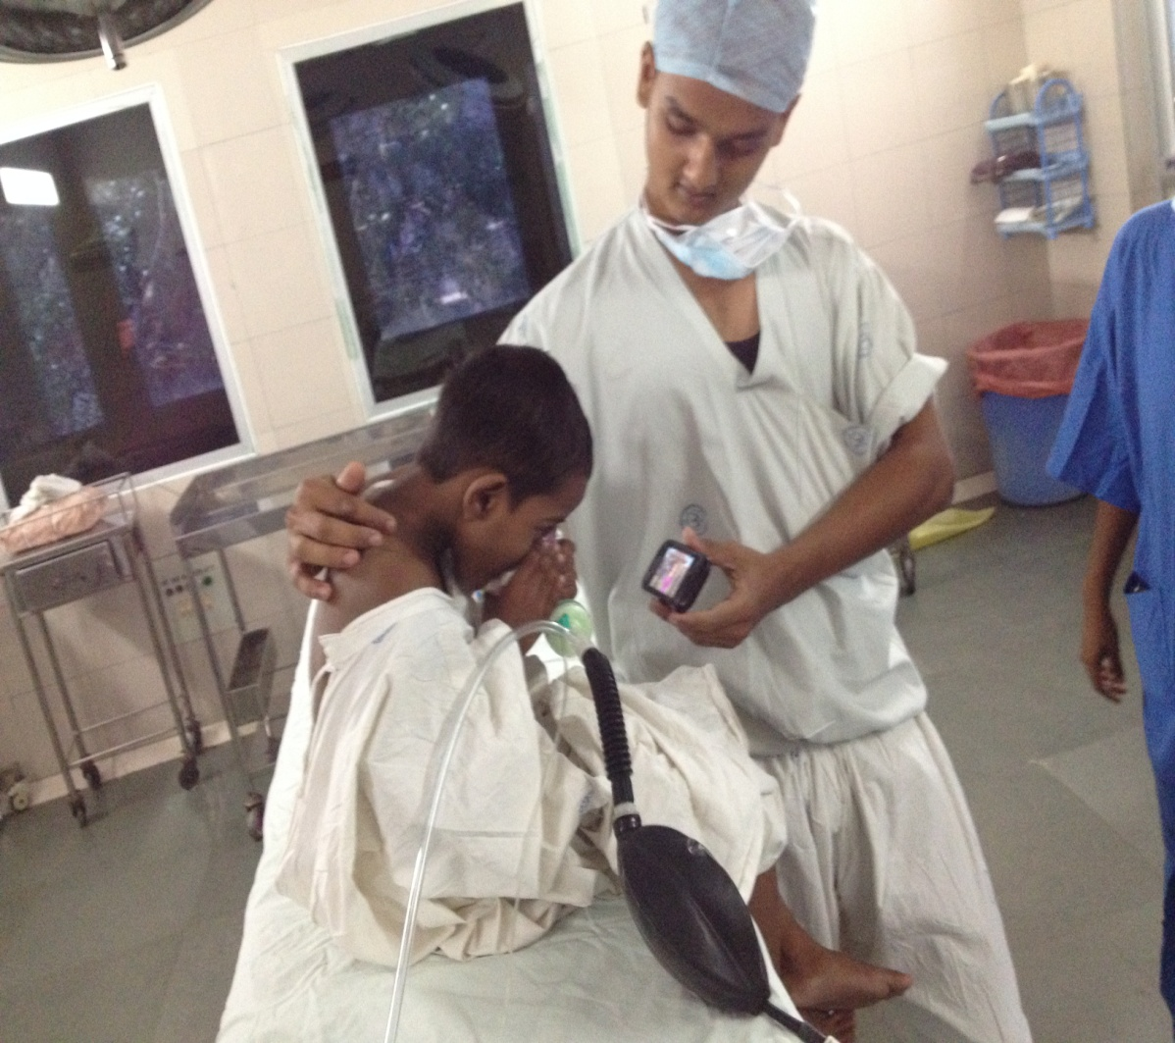
Friendly Anesthesia staff

Slide 15
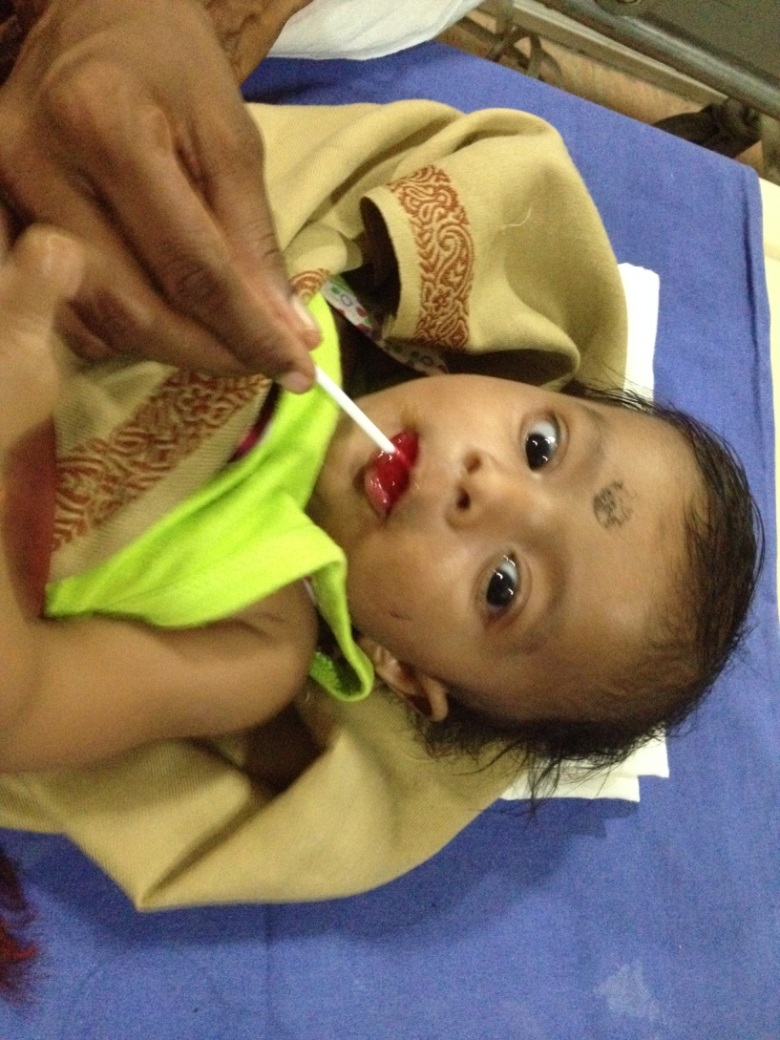
Fasting Strategies
Strict Adherence to Fasting guidelines
Use of Lollipops( Infants)

Slide 16
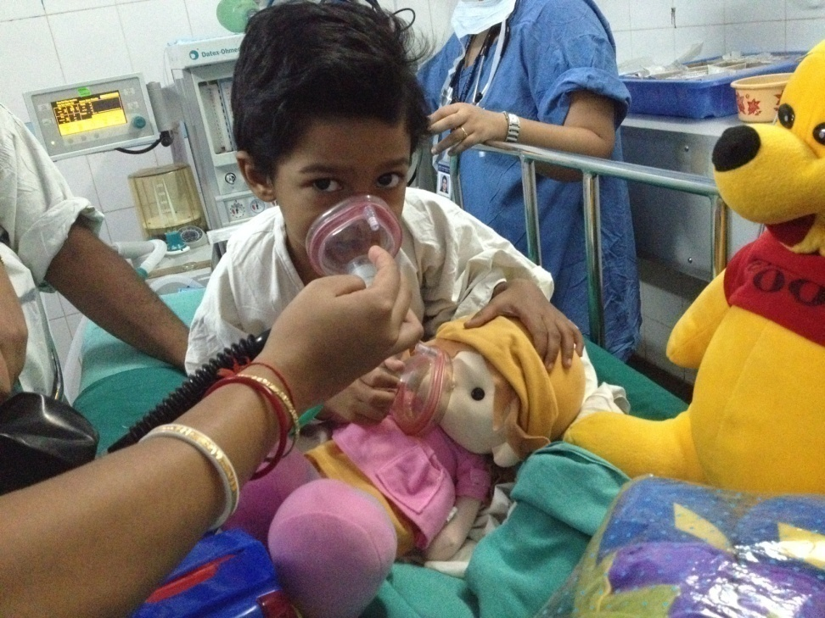
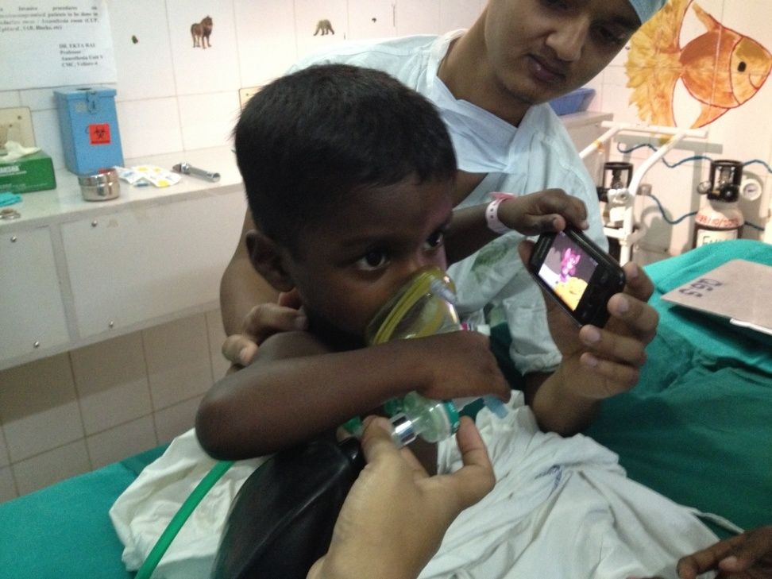
Current status Anesthetist Opinion
Smoother Induction- Relaxed Atmosphere
Calm Parents Help
Improved Bonding
Premedication not always required
Technician play vital role
Improved Bonding

Slide 17
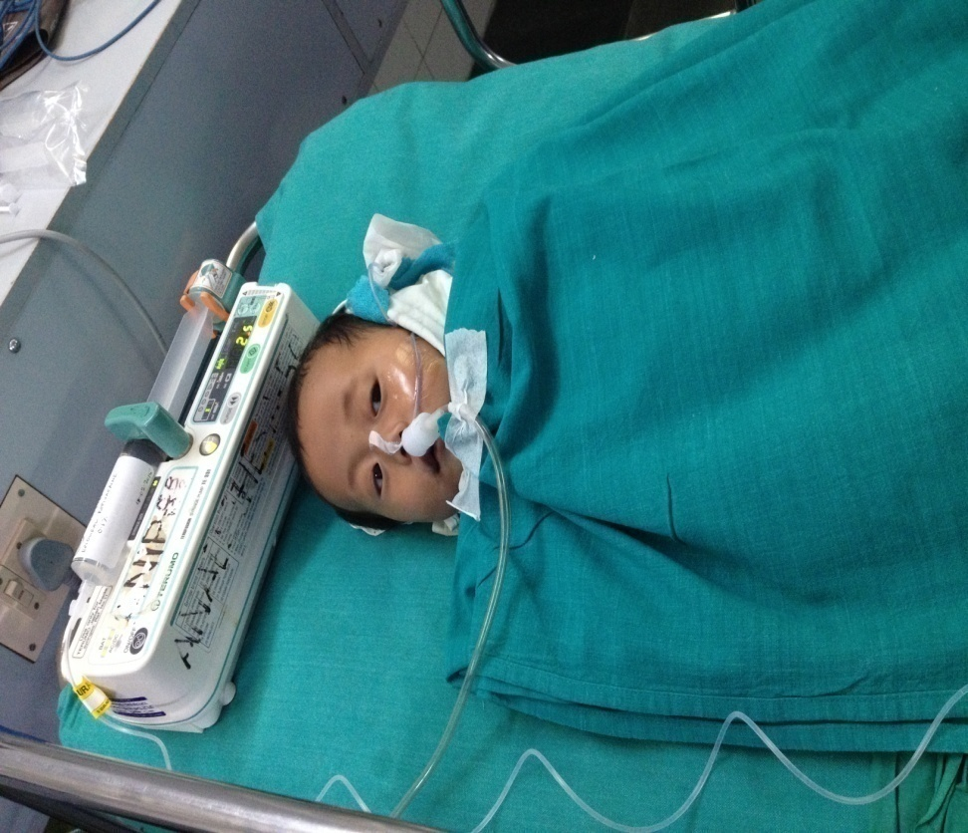
Opinions
Surgeon
Alert ; Quiet; Playful even with Drip on..
Comfortable and composed Older children
Improved used of analgesic techniques

Slide 18
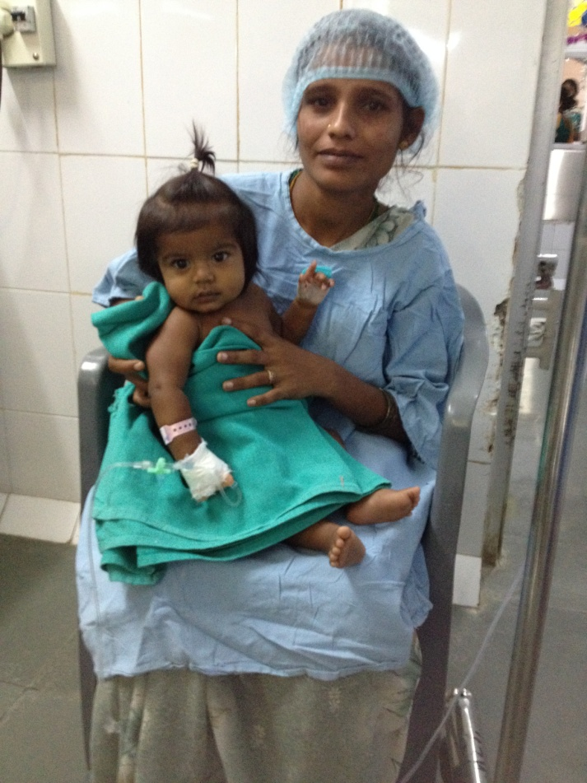
Nurse’sOpinion
Children walking to OT
Comfortable kids in recovery

Slide 19
Thank you

