Slide 1
Quality Management in radiology & Medical imaging
Dr. Madhavan Unni. MD.,DMRD.
KIMS, Thiruvananthapuram.

Slide 2
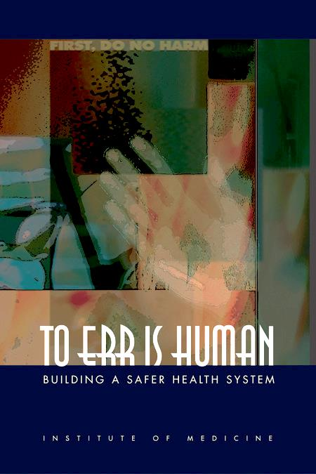
This report, released in 1999, made a paradigm shift in the way we looked at Medical Errors and at
Quality in medical care delivery.
It stated that errors cause between 44000-98000 deaths per year in American hospitals.
It called for 50% reduction in errors over a 5yr period by advocating a comprehensive approach to improve quality of health-care delivery

Slide 3
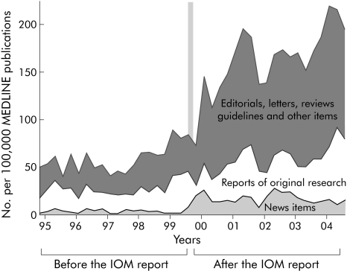

Slide 4

Quality means doing it right, when no one is looking
- Henry Ford

Slide 5
Several important trends are making Quality the centre of attention for Radiologists and the parties judging them.
Radiology is becoming more visible and central in health-care delivery
There is exponential growth in Medical Imaging
Imaging is increasingly performed by non-Radiologists
Commoditisation of Radiology services in the global market-place, after introduction of PACS and Teleradiology
Responsibility for quality is fundamental to professionalism in Medicine and Radiology

Slide 6
Quality in Radiology means the right examination for the right patient,
done in the right way, at the right time, and for the right reason.
This has to be followed by prompt and correct interpretation, quickly
communicated to referring physician and the patient.

Slide 7
RADIOLOGY QUALITY MAP
Ordering of Rad. exam
Scheduling Appointment
Initial Radiology encounter
Exam. Protocol selection
Exam. happens
Interpretation of Images
Report finalisation
Communication of results
Patient outcome

Slide 8
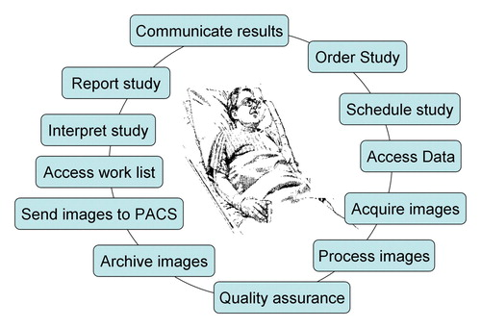

Slide 9
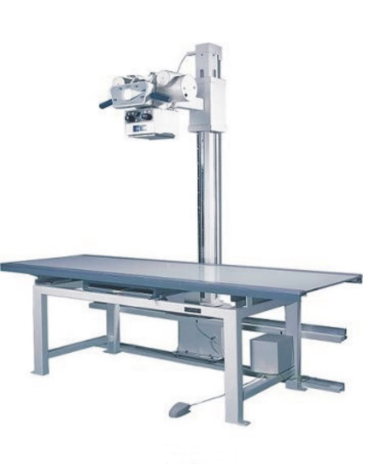
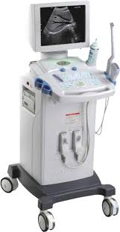
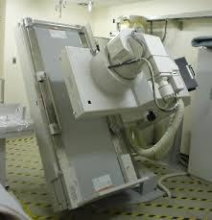
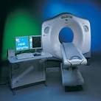
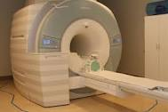
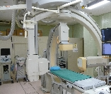
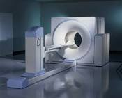
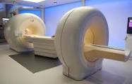

Slide 10



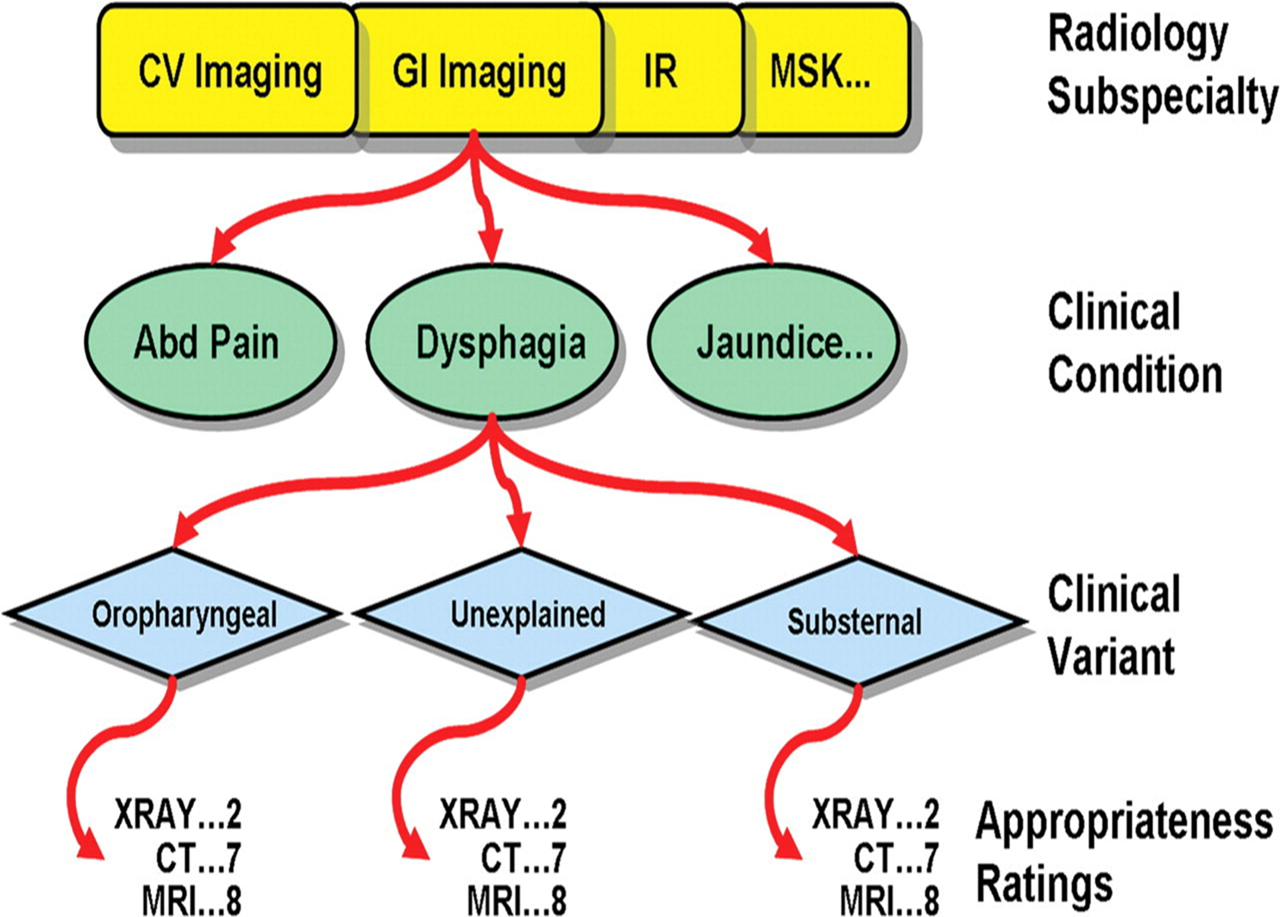

Slide 11
TOTAL QUALITY MANAGEMENT
QUALITY CONTROL
QUALITY ASSURANCE
QUALITY IMPROVEMENT

Slide 12

Quality Control in Radiology
Regular testing and preventive maintenance of equipment
Evaluation of Image Quality
Evaluation of processing parameters
Regular validation of reports
Prompt archiving and retrieval of images
Measurement of Radiation Dose

Slide 13

Constituted by President of India on 15th Nov 1983,to carry out regulatory and safety functions related to ionising Radiations.
Its functions include
-Develop safety codes for siting, construction, commissioning and operation of different
types of radiation facilities.
-Grant consents for the above, after appropriate safety review
-Ensure compliance of the regulatory requirements by periodic review and regulatory
inspections
-Prescribe acceptance limits of radiation-exposure for radiation workers and for members
of public.

Slide 14
Quality Assurance in Radiology
Access to services
Appropriateness of utilization
Timeliness of scheduling
Patient pre-screening
Protocol selection
Waiting time
Technical efficiency
Patient Safety
Image Interpretation
Prior imaging availability
Repeat rate
Missed Diagnosis rate
Pathological/ Surgical correlation
Critical finding reporting

Slide 15


Slide 16
Quality Improvement
Proactive processes that aim to improve quality of care and services to the extent that it exceeds customer expectations.
Highlight and correct mistakes.
Analyse, understand and improve the work process.
Accept quality management as a dynamic and never-ending routine.

Slide 17
Essential Components of a Quality Improvement System
Institutional Leadership and support
Just Culture for Quality and Safety
Process for management of Customer relations
Quality Management Team
Continuous engagement of all staff in the Quality Process
Use of appropriate tools/ metrics

Slide 18
Metrics for Radiology report Quality
Timeliness
Accuracy
Reliability
Brevity
Clarity
Clinical relevance
Use of standard Lexicons
Structured reporting

Slide 19
Metrics for safety in Radiology
Labelling
Wrong side studies
Procedural complications
Medication errors
Falls
Infections
Contrast Reactions, CIN / NSF
Critical Test Reporting
Radiation / MR safety

Slide 20
Any QA program lacking genuine interest from its staff and initiated only as a regulatory requirement is unlikely to produce optimal results

Slide 21

Quality is never an accident. It is always the result of intelligent effort. -John Ruskin

Slide 22






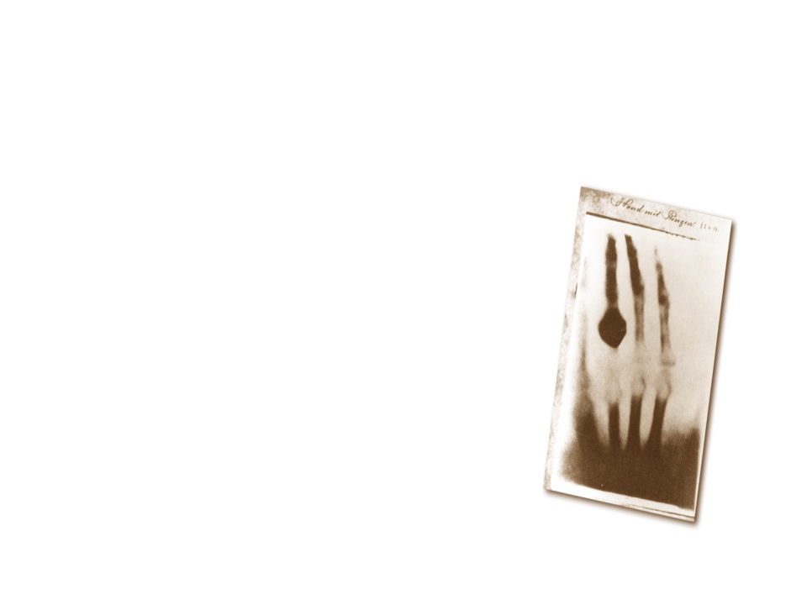
Notes:
It all started with a new kind of ray. In the late 1800s, Wilhelm Roentgen first produced and detected electromagnetic radiation in a wave length now known as X-rays. Initially, this new kind of ray was used in sideshows and for photography. Gradually, X-rays began being used for medical applications.

Slide 23
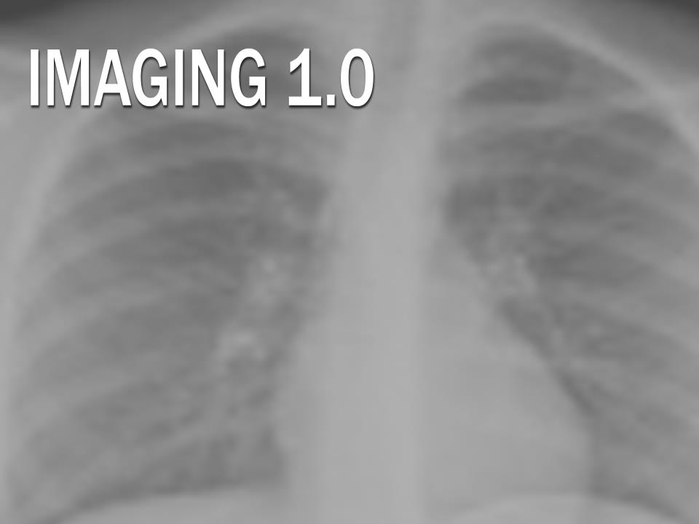
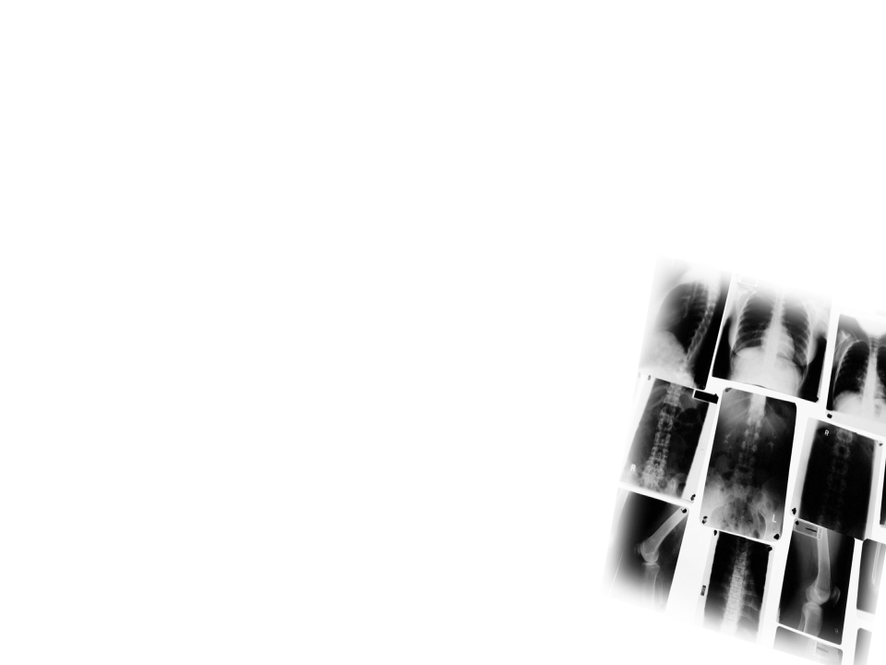

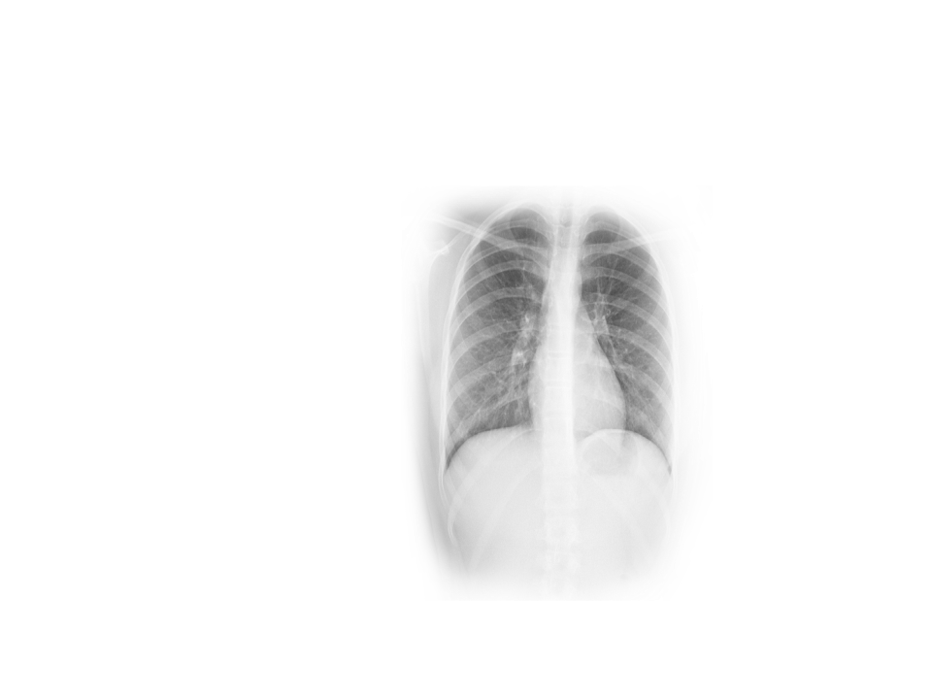
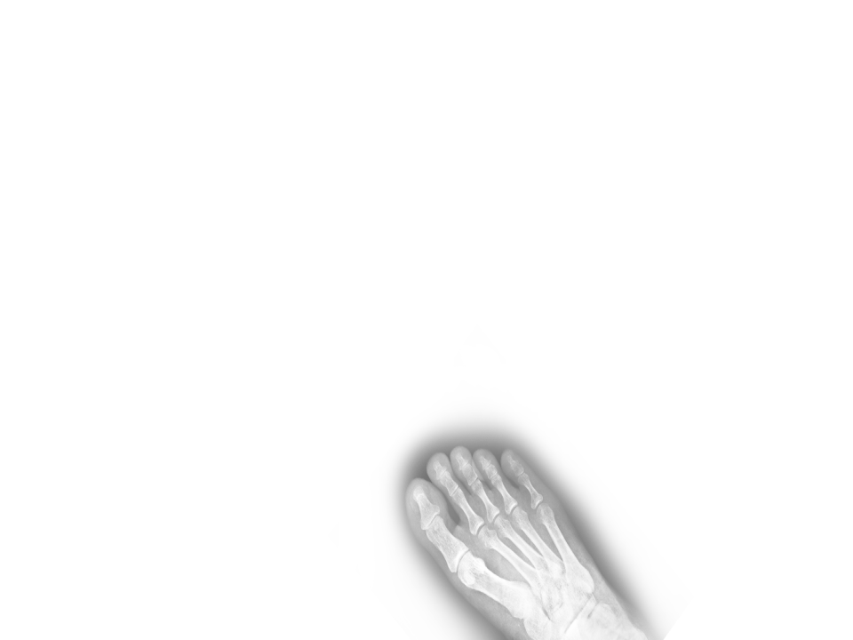
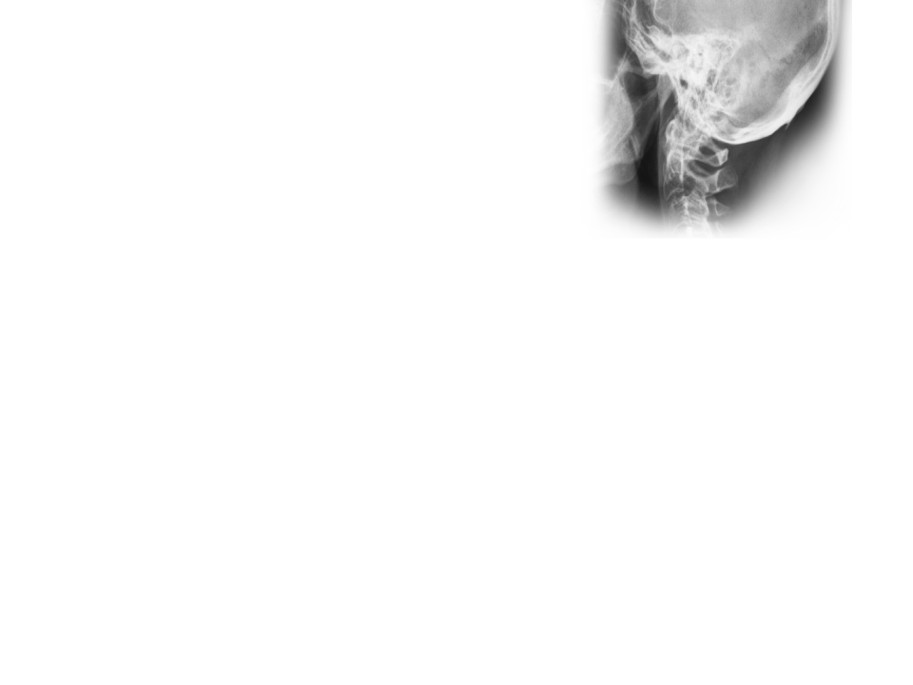

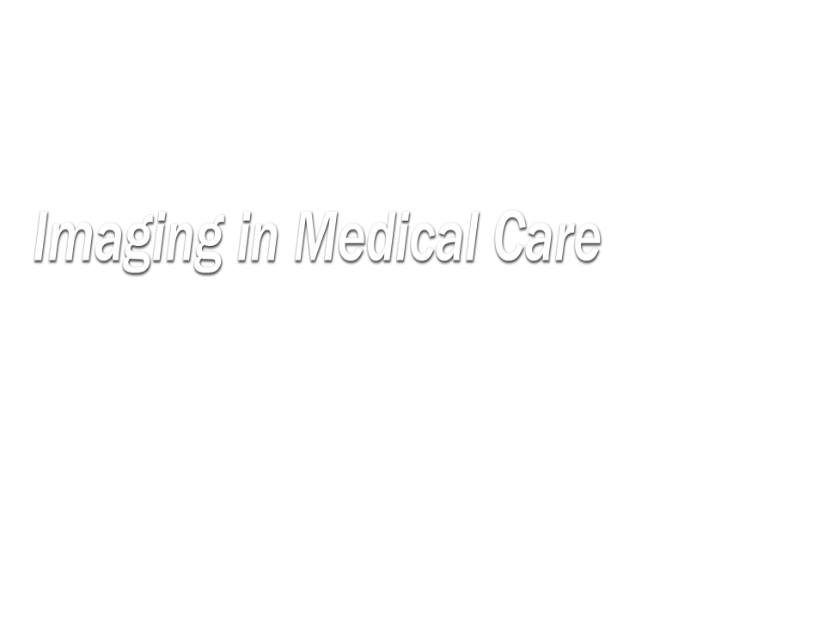
• Physicians
• Contrast Agents
• New Modalities
Notes:
In this first generation of medical imaging, physicians began embracing this capability to diagnose and treat patients. We developed new contrast agents and new modalities. Imaging 1.0 lasted from 1920 to 1990.

Slide 24

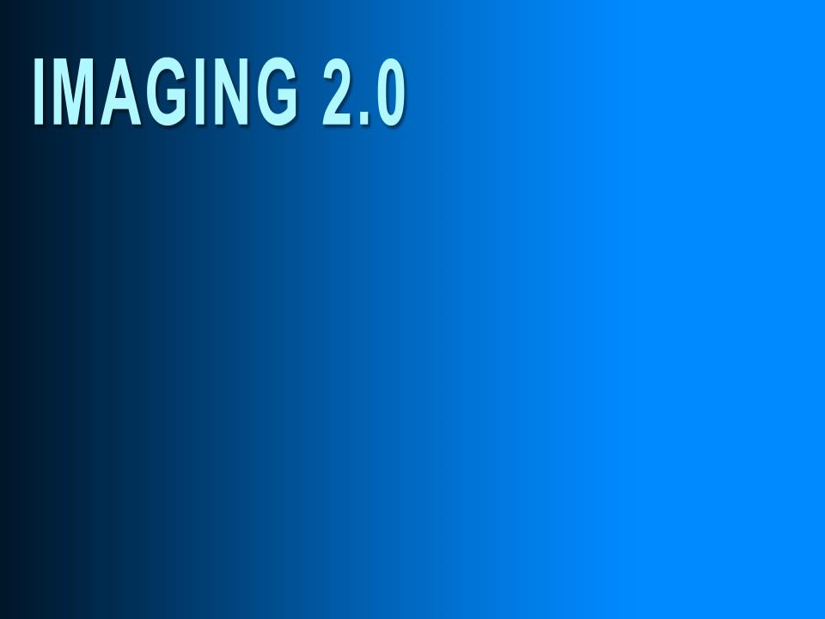
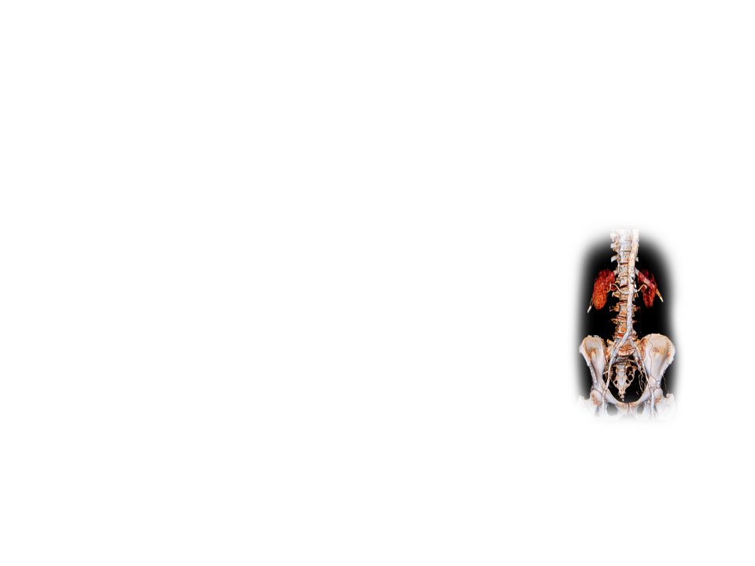


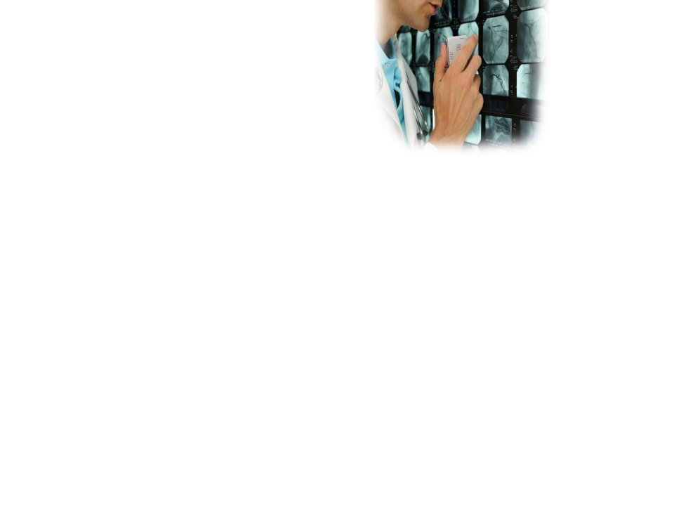
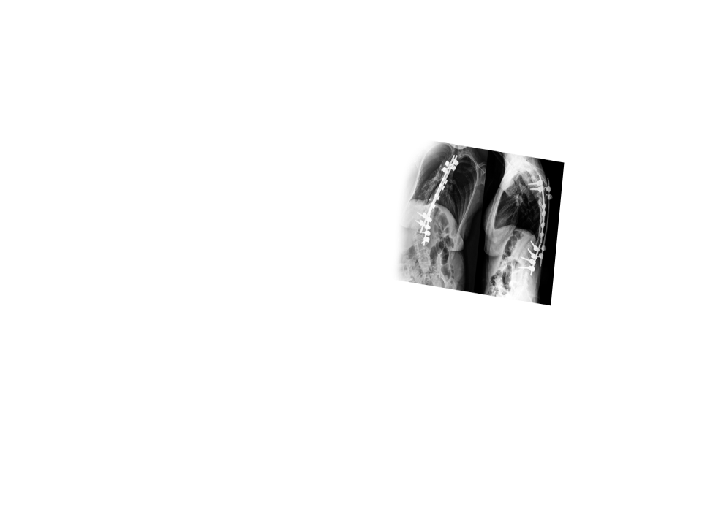

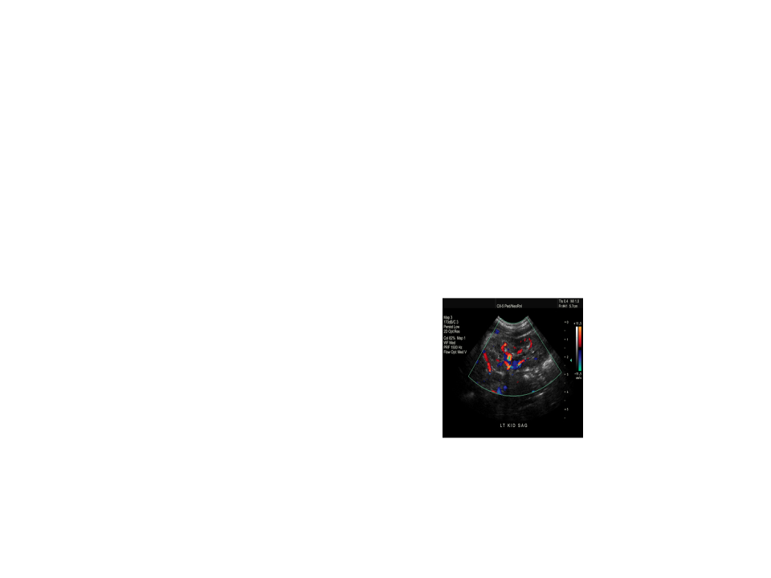
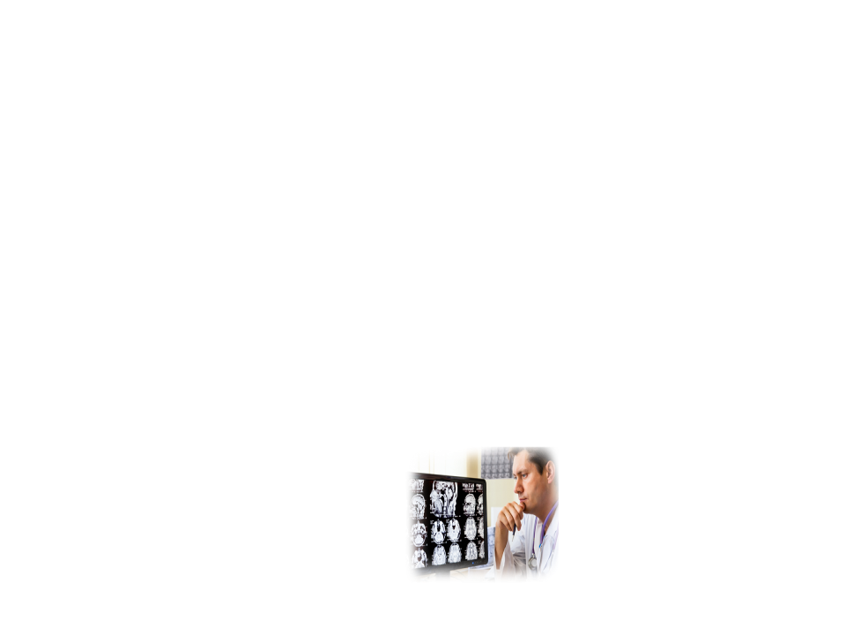

Evolving Modalities
PACS
Knowledge Base
Consultant to Referring Physicians
Unprecedented Demand
Notes:
Imaging 2.0 has been characterized by an explosion of technology. We have more new modalities than ever before. We have seen the advent of PACS and expanding knowledge bases. Radiologists became consultants to referring physicians. We saw unprecedented demand for what we do, and we became indispensible to the health care model.
But now things are changing again…

Slide 25
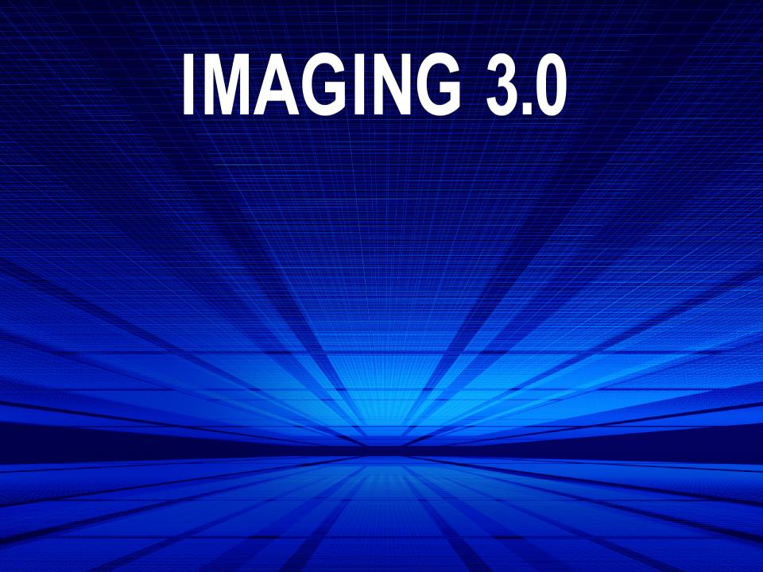


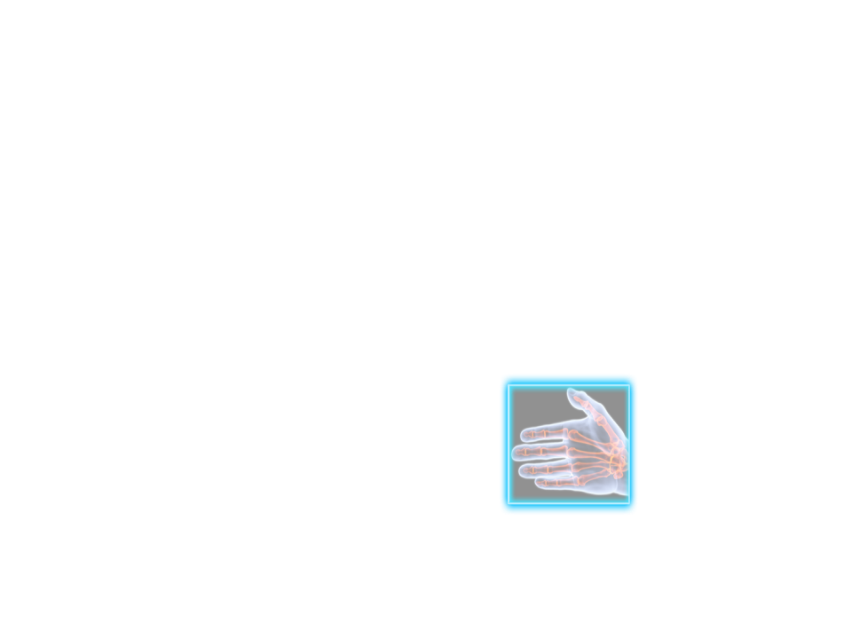
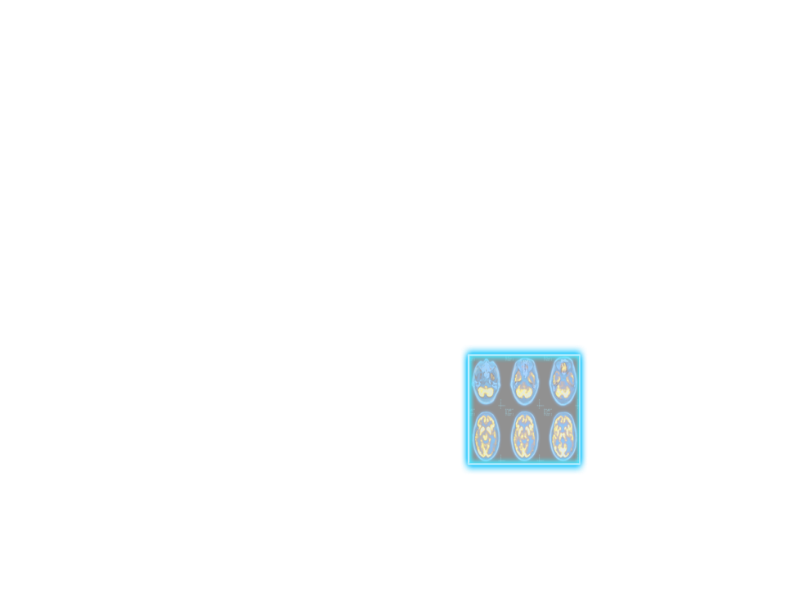

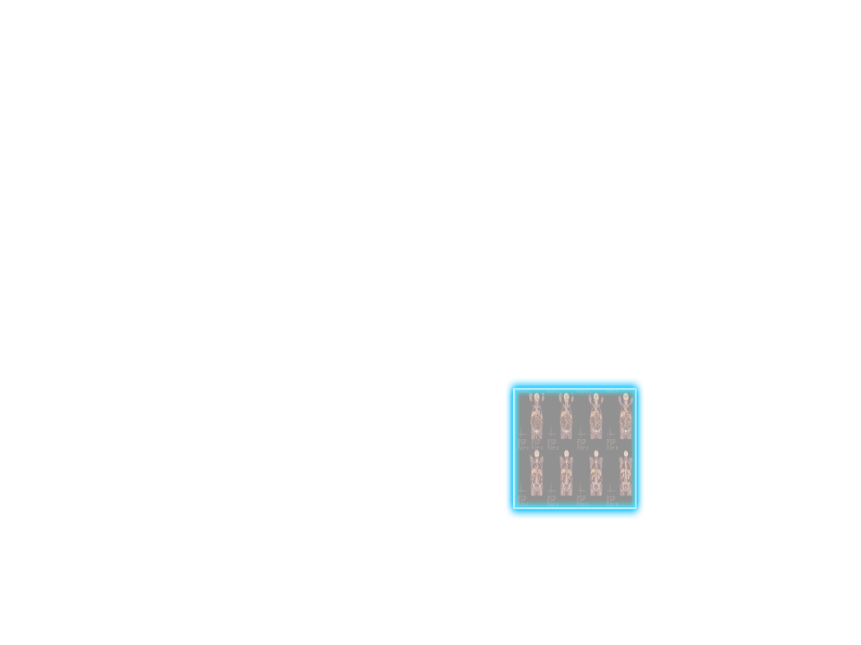
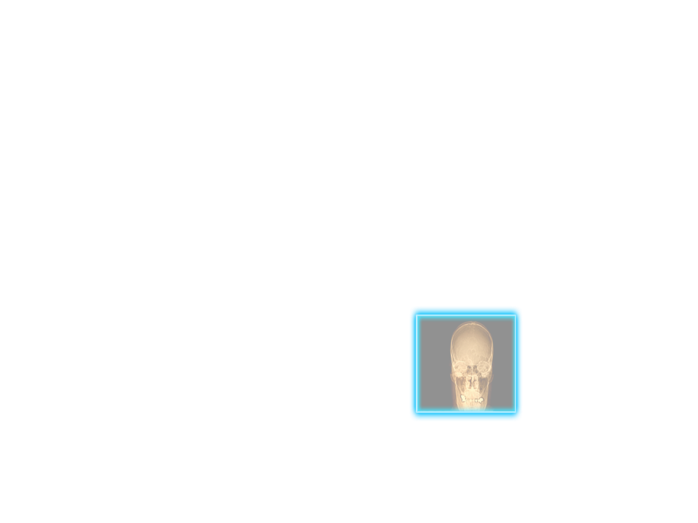




Beyond Interpretations
Assuring Appropriateness
Documenting the Quality and Patient Safety Radiologists Provide
Actionable Reporting with Evidence-based Follow-up Recommendations
Empowered Patients
Notes:
What exactly is Imaging 3.0?
Imaging 3.0 is our framework for the future of radiology. It is our blueprint for providing high-value care. As we move beyond interpretation, we must:
Assure that what we do is appropriate.
Document our quality and safety.
Ensure actionable ways to report our results and evidence-based recommendations.
We must empower our patients.

Slide 26
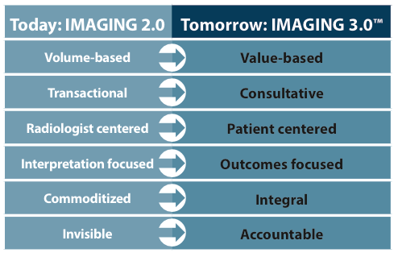
The Future Of Imaging Care
Notes:
As we make the shift from Imaging 2.0 to Imaging 3.0, here are the transformations that must occur.

Slide 27

Thank You!!

