Slide 1


Energy Efficiency Project
At Consortioum of Accredited Healthcare Organizations (CAHO)
THROUGH EESL’S ESCO MODE
Presented by:
ENERGY EFFICIENCY SERVICES LTD.
(A JV company of PSUs of Ministry of Power, Govt. of India)

Slide 2

Energy Efficiency Services Limited
EESL
NTPC
REC
PFC
POWER GRID
100% public owned company
Promoted by Ministry of Power, Government of India
Board of Directors represented by Ministry of Power and Bureau of Energy Efficiency (BEE)
Authorised share capital – Rs. 500 crore

Slide 3
Existing Business Areas
Business Areas for EESL
DELP - Tube light
MSME
Energy Efficient Ceiling Fans
Energy Efficient Air-conditioners
Municipal DSM (Water pumping)
Agriculture Solar Pumping systems
Energy Efficient Chillers
Smart Grid
Tri-generation
Domestic Energy Efficient Lighting Programme (DELP)
Street Lighting
Agriculture Demand Side Management (Ag DSM)
Building
Consulting
Areas for Diversification
Energy Efficiency market potential of INR 1.50 Lakh Crore

Slide 4


Energy conservation strategies in hospitals
HVAC Equipment
Lighting Systems
Building Controls
IAQ
EE appliances & practices
Renewable energy
Building Envelope
Water Conservation
Technology Up-gradation
Design
Energy Training

Slide 5
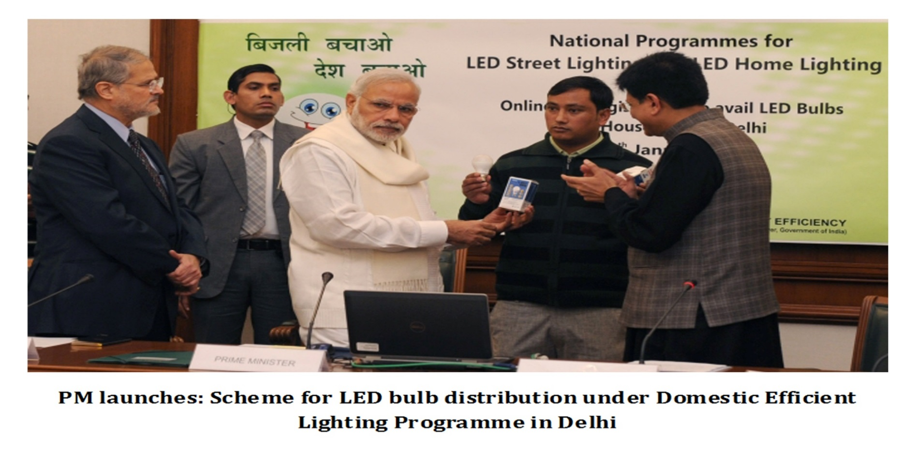
LED based Home and Street Lighting Programme
Programme has 2 components
Conversion of conventional domestic lights with LEDs, and
Conversion of conventional street lights with LEDs,
- 100 cities to be covered by March, 2016 and balance by March, 2019 targeting 77 crore ordinary bulbs and 3.5 crore conventional street lights

Slide 6
Benefits of the LED Programme
Domestic Efficient Lighting Programme (DELP)
Replacement of 77 crore ordinary bulbs will result in savings of 100 billion units annually and Rs. 40,000 crores in consumer bills
Average reduction of electricity bill of consumers by Rs. 160-400 per year per LED
Street Light National Programme (SLNP)
Replacement of 3.5 crore conventional street light will result in savings of 9,000 million units annually
Total cost savings of municipalities every year will be Rs. 5,500 crore
Notes:
2668232+3819000

Slide 7
Innovative Service Model
Major barriers –
High price of LED;
Insufficient availability;
Lack of sufficient awareness.
Service model devised wherein there is no need for upfront capital investment by ULBs. Domestic consumers to get LED s in easy installments with initial payment of Rs. 10
The cost recovery will be done in installments over 7 year period for ULBs and 8-12 months for domestic consumers

Slide 8
Coverage of Programmes - DELP
7.95 Crore bulbs distributed ^{as on 17.03.16}
Programme successfully running in 10-states
245 cities enrolled/ proposed to be covered in the programme
Work completed in 7 cities
Agreements signed with 137 cities, across Puducherry, AP, Rajasthan, Maharashtra, UP, Delhi, HP, Uttarakhand, Karnataka, and Jharkhand
Agreements with 101 more cities in final stages
10 crore LEDs to be distributed by March 2016

Slide 9
Coverage of Programmes - SLNP
7.24 Lac street lights installed ^{as on 17.03.16}
Programme successfully running in 6- states
303 ULBs enrolled in the programme
Work in 30 ULBs completed
Installation in progress in 77 ULBs to replace 2.11 Lac lights
Agreements with 196 municipalities under finalization
10 Lac LEDs to be installed by March 2016.

Slide 10
Buildings’ Projects
Union Public Service commission(ESCO model)
ESCO being taken up in association with UPSC.
Shram Shakti Bhawan (Deferred Payment Model)
Energy Efficiency retrofits for all 3 Ministries – Power, Labour and Water
Project Completed by EESL on ESCO model.
8% on bill energy savings achieved
Project Investment – Rs. 120 Lacs, Energy Cost Savings Rs. 40 lacs
Niti Aayog Phase 2 (ESCO Model)
Project to be taken up on ESCO with CPWD ECD 1 – Investment of Rs. 2 Crores energy + Maintenance cost savings of Rs. 45 Lacs
120TR chiller system to be deployed in addition to thermal and lighting controls, LED lights and portable AC
Agreements being negotiated due to high capital investment for chillers
IP Bhawan (ESCO Model)
ESCO being taken up in direct association with CPWD ED 16
Project Investment – Rs. 2 Crores, E&M Cost savings of Rs. 55 Lacs per year
Project Period of 5 years, EESL share 92% of estimated cost savings
Nirman Bhawan (ESCO Model)
ESCO being taken up in direct association with CPWD ECD 1
Project Investment – Rs. 2.5 Crores, E&M Cost savings of Rs. 80 Lacs per year
Project Period of 5 years, EESL share 82% of estimated cost savings
Project investment- Rs.120 LACS, E & M annual cost savings Rs.50 LACS.

Slide 11
Buildings – Scaling Up
MoU signed between EESL and CPWD for implementation in 100 government buildings in the country
MoU being signed between Ministry of Railways and EESL to implement efficiency measures in buildings, stations, etc
Discussions with large PSUs like ONGC, NLC and Banks (Dena Bank) for implementation of similar projects
DMRC project for 90-metro stations for lighting
Notes:
. It is noteworthy to mention that the LED bulbs are sold at Rs.400-500 in the open market. EESL process has been very successful in the past and the prices of LED bulbs have reduced by more than 65% in the last 6-8 months as a result thereof

Slide 12
ESCO Based implementation
Entire Capital Cost arranged by ESCO – no budget provision required
Financial risk borne by ESCO subject to payment security
Payments based on technical performance – with adequate balancing of risks by using deemed savings model
Deemed approach with minimal impediments related to baseline variation
Annual monitoring and verification by 3rd party independent agency
Type A International project measurement and verification protocol (IPMVP) for projects globally accepted
Competitive bidding to ensure procurement of best available products back with maximum field warranties at best cost
Increased energy cost savings due to increased tariff or better performance by new equipment shall be to the advantage of the client.

Slide 13
Key provisions of ESCO Agreement
EESL to invest the capital up-front without any collaterals from client.
Debt: Equity Ratio of 80:20 to source best cost of capital
EESL Interest liability of 11% but in case of any lower rate available, the same shall be passed onto the client.
Equity returns of 14% on post tax as per public norms
EESL service fee for Project Management of 12% estimated investment as per approved board approval
Technical accuracy of project on EESL – BEE to act as facilitator
Deployment of EESL technicians at the concerned building for immediate rectification of faults.

Slide 14
ESCO in 18 Central govt. buildings
MoUD and MoP have collaborated to initiate an endeavour for harnessing energy savings in various central govt. buildings in Delhi
Under this initiative, CPWD and EESL have signed ESCO agreements for 18 buildings in Delhi
Annual Energy Savings – 12 Mn Units
Equivalent Cost Savings – Rs. 105 Mn per year
Estimated Investment to be arranged by EESL – Rs. 30 Crores including EESL PMC fee 8%
Contract Period – 5 years
EESL to resort to open competitive bidding and any reduction in prices to be passed onto CPWD
EESL shall be liable for technical and financial risks, undertaking from JS MoUD received regarding diversion of CPWD’s non-plan funds to EESL in case of payment default by CPWD

Slide 15
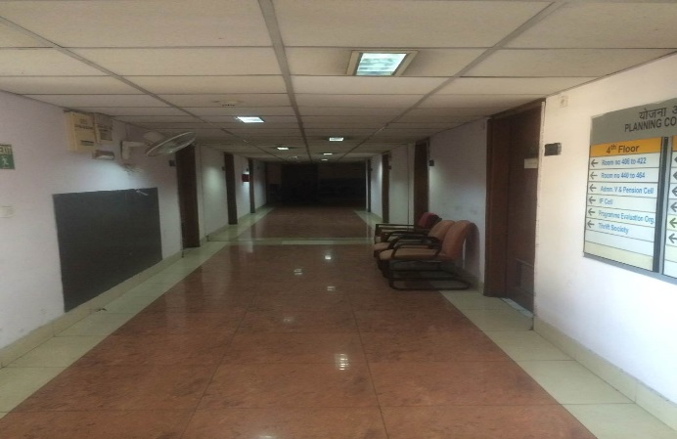
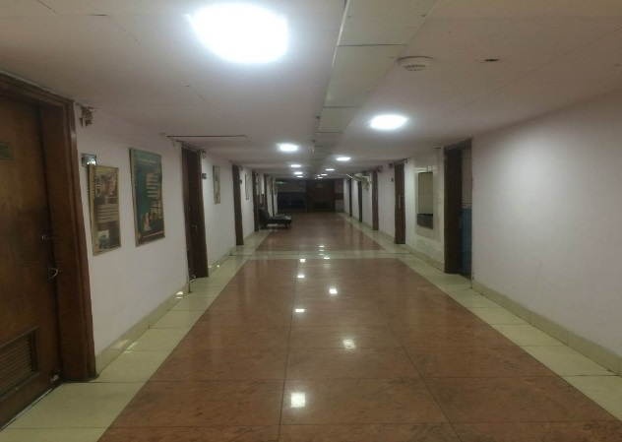
Building Projects
Niti Aayog (Before)
Niti Aayog (After)

Slide 16
Indian Medical footprint(Energy Terms)
Average Indian household spends nearly 6% of annual income on healthcare.
There are an estimated 35000 medium to large scale hospitals with almost similar number of smaller nursing centres.
These buildings account for high energy consumption – between 5 to 9 Bn units
Major Energy Consumption centres:-
Lighting – upto 40%
Air-conditioning – upto 50%
Process Heating – upto 10%
Water Pumping – upto 15%
Others – upto 10%

Slide 17

Let us paint...
Make India Green!!

