Slide 1
Barriers to Implementation- In intent and spirit
Lallu Joseph
Quality Manager
CMC, Vellore
(Currently on sabbatical with CAHO as Technical Advisor)

Slide 2
Disclaimer
This presentation has the views of the speaker through her journey on implementation of the accreditation standards as quality manager and as a principal assessor for NABH. The views expressed are purely personal.

Slide 3
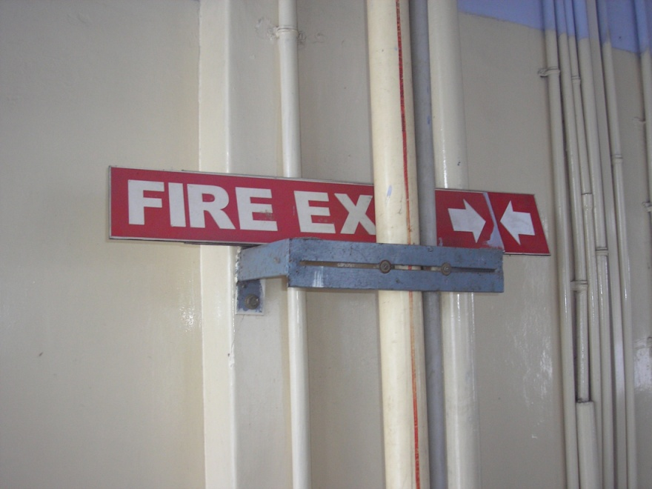
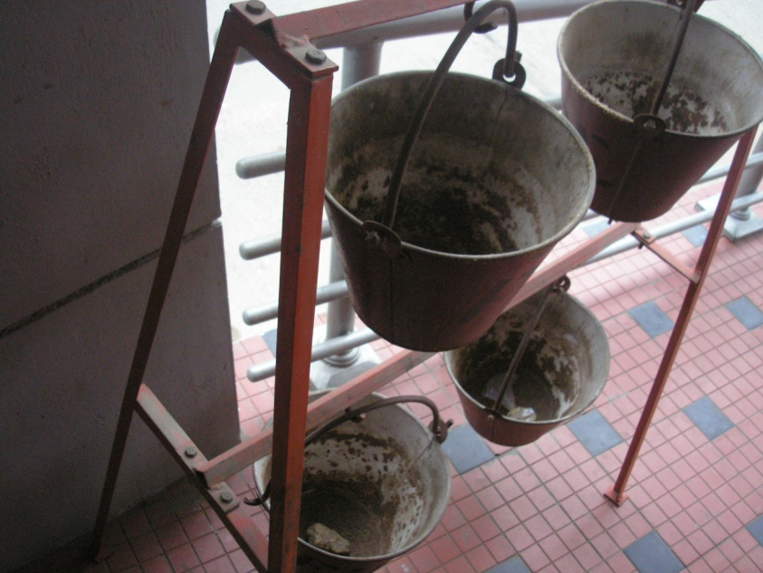
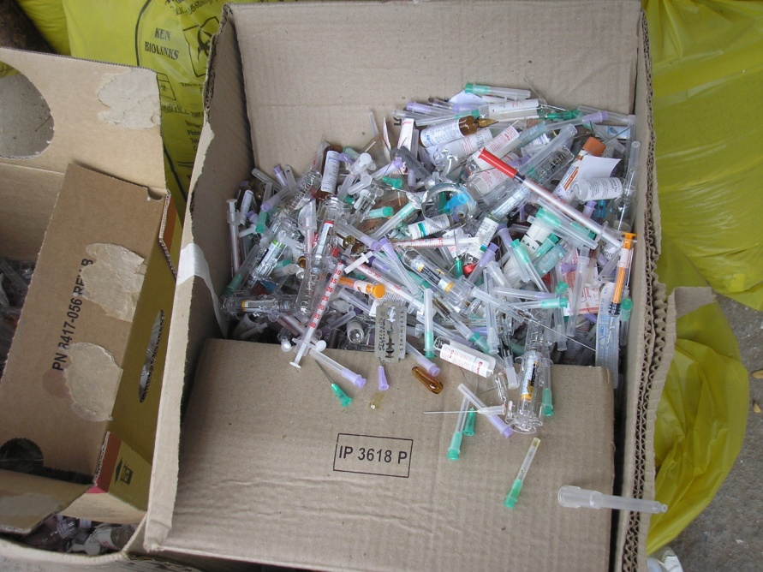
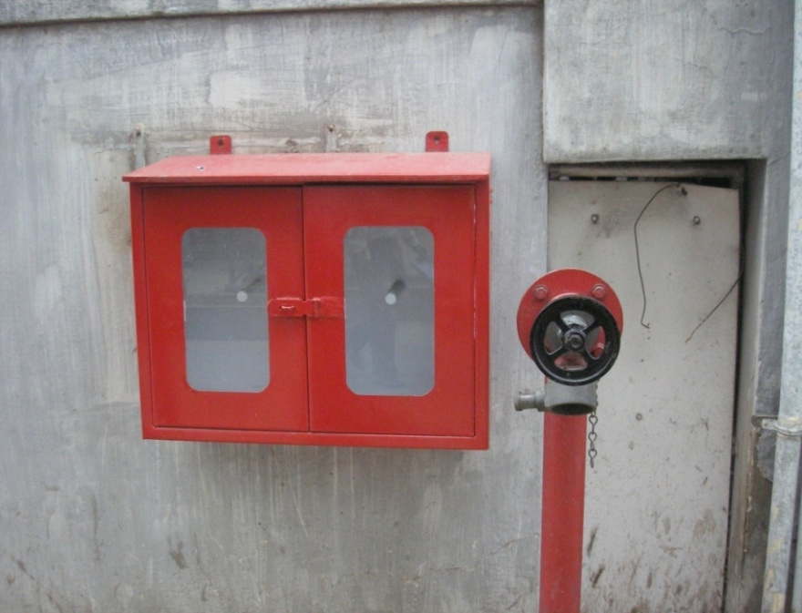

Slide 4
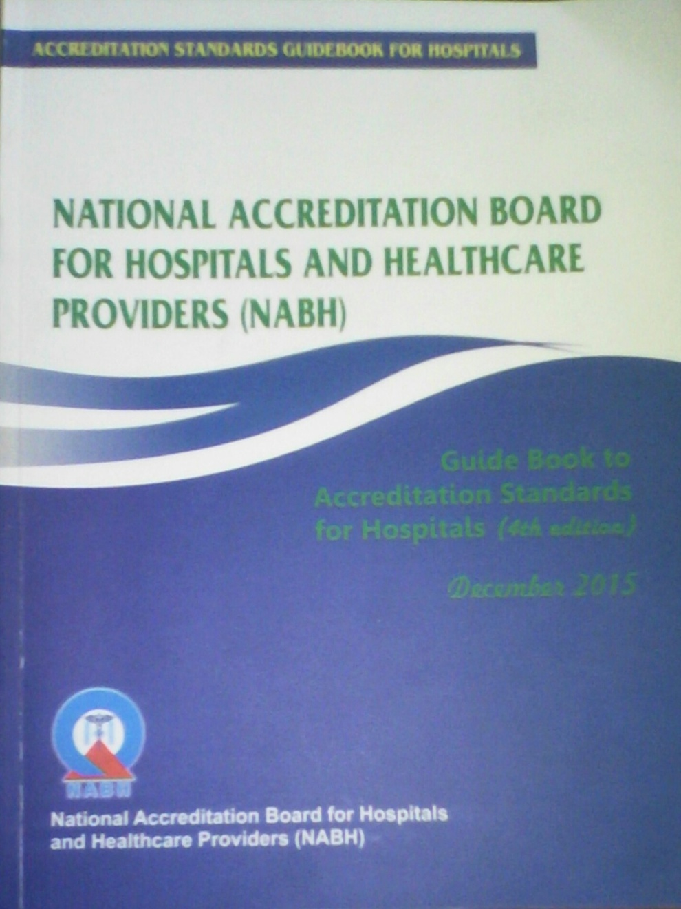
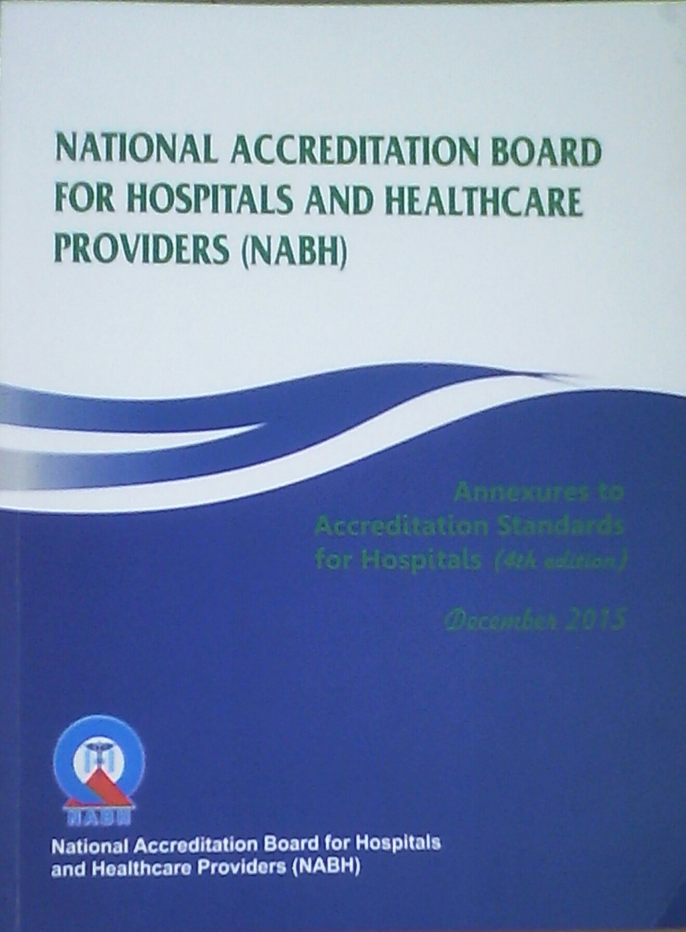

Slide 5
What are the barriers??
Lack of understanding of the intent and the standards
Myths of clinicians and seniors
Closures of deficiencies- Low hanging fruits.
Not seen as a team exercise, but as the job of the quality team- seen as a police force.
Financial implications.
Standardization of assessment.

Slide 6
Lack of understanding of the intent
Implementations resulting in more confusion than before
Scope of services
LASA Medications
Crash cart
Narcotics storage
Calibration of equipments
Quality indicators
Committees
Clinical audits

Slide 7
Myths of clinicians and seniors
Accreditation involves excessive and unwanted documentation
It infringes on the autonomy of the clinicians
It makes healthcare delivery expensive
I have been doing this many years, who are they to tell me how to do
Accreditation expects me to tell the patient the expenses, risks, benefits, complications etc..
Diet, pain, rehabilitation and prevention are not my business

Slide 8

Closures of deficiencies- Low hanging fruits.

Slide 9
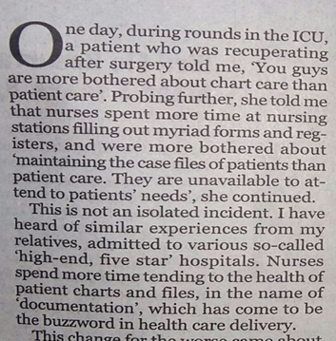

Slide 10
Introducing forms and templates for closing NCs
Too many formats in circulation
Lack of co-ordination between teams
Just filled for the sake of documentation

Slide 11
Not a team exercise
Not seen as a team exercise, but as the job of the quality team- seen as a police force.
Quality team audits
Collects data and indicators
Conducts committees
Analyses the data for the sake of accreditation
Stake holders are not informed

Slide 12
Financial Implications
Compromise on safety- fire installations, HVAC etc
Personal protective equipments and other infection control practices
Equipment maintenance
Inadequate and unqualified staff

Slide 13
Standardization of assessment
Lack of standardization between assessors
Try to push their point of view
Unnecessary observations

Slide 14


Slide 15
Understand the standard and the objective elements- Ask why, why, why,…..
Attend POI
Don’t copy from others- Your hospital, your patients, your staff
Team exercise- from doorman to chairman
Take NCs as improvement points and use them as improvement projects
Handle clinicians with care- with data and evidence, work around them
Be careful with closures and don’t do a superficial job- Don’t complicate

Slide 16
