Slide 1

Quality Beyond Accreditation
Prof. Anupam Sibal
MD, FIAP, FIMSA, FRCP (Lon), FRCP (Glas),
FRCPCH, FAAP
Group Medical Director | Apollo Hospitals Group
Senior Consultant Pediatric Gastroenterologist and Hepatologist

Slide 2
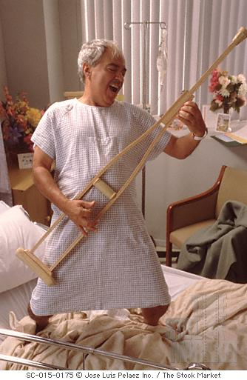

Slide 3

ISO 9001:2008
ISO 22870:2006
ISO 14001

Slide 4












Slide 5

323 Standards + 6 IPSGs
1196 Measurable elements

Slide 6
The JCI journey
The first JCI accredited hospital in India
The first JCI accredited Stroke program in the world
The first JCI accredited hospital in Bangladesh
Indraprastha Apollo Delhi
Apollo
Hyderabad
Apollo
Dhaka
Apollo
Kolkata
June
2005
Apollo
Chennai
April
2006
Apollo
Ludhiana
April
2008
Apollo
Bangalore
June
2009
Apollo
Mauritius
Jan
2006
Feb
2007
July
2008
2012

Slide 7

100 Standards
503 Objective elements

Slide 8


The NABH journey
Apollo Hospitals Bhilai
Apollo Hospital Trichy
ASH, Vanagram Chennai
Apollo Hospitals Bhubaneswar
Apollo Hospital, Kakinada
Apollo BGS Hospitals Mysore
Apollo Hospital
Hyderguda
Apollo Hospitals Secunderabad
Jehangir Hospital Pune
Apollo Hospitals Ahmedabad
Apollo Hospitals Bilaspur
Apollo Hospitals Noida
ASH Nandanam, Chennai
Apollo Speciality Hospitals Madurai

Slide 9


Slide 10


Slide 11


Slide 12


Slide 13


Slide 14


Slide 15


Slide 16


Slide 17
T The
A Artist
F Formerly
K Known
A As
P Prince

Slide 18


Slide 19
T The
I Individual
F Formerly
K Known
A As
P Patient

Slide 20
T The
I Individual
F Formerly
K Known
A As
P Patient
Now A Partner

Slide 21


Slide 22






The patient perspective
Good clinical outcomes
Value for money
Service quality

Slide 23



The physician perspective
Good clinical outcomes
Patient Experience
Conducive milieu

Slide 24


The health insurance perspective
Good clinical outcomes
Lower payouts
Retention

Slide 25


The common thread

Slide 26

ACE @ 25
Clinical balanced scorecard
25 parameters assessed against published international bench marks
Apollo light house

Slide 27

International benchmarks
Cleveland Clinic
Mayo Clinic
National Healthcare Safety Network
Massachusetts General Hospital
AHRQ US
Columbia University Medical Center
US Census Bureau
National Kidney Foundation Disease Outcomes Quality Initiative
(NKF KDOQI)

Slide 28
CABG mortality rate
Benchmark: 0.60%
Numerator :Number of in-hospital deaths after CABG
Denominator: Total number of CABGs conducted
Indicator | Benchmark | Range | Score
CABG mortality rate | 0.60% | ≤0.80 | 4
 |  | 0.81-1.20 | 3
 |  | 1.21-1.60 | 2
 |  | 1.61-2.00 | 1
 |  | >2.00 | 0

Slide 29
One year survival rate for liver transplants
Bench mark: 93.1%
Numerator: Number of living patients one year post liver transplant
Denominator: Number of liver transplants conducted during a defined period
One year survival rate for liver transplants | 93.1% Adult | ≥93.1% | 4
 | Mayo Clinic | 93.00-84.81 | 3
 |  | 84.80-76.61 | 2
 |  | 76.60-68.41 | 1
 |  | <68.41 | 0

Slide 30
Catheter Related Blood Stream Infections (BSI)
Bench mark: 1
Numerator: Total number of CR-BSI cases
Denominator: Total number of catheter (central line ) days
Catheter Related Blood Stream Infections (CR-BSI) | 1 | <1.0 | 4
 | National | 1.01-2.2 | 3
 | Healthcare | 2.21-3.4 | 2
 | Safety | 3.41-4.6 | 1
 | Network | >4.6 | 0

Slide 31
ACE @ 25
Parameters scored as a percentage
Maximum score attainable 100
Over all hospital cumulative scores
50 - 75
< 50
> 75

Slide 32
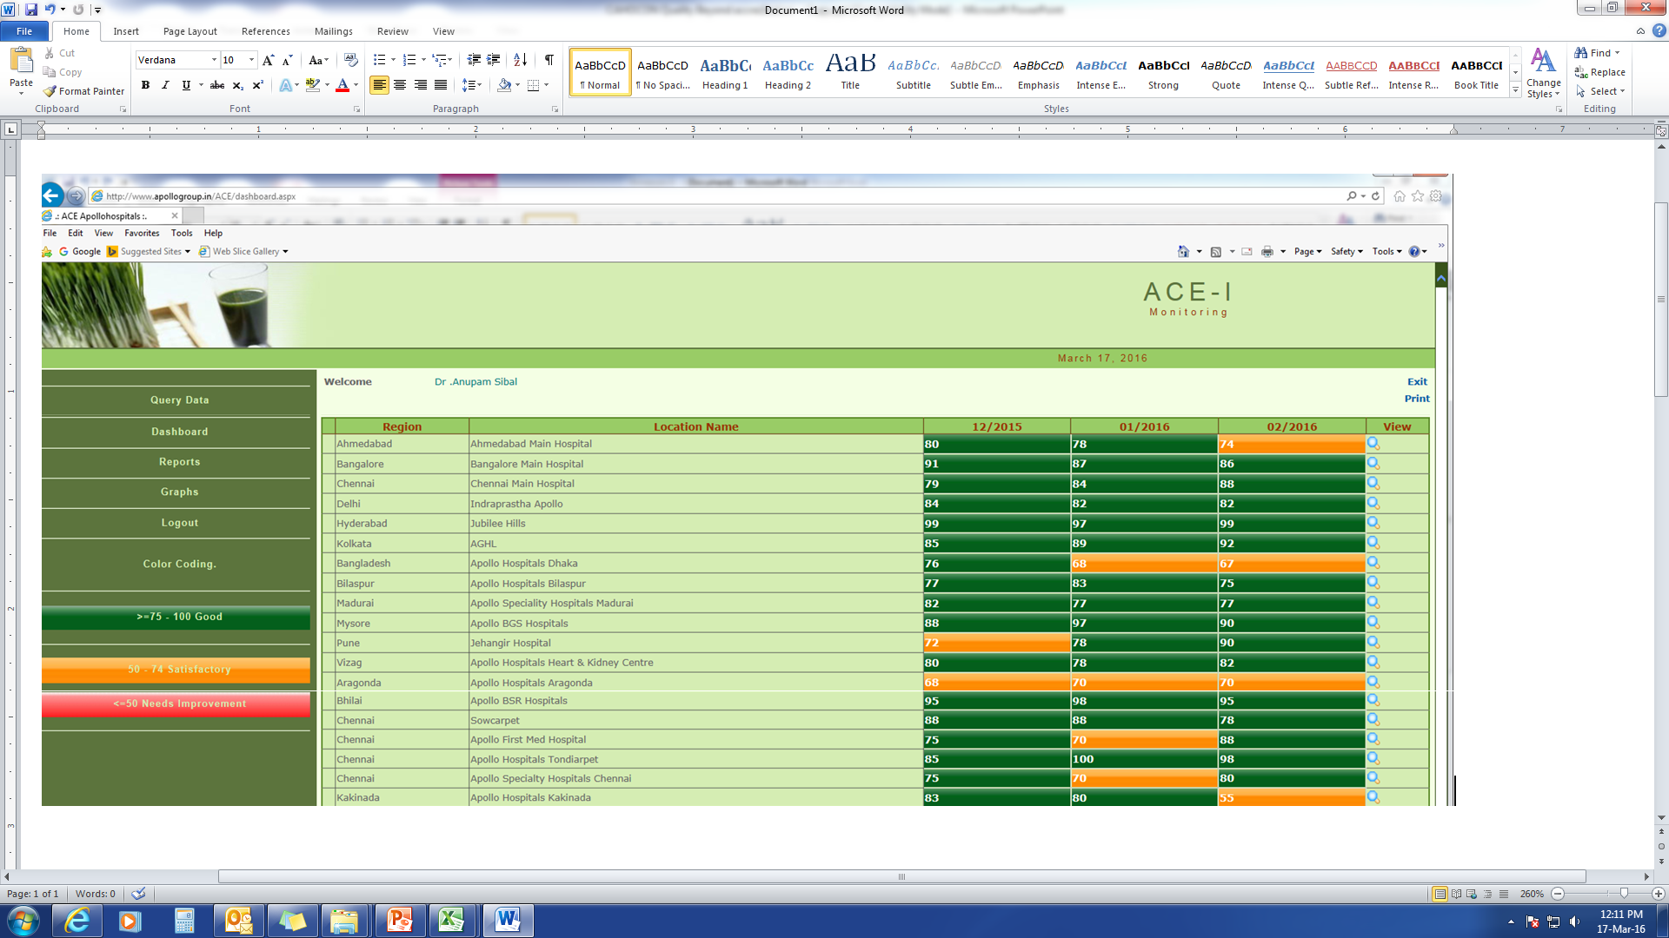
ACE @ 25

Slide 33
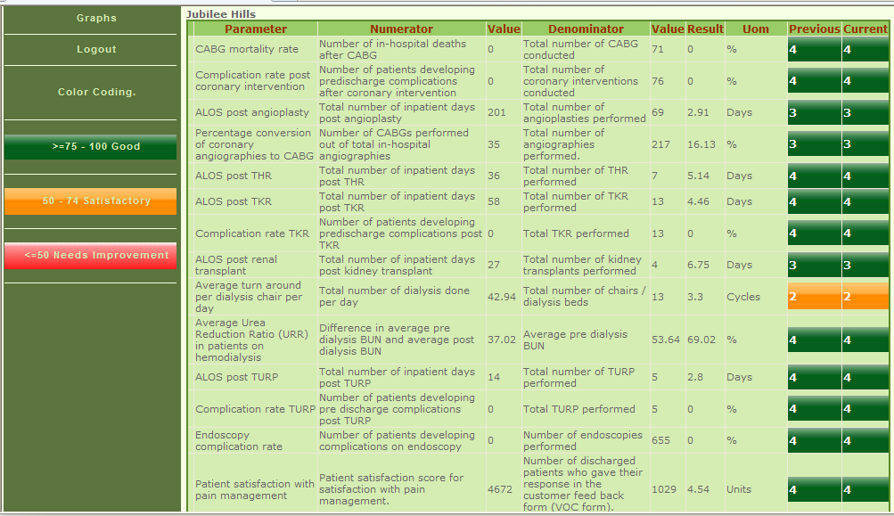
ACE @ 25

Slide 34

Apollo clinical audit team
Standardization of methodology of data collection and validation
Auditor training
Audit guide
Annual and interim ACAT

Slide 35


Slide 36
Sustainability
Started with 6 locations, expanded to 25 in the first year, 32 in the second year, at present, implemented at 42 locations
Group leadership review every month
Quarterly action taken reports to the Board

Slide 37
Sustainability
Medical head’s and operational head’s appraisal
ACE @ 25 awards
After two years of reporting, ACE @ 25 was upgraded to include new parameters and raise the benchmarks

Slide 38
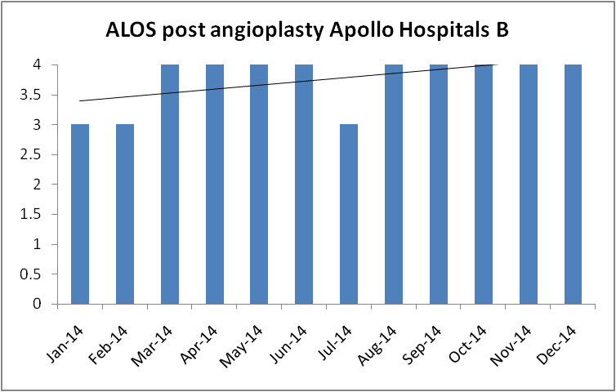
Impact

Slide 39
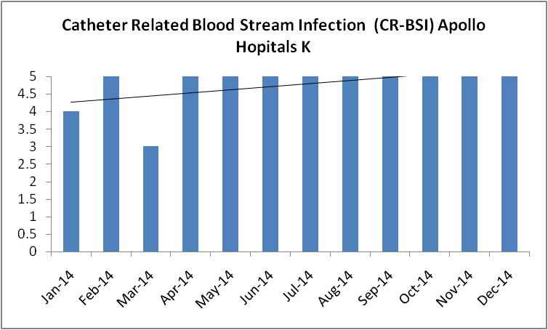
Impact

Slide 40
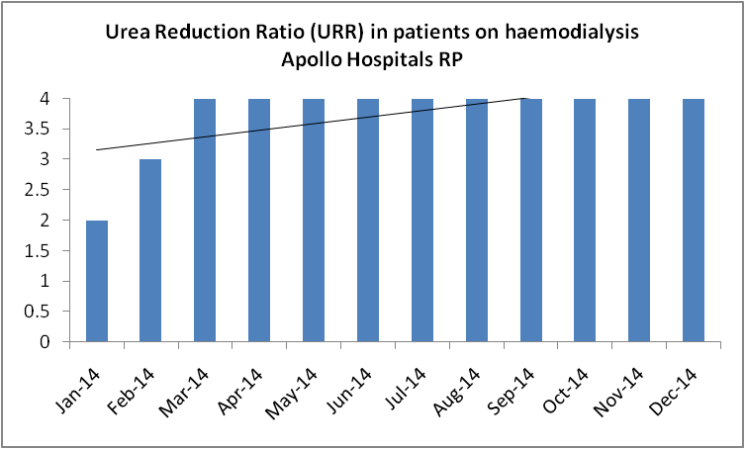
Impact

Slide 41
Impact

Slide 42
Impact

Slide 43
Impact

Slide 44
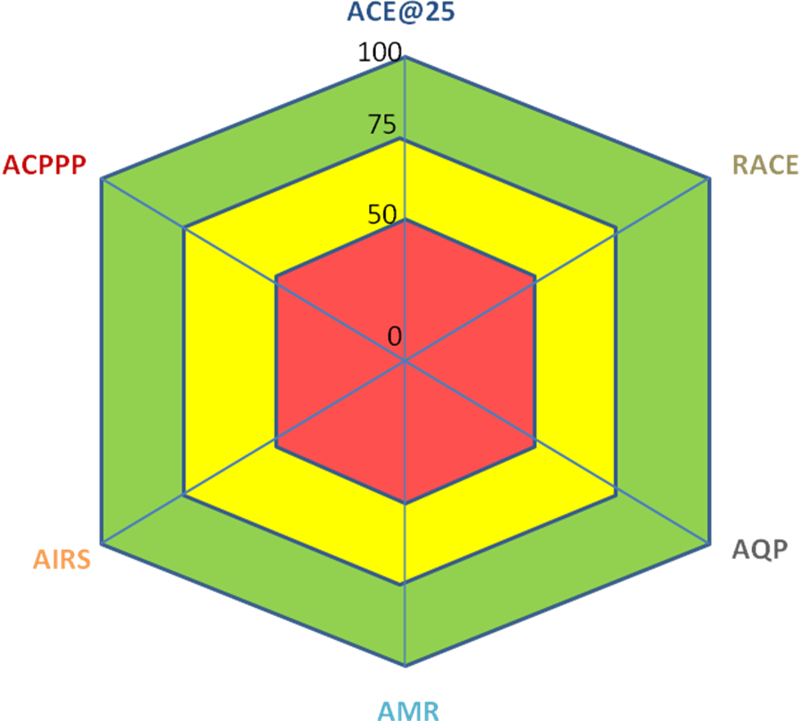
The Apollo Standards of Clinical Care (TASCC)
Apollo Clinical Excellence (ACE @ 25)
Apollo Critical Policies Plans and Procedures (ACPPP)
ACE 2
Apollo Incident Reporting System (AIRS)
Apollo Quality Plan (AQP)
Apollo Mortality Review (AMR)

Slide 45


Slide 46


Slide 47


