Slide 1

Transforming Healthcare-
Leveraging Technology
Som Mittal
Sep 2016

Slide 2
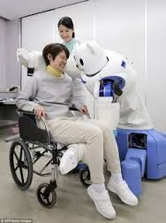
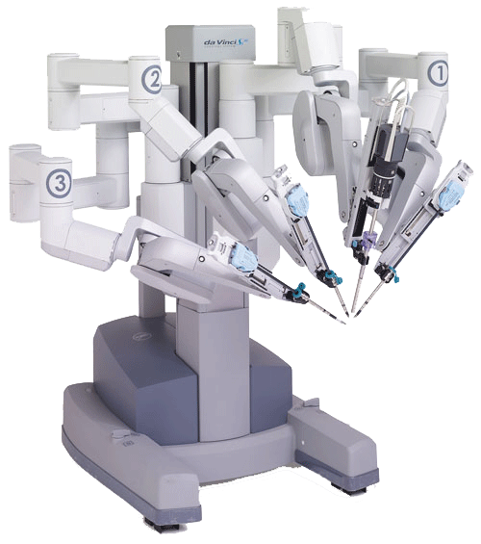

Why is this topic so important?
Healthcare has always leveraged new technologies and delivered high impact.
What is new, What is the hype ?
Is it now or futuristic ?
What is the urgency ?
Are their any barriers ?

Slide 3
What is Digital & Why is it Disruptive ??
Confluence of many new interlinked technologies.
Increased affordability Ever reducing cost of technologies CPU/Storage/Connectivity/smart phones/apps.
Focus shifted to consumer. The consumer /patient is empowered. Personalize & customize offering treatment.
Impactful technologies: Solve important problems and improve lives.
No more good to have they are transformational.

Slide 4

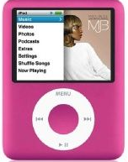

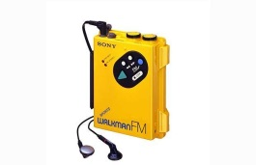



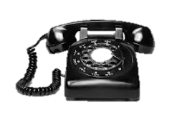



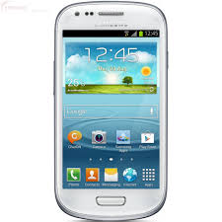



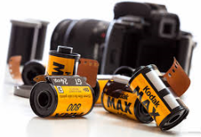

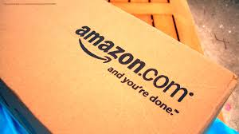

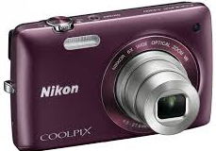
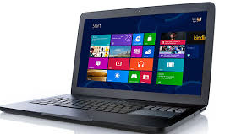
What do these things have in common?
Technology is constantly impacting our lives...

Slide 5
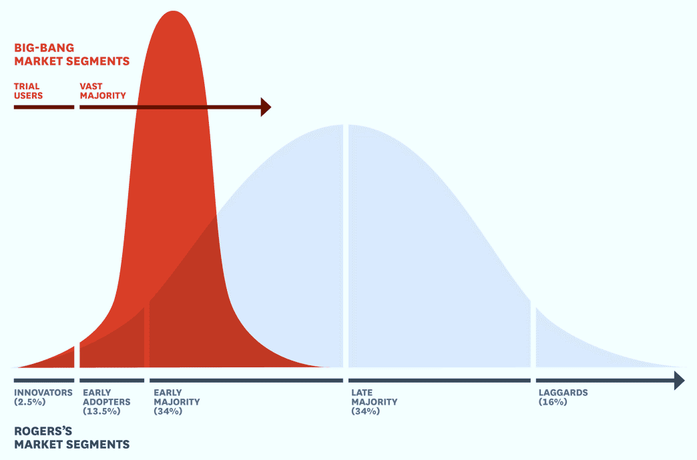
Increasingly rapid adoption of innovative technologies
Big Bang market adoption with disruptions
Time to reach 1bn users has been halving with each new technology!
Telephone – 110 yrs
TV – 50 yrs
Mobile – 20 yrs
Internet – 15 yrs
Smartphones – 8 yrs
Messaging apps – 2 yrs
Next 1bn in less than 5 years?
Cannot Wait - Will Miss Opportunity
Notes:
When Big Bang disruptions arrive, the slope of market adoption is nearly vertical.
Thanks to social network and other information exchanges, customers in every segment now have instant access to nearly complete information about new products & services.
Today there are only two kinds of buyers – trial users and everyone else.
These markets exhibit winner takes all results and short product lives.

Slide 6
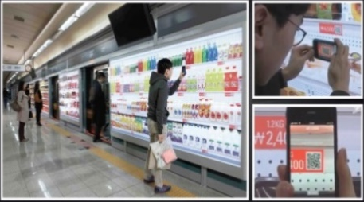

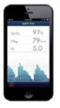
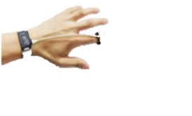





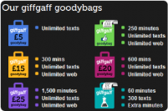
Disruptions are triggering a PARADIGM SHIFT
Add to cart by scanning code with smart-phone
Home delivery after work
Better health care at lower costs using interactive devices
Monitor members, through remote detection/ advisory
Physical footprint much less relevant today
Big Data and Analytics break entry barriers
Virtual shopping in subways-Korea
US health insurer
130% increase in online sales
Clinical visits reduced by 50%
Disrupts physical retail!
Disrupts medical consulting & pathology labs!
Intelligent personalized
public transport (Finland)
New platforms make interactions social
Social forums - customers are rewarded for answering other customer queries
P2P lending, free SIM and other offers
Personalised public transport - Travel almost door to door using shared transport
Tailored trips without transfers & parking concerns
Mobile Virtual N/w Operator, UK Telefonica
Kutsu plus offering new kind of bus service
Disrupts public transportation,
private car ownership?
90 secs avg waiting time for complaints
Disrupts Call Centres & BPO!
5

Slide 7

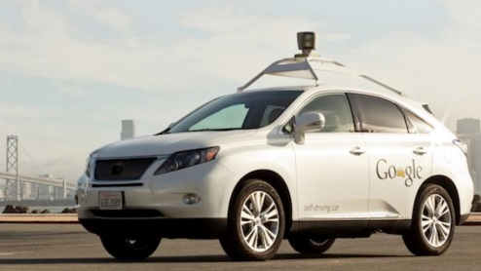











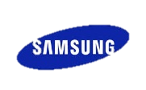

...some could impact MULTIPLE INDUSTRIES
Google driverless cars
3D Printing
3-D printing consumers could save 50-60% in costs per printed product
Rapid prototyping, rapid manufacturing, mass customization, bioprinting
Self-driven car will reduce automobile accidents, nullifying speeding, drunk/ distracted driving - 6.5 bn hours of on-road driving time to be available
Use as automatic taxis, cars for disabled
Disrupts automotive industry?
Disrupts manufacturing!
Tractor Health Monitoring
Internet of things
N/w of low-cost sensors, wireless NFC devices
Smart devices connect to mobile wallet & auto debit
Big data gets bigger with interacting machines
Early warning messages
Disrupts service centres?
Disrupts energy, home automation?
They are all here and now.
6
Notes:
Google Car
Piloted already & working prototype by early 2016
Internet of Things
Apple announced a new ‘smart home’ platform
Google - Android and purchased Nest (smart home appliance maker) for $3.2 billion
Samsung smart home can be controlled with a single app
Vodafone to buy Cobra automative Tech – electronic services for car industry - The combination of Vodafone and Cobra will create a new global provider of connected car services
Cisco offer internet of things solutions for utilities, manufacturing, mining, oil and gas. Network plays a critical role as the connectivity platform for control & operational systems, sensors, machines, and devices.
Kutsu Fi - Intelligence personalized public transport
Available on certain restricted routes in Helsinki, Finland
Next step – country wide availability

Slide 8
12 Technologies Can Help India Leapfrog
Smart physical systems
6
The Internet of things
Digitizing Life and Work
1
Mobile internet
7
Intelligent transportation and distribution
2
Cloud technology
8
Advanced geographic information systems (GIS)
3
Automation of knowledge work
9
Next generation genomics
4
Digital payments
Rethinking energy comes of age
10
Advanced oil and gas exploration and recovery
5
Verifiable digital identity
11
Renewable energy sources
12
Advanced energy storage and utilisation
Source: Mckinsey

Slide 9

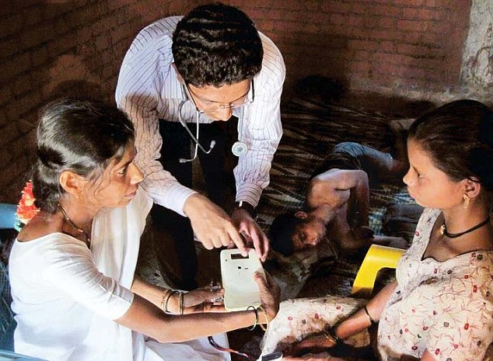
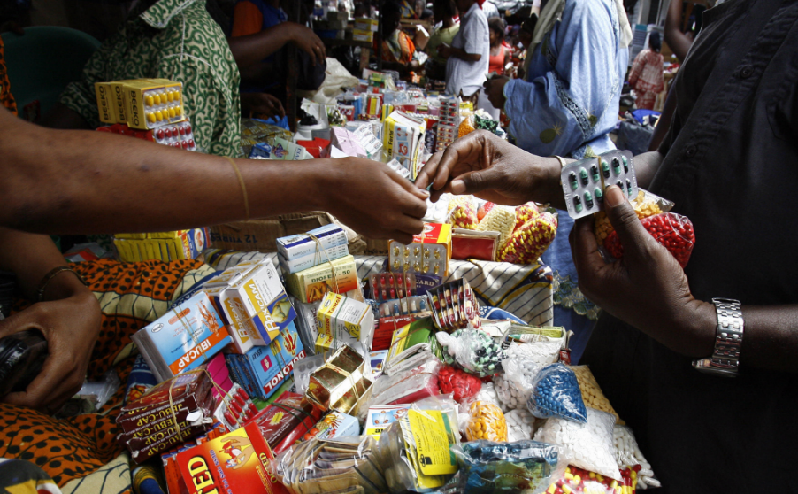

Potential Impact: Healthcare
60%-80% reduction in time for a health worker to become fully productive
400 million with access to quality health care and >40 decision support systems at a health centre
50% reduction in counterfeit drugs valued at $7 billion
5-7,00,000 people living an additional year with advanced genomics based diagnosis

Slide 10
What's impacting the hospital?
Search
Big Data
RFID Technology
Mobile Diagnostics
Connected Devices, Wearable & Embedded Devices
Wellness Apps
3d Printing & Bio-printing
Source: BCG
Online information or tools have influenced the choice of healthcare providers, treatments, and services
The software provides real-time feedback and guidance for treatment to improve patient outcomes.
With RFID tags affixed to items like, wheel chairs, beds, cardiac monitors the staff can very quickly locate an item
The mobile device snaps onto native app and wirelessly communicates between the app and the hospital
A device (sensor or meter) is connected to another device through a network to an application
Healthcare & fitness app enhances learning, engages users to take proactive role in their health management
A 3D printer uses data from patients to replicate the organs reflecting their intricacies and deformities.

Slide 11
5 Trends Driving Adoption Of Technology In Healthcare
Patients
Suppliers
Providers, health systems
Third world countries
Technology advances
Want to interact more digitally with their health system (driven by experience in other aspects of their lives), however
There are new entrants into the market, who will do things very different
New healthtech start-ups are much more data-driven
New offerings will avoid the "benefit-effort dilemma" as they address the patient directly
New entrants don't have to take care of existing business
New entrants can offer segmented services.
Struggling to meet challenges of productivity, shortage of staff turning to digital solutions
Creating new models of low cost health care and demonstrating what is possible.
Making new things possible (including cloud / big data)

Slide 12
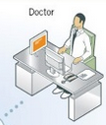
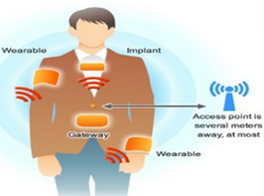

Smart hospitals - IOT- Intelligent sensors
Body Area Network (BAN)
Short range wireless network for an individual or an asset
Consists of wearable or implanted electronic devices that transmit ID or sensor data to a gateway device.
Uses either electric field, electric current or electromagnetic communication technology.
Connects to an external access point that is not more than several meters distant
Apps operating on PC's or Smartphone
Wireless Technology = Pervasive healthcare

Slide 13
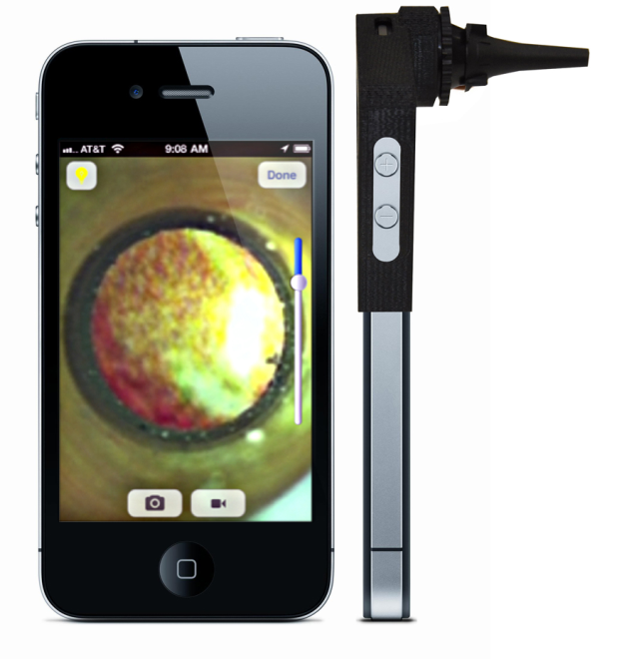
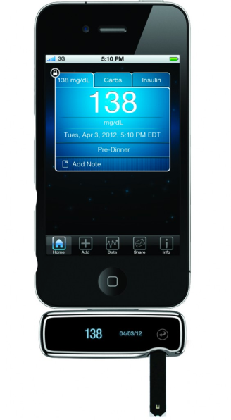
Mobile Applications
CELESCOPE
GLUCOSE METER
Cellscope converts the phone into a connected digital otoscope. It utilizes an attachment and the phone camera to view inside an individual’s ear.
Doctors can view their patient's ear canal and eardrum, then share images & symptoms with their physician community.
A blood glucose meter that can be used on its own or connected to an iphone to manage and communicate the diabetes information.
The meter will automatically sync data with the Diabetes Manager app – tracking glucose, insulin and carbs while also charting glucose patterns over time.

Slide 14
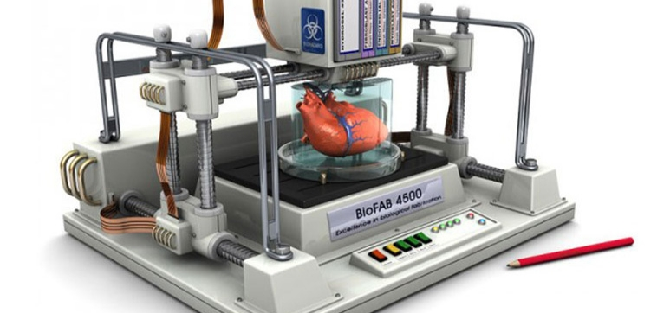
3D and Bio Printing
What is it? Process of layering materials – resin, glass, metals, cell tissue – into objects defined by a digital model
Pros Enables rapid prototyping
Opening the door for new research and opportunities in healthcare
Inspiration Children’s National Medical Center, 3D Printed Kidneys
A 3D printer uses data from images, CT Scans, Ultrasounds individual patients to replicate the organs of those individuals, reflecting their particular intricacies and deformities. Can make a customized parts for replacement.

Slide 15
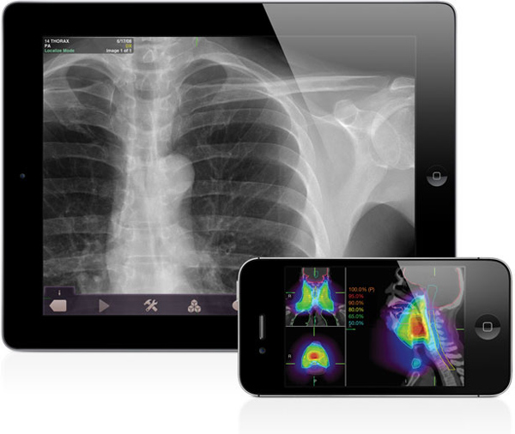
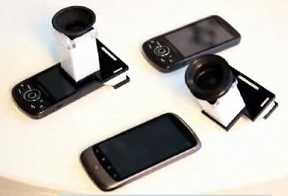
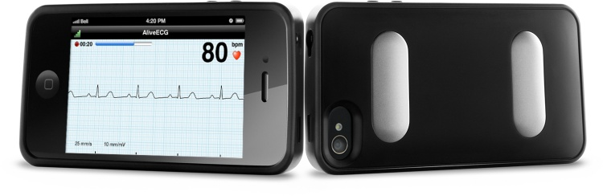
Mobile Diagnostic
What is it? Mobile phones are enabling hospitals to identify & manage health of their patients
Pros
Gives hospital the tools they need to assess their patients health at a low cost
Cons Patients may use the tools in lieu of doctors, risking an inaccurate diagnosis
Inspiration EyeNetra, Cellscope, AliveCor, Quanttus, Scanadu, iBGStar

Slide 16
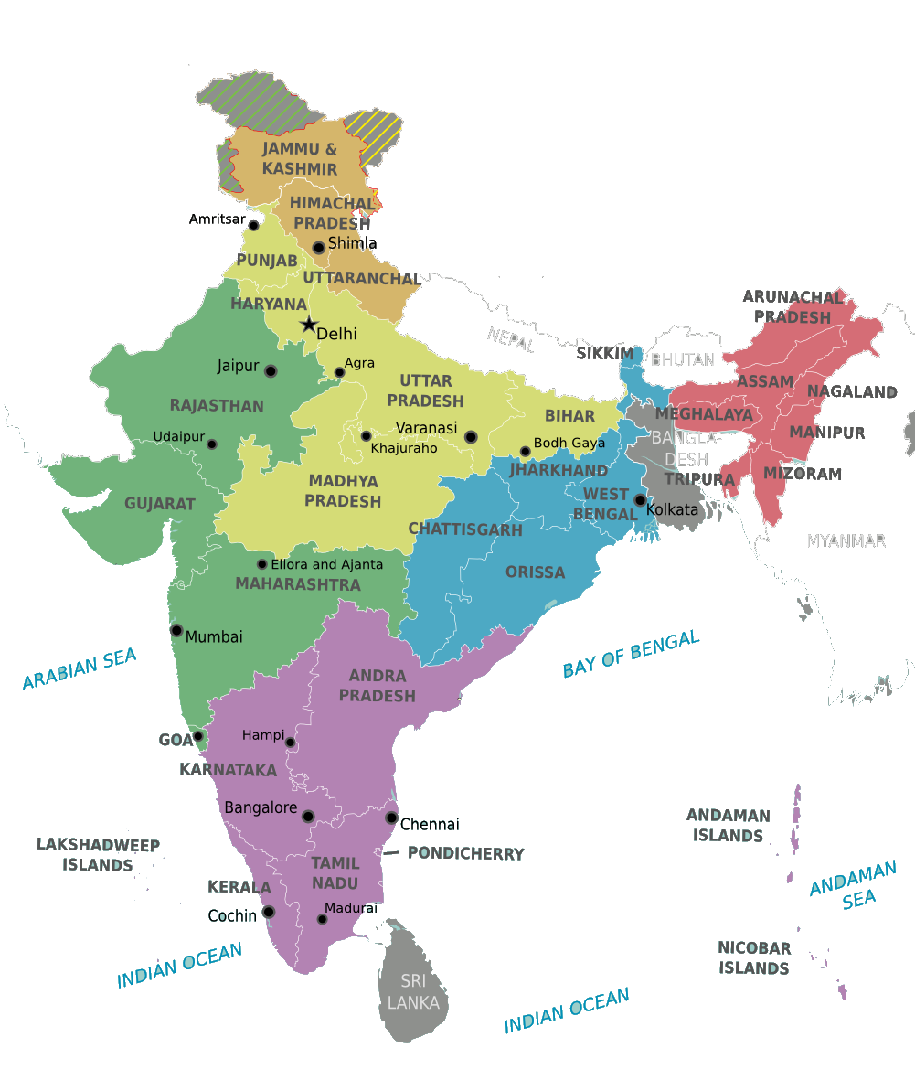




Rural Connect- Primary Health
Common Service Center
NOFN etc
Tele Advice
Telemedicine
PHC
MMUs
Healthcare Education
CHC
PPP Models
…
More than 100 Centers operational
Source: Apollo Hospitals

Slide 17
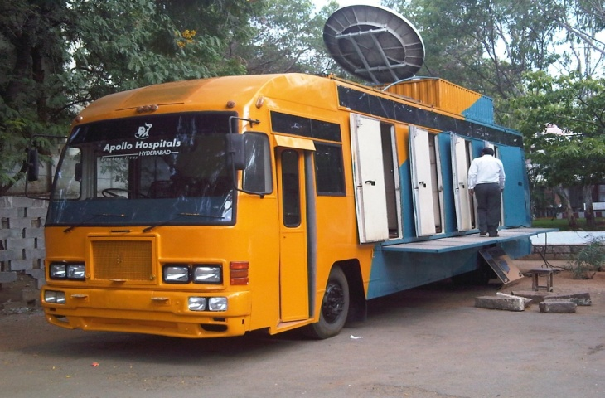
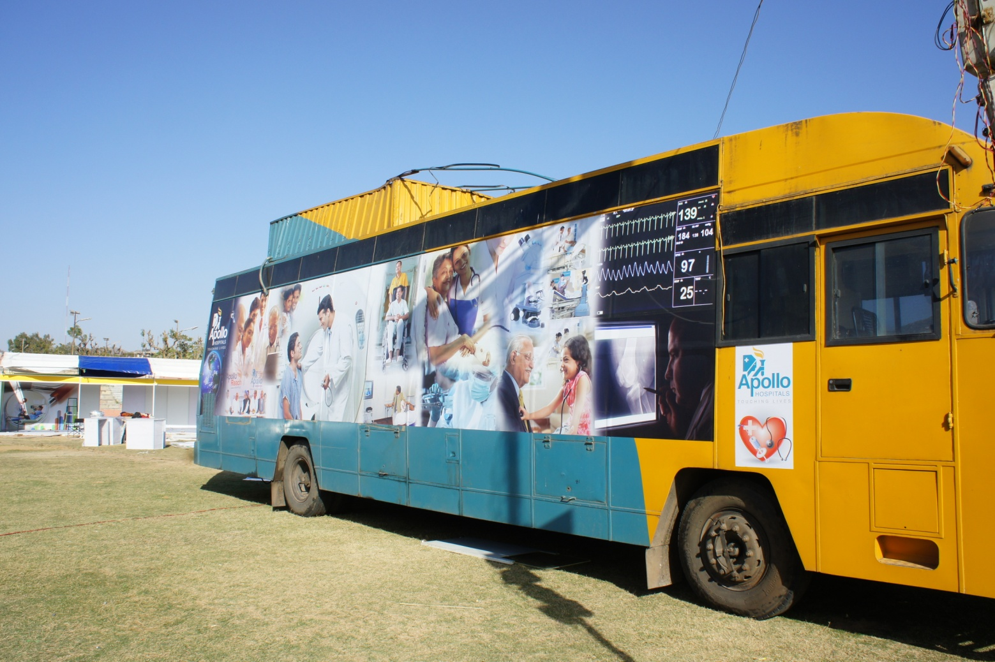
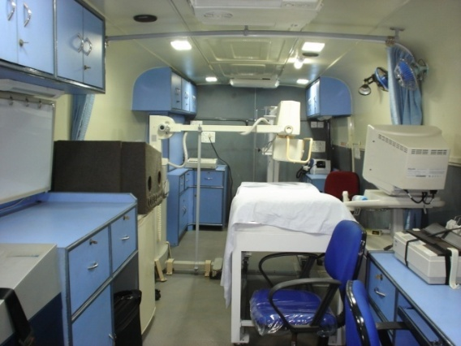
Mobile Telemedicine Units
Mobile Telemedicine Medical Units - provide quality healthcare at their door step for the people in remote and rural habitations
Notes:
17

Slide 18
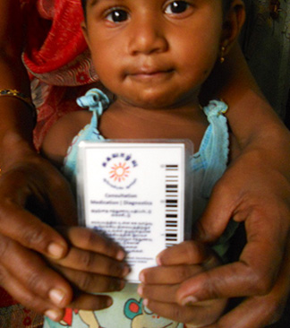
Healthcare: Last mile primary care system
Low cost tablets for door-to-door household screening of treating 100,000 patients in rural Tamil Nadu
Geotagging and barcoded identity for all patients
Cloud-based Health Management Information System
Low cost diagnostics at central labs with online reports
Smart App for protocol-based treatment run by health workers with just 8-12 weeks of training
Online drug prescription, stocking and scheduling follow ups
SOURCE: McKinsey Global Institute’s India’s technology opportunity: transforming work, empowering people, 2014

Slide 19




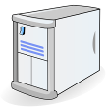





Healthcare: Home-based remote health monitoring
1
2
3
4
Electronic capture of cardiac, sleep, ambulatory , ECG, blood pressure, glucose, and medication adherence
Data feed to “eHealth.com” through integrated connectivity devices
Link with patient’s physician to “red flag” unusual events and plan interventions
Automatic follow-up compliance monitoring
5
Multiple modes of delivering patient support, information and feedback
SMS alerts
Custom TV programs
Internet community
Counseling
>4 million dedicated home monitoring devices with integrated connectivity used by people globally in 2014, projected to rise to 9.4 million by 2017¹

Slide 20
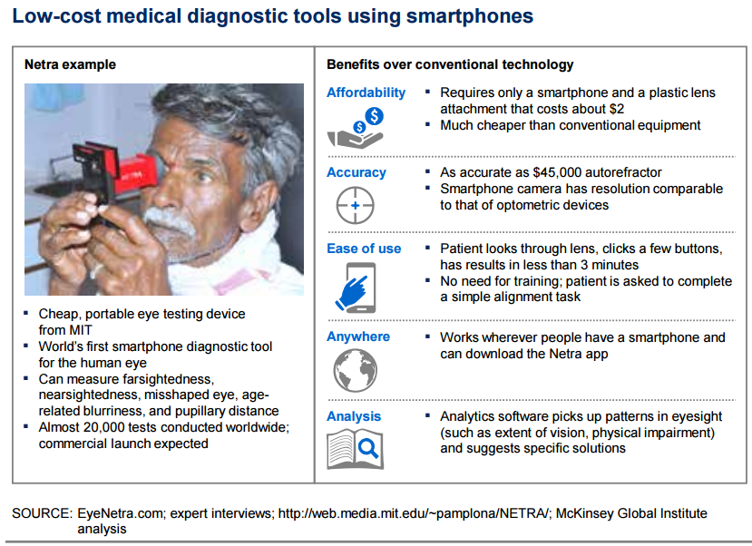

Slide 21
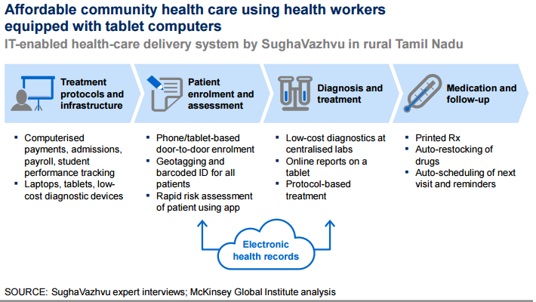

Slide 22
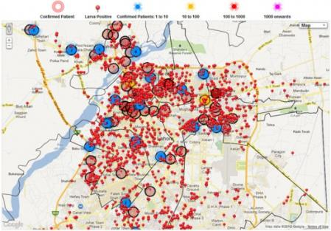
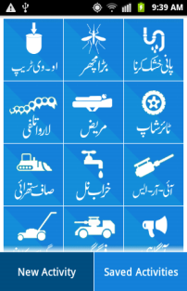
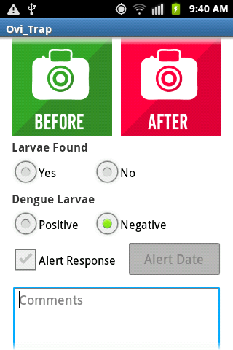
Healthcare: GIS & big-data based disease monitoring
Dengue activity tracking portal
Google Play app for dengue tracking
How the tracking system works
Field reports on location and timing of confirmed dengue cases and mosquito larvae sent via Android phone
Each case tagged by time and location
Source of infection identified and nearby mosquito breeding hotspots located
Teams deployed to exterminate in outbreak areas
Photos of pre- and post-activity geotagged with spatial coordinates and transferred to database
Automated analysis generates performance reports on a dashboard

Slide 23
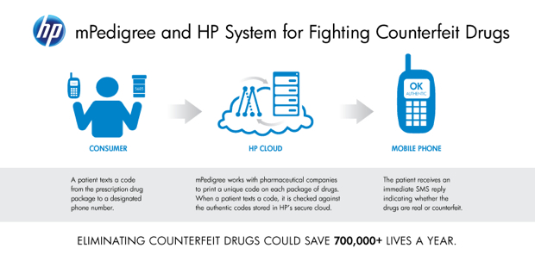
Tech helping pharma companies track counterfeit drugs
Customers can verify the authenticity of drugs by sending a 12-digit code via SMS to a Authentication Service
The unique codes are printed with approval from pharma companies. HP is already in talks with Cipla, Tablet India & CAMA
mPedigree is already been implemented in Africa with most Indian companies having adopted it in global supply chains.
SOURCE: Press research, Company websites

Slide 24



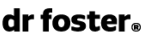






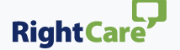


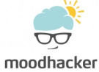



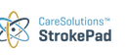






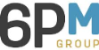

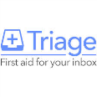
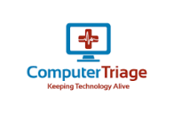

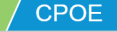
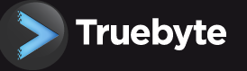
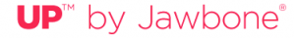
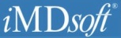



















Several examples of digital technology in global healthcare
Stay healthy
Choose the right care
Access care
Provide treatment
Manage chronic conditions
Type of digital solutions¹
Utilise “big data” and advanced analytics
1
Automate previously manual tasks and reduce variation
2
Enhance connectivity to remove need to be co-located
3
1 Many of these technologies are doing more than one of these at once
SOURCE: Team analysis

Slide 25
































































































Health-tech- Forums for India Startups
Healthcare Landscape
Administration & Management Software Solutions
Hospital/Practice management software, PHR, EMR
Hospital/Practice Management Software
The Indian health-tech market is extremely fragmented with small and medium sized players
PHR, EMR
Mobile Apps
Health & Wellness Analytics
Healthcare Platforms
Telemedicine
Wearables
Genomics
Medical Devices
~80 unique companies providing healthcare solutions are evaluated
Source: Deloitte Analysis
Notes:
The healthcare IT market in India comprises of a healthy ecosystem of players both big and small. The focus is not only on category wise vendors but also on the maturity level of the company.
Healthcare software solutions are broadly categorized into 4 categories.
Administration and management software – Hospital/Practice management software- These software deals with the day-to-day operations of a hospital or medical practice. Such software frequently allows users to capture patient demographics, schedule appointments, maintain lists of insurance payers, perform billing tasks, and generate reports (including specific lab reports in some cases)
Health & Wellness analytics- Solutions that helps in tracking, analyzing and predicting users overall physical, mental and emotional health. It makes extensive use of data, statistical and qualitative analysis, explanatory and predictive modeling
Mobile App- Healthcare solutions delivered over mobile phone devices, in the form of an application. It contains solutions such as applications analyzing users health stats, applications acting as mobile clinic or platforms helping you connect with healthcare providers, etc.
Healthcare Platform- These solutions are delivered over web and aims at providing a bridge between healthcare providers and patients. They include solutions such as cloud clinic (online consulting, video consultation), disease monitoring platform using geodata, remote care delivery platform, etc.

Slide 26
Barriers to Technology Adoption in Healthcare
Commonly Mentioned Reasons :
Concerns of regulations/approvals/safety.
Concerns of privacy/data protection.
Lack of common standards on EMR & diagnostic/medical devices.
Some technologies don’t address: Real Problem.
Slows down Physician - Technology is impersonal.
Main Barriers though are:
No “Burning platform”- Lack of urgency.
Culture not amenable to change.
Lack of vision & leadership drive.
Risk Aversion.
Belief it is expensive & unaffordable.
These are common across sectors - disruption is happening everywhere

Slide 27
Conclusion & What Next
New digital technology are here and now and an evolving fast.
Conventional Healthcare would not solve India’s large healthcare needs (Primary, Secondary, Tertiary)- Need to Leverage Digital.
Digital Tech are affordable and cost of adoption relatively low.
Needs a mind set change. If we resist we risk being getting marginalized.
India has unique opportunity as we have not baggage and can leapfrog as we did with mobile, Aadhar etc.
Work with Health Tech companies to create India Specific Solutions.

Slide 28








This is the opportunity for Healthcare to Transform
Lets collaborate to make it happen.
28

