Slide 1

A CLINICIAN’S PERSPECTIVE OF QUALITY
Dr. H. Sudarshan Ballal, MD,FRCP
Chairman
Manipal Hospitals
Manipal Health Enterprises Pvt Ltd
Bangalore

Slide 2
Contents of Talk
Introduction: What is Quality?
Healthcare Quality scenario in India
Top priorities of Quality care
Standardization and Accreditations of Quality care
ISO, JCI, NABH
Benefits of Accreditation

Slide 3
….Continued
Barriers to Quality care
Concepts of Quality care
Personal Thoughts
DNA of a high Quality doctor
Revival of the sacred Patient-Doctor relationship
Conclusions

Slide 4
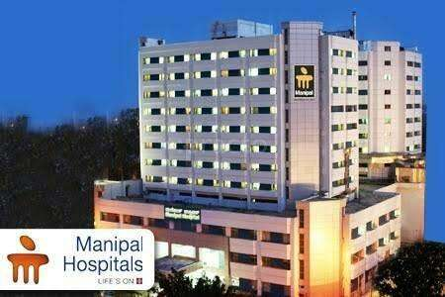


What is Quality?

Slide 5
…... continued
According to ISO
Quality is defined as the degree to which a set of
inherent characteristics fulfills requirements
In a health care setting Quality refers to the degree to
which a set of inherent characteristics fulfill the patient’s
requirements, stated or implied
It is both objective and subjective in nature
According to WHO
Quality of care is the level of attainment of health
systems intrinsic goals for health improvement and
responsiveness to legitimate expectations of the
population

Slide 6
…... continued
Quality in healthcare is getting the right care to the
right patient at the right time – every time
Quality lies in the eyes of beholder

Slide 7
Quality Care Scenario in India
PERIOD | QUALITY MANAGEMENT SYSTEM | ACCREDITATION
1980’s | Healthcare does not need it, more of an industrial Requirement | what it is and why?
1990’s | A fad of few, let us try, no harm | Yes, but not so relevant to Indian healthcare system
2000’s | A useful tool, must for a well run organization, good for marketing too | Required urgently RED ALERT SOUNDED

Slide 8
Top Priorities of Quality Care
Patient Safety
To ensure expert medical care in the safest environment possible, in both an inpatient and outpatient setting
Standardization of care
Commitment to provide exceptional patient care and customer service throughout all our facilities
Quality management
Managing the continuous improvement of service delivery processes and outcomes through data-driven strategies and empowered staff to exceed customer expectations

Slide 9
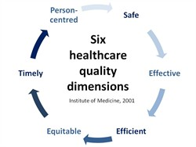
…... continued

Slide 10
Standardization and Accreditations
International Organization for Standardization (ISO)
Formed in 1947, Headquarters at Geneva
Harmonize standards at international levels
ISO 9001 applied as a healthcare quality management tool
introduced in 1987
It is the fundamental quality management system standard
that requires an organization to identify, define,
document, implement (follow), monitor/measure, and
continually improve the effectiveness of its processes

Slide 11
…... continued
Hospital Accreditations
A process of external review of the compliance of an
organization with the applicable standards of the quality
of healthcare being provided by an accreditation board
Joint Commission International Accreditation (JCIA)
Experience in accrediting health care organizations in
U.S, the Joint Commission on Accreditation of
Healthcare Organizations initiated the development of
an international accreditation program in 1998 and
was fully implemented in late 1999
JCIA standards, organized according to either patient
care functions or management functions

Slide 12
…... continued
National Accreditation Board for Hospitals and
Healthcare Providers (NABH)
It is a constituent board of Quality Council of India, set up
to establish and operate accreditation programme for
healthcare organizations
Standards provide framework for quality assurance and
quality improvement for hospitals
Focus on patient safety and quality of care
Standards call for continuous monitoring of sentinel events
and comprehensive corrective action plan leading to building
of quality culture at all levels and across all the functions

Slide 13
Benefits of Accreditation
Benefits to patients
Continuity of care & Safe transport
Pain management & Focus on patient safety
Patient satisfaction is evaluated
Rights are respected and protected

Slide 14
…... continued
Access to a quality focused organization
Credentialed and privileged medical staff
High quality of care
Understandable education and communication

Slide 15
…... continued
Benefits to the staffs
Improves professional staff development
Provides education on consensus standards
Provides leadership for quality improvement within
medicine and nursing
Increases satisfaction with continuous learning, good
working environment, leadership and ownership

Slide 16
…... continued
Benefits to the hospital
Improves care
Stimulates continuous improvement
Demonstrates commitment to quality care
Raises community confidence
Opportunity to benchmark with the best

Slide 17
Barriers to Quality Care
Biggest barrier is the mind set of the medical fraternity and
hospital administration which fortunately is slowly and
steadily changing
Other barriers
Lack of reliable and comparable data
Lack of automated information systems
Inadequate resource allocation
Lack of organizational and systems support

Slide 18
Concepts of Quality Care
Defined and specific quality policies and objectives
Strong customer orientation
All the activities necessary to achieve these quality policies
and objectives
Organization’s wide integration of the activities
Clear personnel assignments for quality achievement
Specific vendor-control activities through quality equipment
identification

Slide 19
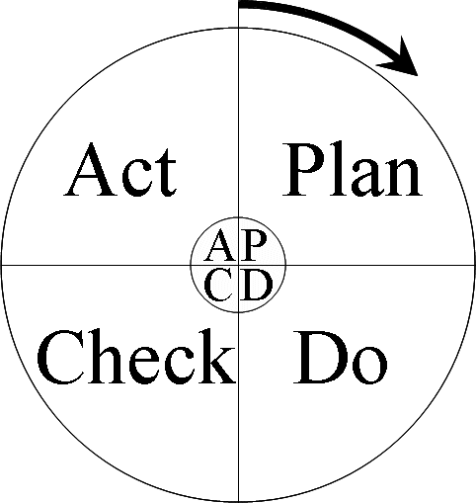
…... continued
PDCA cycle for quality improvements

Slide 20
Personal Thoughts
DNA of a high Quality doctor
Compassion, Empathy and People skills
Clinical excellence
Apolitical, Non-communal and Unbiased
Leadership skills
Ethical practice of medicine
Social responsibility

Slide 21
…... continued
Revival of Sacred Patient-Doctor relationship
It is based on trust, confidence and respect
Reasons for steady decline in this relationship
Huge increase in the cost of treatment
Misconceptions of what constitutes negligence
Corruption and Unethical practices
Lawless behavior for extortion
Media coverage

Slide 22
…... continued
Mantras for revival of Patient-Doctor relationship
Be a compassionate doctor who empathizes with the
patient
Inculcate excellent people and soft skills
Be honest, transparent and ethical
Frequent communication between patient/family
Good financial counselor

Slide 23

…... continued
Actively involve the patient/family in care plan and
make them aware of all the nuances
Offer second opinion
Role of media
Role of medical fraternity, regulatory authority and
insurance companies

Slide 24
Conclusions
In conclusion as a clinician my perspective is that Quality
means making sure that the most important person in the
healthcare industry “The Patient” gets the right
care, in a safe environment at the right time, every time who
ever the healthcare giver is.
Quality is here to stay and patients will reject us if we do not
demonstrate to them our capability to deliver
Quality/ standardized healthcare to them in the future.

Slide 25

You will never be a good doctor unless you are a
GOOD HUMAN BEING
Thank you

Slide 26
…... continued
Donabedian (1982) has
defined quality in terms of
Structure, Process, Outcome
(SPO) model
Structure is defined as the
resources used in the
provision of care and the
facilities under which care is
provided
Process refers to the
delivery of care
Outcome implies the end
result of the care
STRUCTURE
PROCESS
QUALITY
OUTCOME

Slide 27
…... continued
Structure of the ISO 9001 Standard
Provides a solid basis for compliance with all imposed
requirements and healthcare quality certifications (e.g.,
JCAHO, Federal & State regulations)
Makes all other healthcare quality certifications &
accreditations processes easier and less costly
Facilitates improved understanding of roles &
responsibilities among employees; and enhanced
communication and coordination between departments

Slide 28
…... continued
Requires the establishment of measurable
improvement objectives and accountability to those
objectives through monitoring, measuring and
reporting
Results in improved systems, processes, and outcomes

Slide 29
…... continued
ISO 9001 Standard is comprised of eight Clauses
first three are introductory in nature
next 5 clauses include the requirements the healthcare
organization must address
Clause 4 – Quality Management System
Process Management, Documentation Requirements,
Records Control
Clause 5 – Management Responsibility
Customer/Patient Focus, Policy, Objectives, Planning,
Responsibility & Authority

Slide 30
…... continued
Clause 6 – Resource Management
Human Resources, Infrastructure, Work Environment
Clause 7 – Product / Service Realization
Planning of New Products & Services, Customer
Interface/ Communication, Design, Purchasing/Supplier
Management, Production/ Service Operations,
Calibration
Clause 8 – Measurement, Analysis, and Improvement
Internal Audits, Customer/Patient Satisfaction,
Monitoring/Measurement of Products/Services and
Processes, Handling Non conformances, Corrective &
Preventive Action, Continual Improvement

Slide 31
…... continued
Patient Centered Standards
1. Access, Assessment and Continuity of Care (AAC)
2. Care of Patients (COP)
3. Management of Medication (MOM)
4. Patient Rights and Education (PRE)
5. Hospital Infection Control (HIC)
Organization Centered Standards
6. Continuous Quality Improvement (CQI)
7. Responsibility of Management (ROM)
8. Facility Management and Safety (FMS)
9. Human Resource Management (HRM)
10. Information Management System (IMS)

Slide 32
Accreditation Survey
Leadership interviews
Clinical and support staff interviews
Patient and family interviews
Observation of patient care and services provided
Building tour and observation of patient care areas, building
facilities, equipment management, and diagnostic testing
services

Slide 33
…... continued
Review of written documents such as policies and
procedures, orientation and training plans and documents,
budgets, and quality assurance plans
Evaluation of the organization’s achievement of specific
outcome measures (e.g., immunization rates, hospital-
acquired infection rates, patient satisfaction) through a
review and discussion of monitoring and improvement
activities
Review of patient’s medical records

Slide 34
Conclusions
Systems of health care service delivery, political processes
of health care reform and methods of quality assurance vary
through out the world
Proposals for quality improvement should be
comprehensive, to include accreditation, licensure, and
certification
Voluntary accreditation was considered the most reasonable
approach such that client participation is stimulated and that
standards are promoted and established

Slide 35
…... continued
The accreditation process would be most effective if it were
designed by and adapted to the needs and resources of
individual countries
Accreditation would be a valuable quality assurance
approach not only in hospitals, but also all health care
institutions within the system of services
Licensing should remain the responsibility of the state,
which is legally authorized
The focus of certification would be better placed in assuring
quality of care, rather than creating competition between
professionals

